Slide 1
Applying Addition and Subtraction Strategies within Context
Worksheet
Mathematics
Mrs Behan

Slide 2
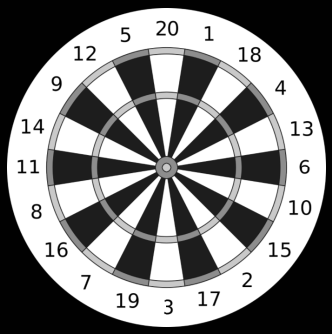
Independent task
I started with 501 points.
Turn 1: I scored 20, 13 and 6.
Turn 2: I scored 14, 9 and 15.
Turn 3: I scored 10, 15 and double 8.
Turn 4: I scored 11, triple 3 and a bullseye.
Turn 5: I scored triple 8, a bullseye and 20.
Turn 6: I scored double 15, 16 and 9.
How many points do I have left?

