Slide 1
Area of a trapezium
Maths
Mr Chan

Slide 2
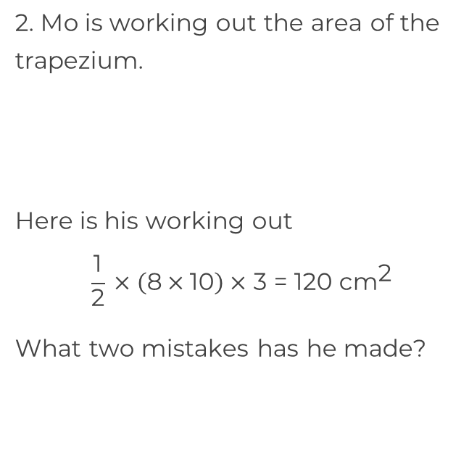
Area of a trapezium
1. Calculate the area of the trapezia.
a)
b)
12 m
8 cm
5 m
2 cm
3 cm
5.5 m
8 m
10 cm
7 mm
4 mm
8 mm
6 mm

Slide 3
Area of a trapezium
3. Calculate the missing length.
4. An isosceles trapezium has parallel sides of length 6 mm and 9 mm.
The sloped sides measure 8 mm.
The area of the trapezium is 22.5 mm².
Work out the perpendicular height.
5. Grass seed costs £3.50 per square meter. Harry wants to seed his garden. He has £85 to spend.
Use the diagram to calculate if Harry has enough money to seed his garden.
14 cm
10 cm
Area = 150 cm²
? cm
4.5 m
4 m
7 m
5 m

Slide 4
Answers

Slide 5
Area of a trapezium
1. Calculate the area of the trapezia.
a)
b)
12 m
8 cm
5 m
50 m²
2 cm
3 cm
5.5 m
8 m
10 cm
7 mm
8 mm
4 mm
36 mm²
6 mm
Multiplied the parallel sides and not multiplied by the perpendicular height of 2 cm.

Slide 6
Area of a trapezium
3. Calculate the missing length.
4. An isosceles trapezium has parallel sides of length 6 mm and 9 mm.
The sloped sides measure 8 mm.
The area of the trapezium is 22.5 mm².
Work out the perpendicular height.
5. Grass seed costs £3.50 per square meter. Harry wants to seed his garden. He has £85 to spend.
Use the diagram to calculate if Harry has enough money to seed his garden.
14 cm
10 cm
Area = 150 cm²
? cm
16 cm
4.5 m
Area = 24.75 m²
Cost = £86.63
No he does not have enough.
4 m
7 m
3 mm
5 m

