Slide 1
Solving geometric problems
Downloadable resource
Lesson 4 of 8
Mathematics
Dr Rim Saada

Slide 2
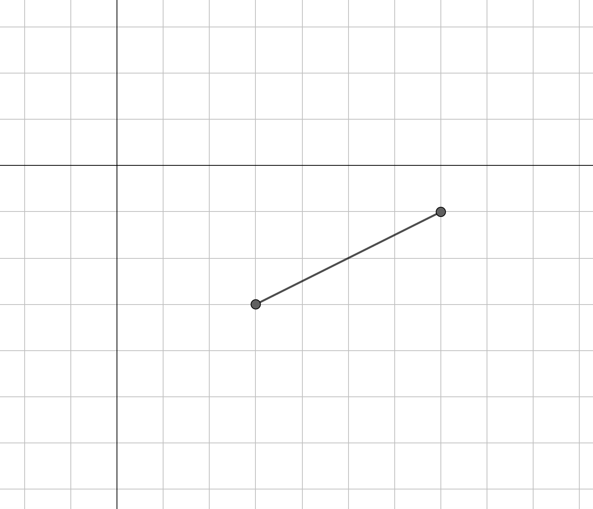
In the diagram, one side of a square is shown.
What could the coordinates
of the other vertices be?

Slide 3
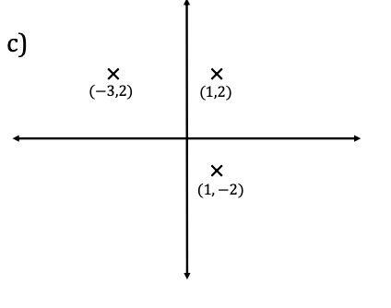
1) Find the coordinates of the remaining vertex for each of the squares:
a)
b)
2) Find the coordinates of the remaining vertex for each of the squares described:
a) Three of the vertices are (1,1) , (3,3) and (3,1).
b) Two of the vertices are (−2,4) and (0,2).

Slide 4
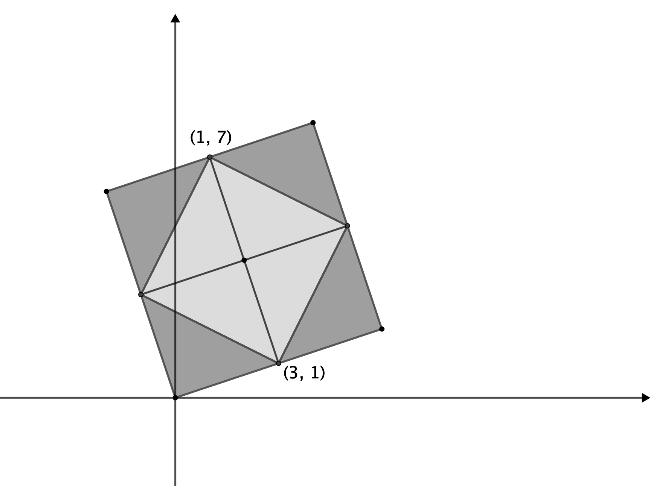
The large square encloses the pale grey square in the diagram below.
Find all the missing coordinates

