Slide 1
Which materials float and sink?
Downloadable Resource
Science
Miss Harris

Slide 2
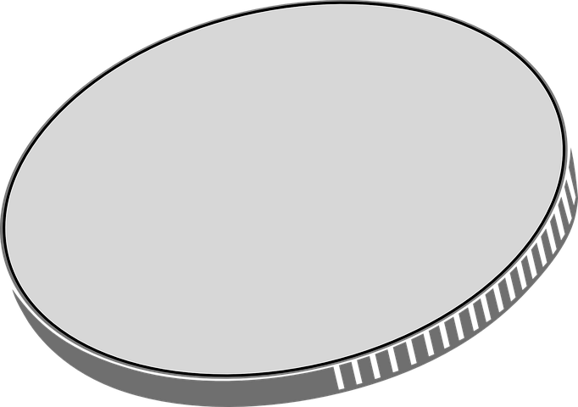
Draw this table
Credit: Pixabay
You can change the objects if you want to.
Object | Material | Float | Sink
rock
pencil
cotton ball
coin
Choose your own object!
Notes:
We are going to tick whether the materials float or sink!
1st let’s write the names of each material

Slide 3
ANSWERS
Credit: Pixabay
You can change the objects if you want to.
Object | Material | Float | Sink
rock | rock
pencil | wood
cotton ball | cotton
coin | metal
Choose your own object!
Notes:
We are going to tick whether the materials float or sink!
1st let’s write the names of each material

