Slide 1
Calendar and time:
Using everyday language to talk about and sequence daily events
Mathematics
Lesson 3 of 5
Miss. Molnar

Slide 2
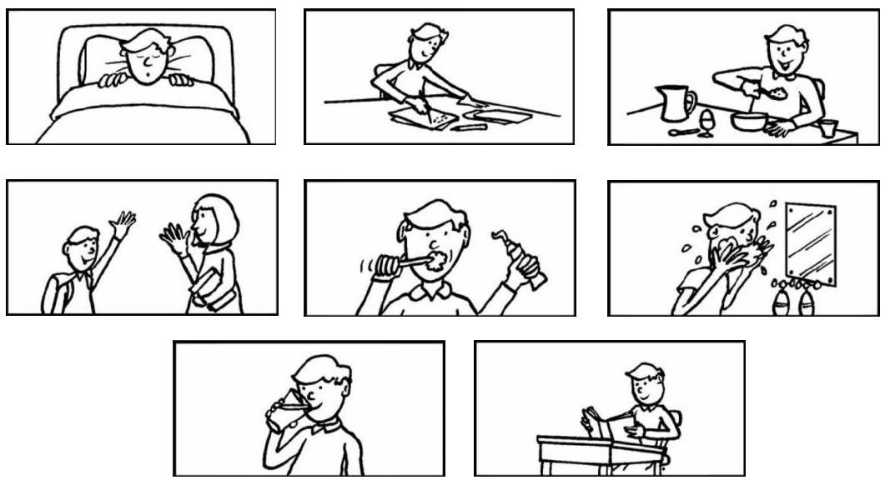
Choose some of the cards and tell a time story!

Slide 3
