Slide 1
Required Practical - Temperature Change Part 1
Combined Science - Chemistry - Key Stage 4
Energy Changes
Mrs. Begum

Slide 2
Graph paper

Slide 3
Independent task 1 - variables
What are we changing? (independent variable)
What are we measuring? (dependent variable)
What are we keeping the same? (control variables)

Slide 4
Independent task 1 - answers
What are we changing? (independent variable) The volume of alkali added
What are we measuring (dependent variable) The temperature increase
What are we keeping the same (control variables) Concentration of alkali, concentration of acid, volume of acid

Slide 5
Independent task 2
Explain why these steps were taken:
A polystyrene cup was used
The polystyrene cup was placed in the beaker
The lid was used to cover the cup
The experiment was repeated

Slide 6
Independent task 2 - answers
Explain why these steps were taken:
A polystyrene cup was used. To reduce heat loss to the surroundings
The polystyrene cup was placed in the beaker. To make it more stable, so it didn’t fall over
The lid was used to cover the cup. To reduce heat loss to the surroundings from the surface
Repeats were done. To identify anomalies and calculate the mean

Slide 7
Independent task 3
Identify the anomalies and calculate the mean maximum temperature.
Total volume of sodium hydroxide (cm³) | Maximum temperature (ºC) |  |  | Mean
 | 1st | 2nd | 3rd
5 | 22 | 23 | 22
10 | 24 | 30 | 24
15 | 26 | 27 | 25
20 | 29 | 29 | 28
25 | 32 | 33 | 34
30 | 34 | 35 | 36
35 | 33 | 31 | 32
40 | 29 | 22 | 29
45 | 27 | 26 | 28

Slide 8
Independent task 3 - answers
Identify the anomalies and calculate the mean maximum temperature.
Total volume of sodium hydroxide (cm³) | Maximum temperature (ºC) |  |  | Mean
 | 1st | 2nd | 3rd
5 | 22 | 23 | 22 | 22
10 | 24 | 30 | 24 | 24
15 | 26 | 27 | 25 | 26
20 | 29 | 29 | 28 | 29
25 | 32 | 33 | 34 | 33
30 | 34 | 35 | 36 | 35
35 | 33 | 31 | 32 | 32
40 | 29 | 22 | 29 | 29
45 | 27 | 26 | 28 | 27

Slide 9
Graph
Plot a graph for these results
Total volume of sodium hydroxide (cm³) | Mean
5 | 22
10 | 24
15 | 26
20 | 29
25 | 33
30 | 35
35 | 32
40 | 29
45 | 27

Slide 10
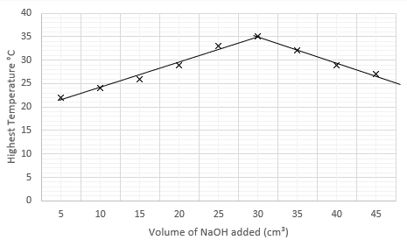
Graph

