Slide 1
Prove that Two Vectors are Colinear
Maths
Mr Bond
Please note this downloadable resource contains some colored font

Slide 3
Prove that two vectors are colinear
2. ABCD is a parallelogram. P and Q are the midpoints of CD and BC respectively.
N is the point such that AB : BN is 2 : 1
Show that P, Q and N are colinear.
A
>
B
N
>
l
Q
D
l
C
P
‹#›

Slide 4
Prove that two vectors are colinear
A
V
B
N
V
D
V
C
‹#›

Slide 5
Answers

Slide 6
Prove that two vectors are colinear
2. ABCD is a parallelogram. P and Q are the midpoints of CD and BC respectively.
N is the point such that AB : BN is 2 : 1
Show that P, Q and N are colinear.
A
>
B
N
X
Y
>
l
Q
Z
D
l
C
P
PQ and QN are parallel through a common point so P, Q and N are colinear.
X, Y and Z lie on the same straight line so the vectors are colinear.
‹#›

Slide 7
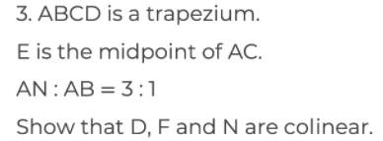
Prove that two vectors are colinear
A
V
B
V
N
V
E
l
D
V
C
‹#›

