Slide 1
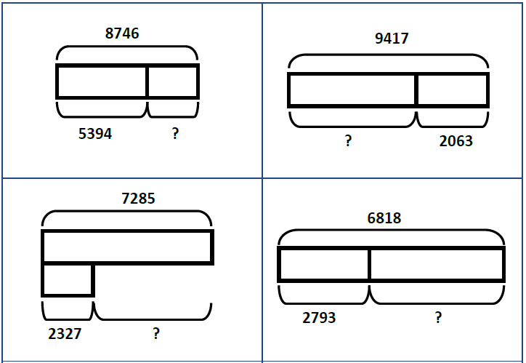
Independent Task
Column method
For each bar model, write the subtraction equation it represents. Estimate your answer then use column subtraction to calculate the missing part.
Challenge: Can you work out which columns regrouping will occur in?

