Slide 1
Sketching quadratic graphs II
Mathematics
Mr Coward

Slide 2
Try this
Antoni has sketched a graph below. Can you work out what the equation of the graph is?
Notes:
Offer a hint showing how to start another example.
Talk about how we can use common factors e.g. (x+5) or (2x+10) etc
But we can also change it by rearranging

Slide 3
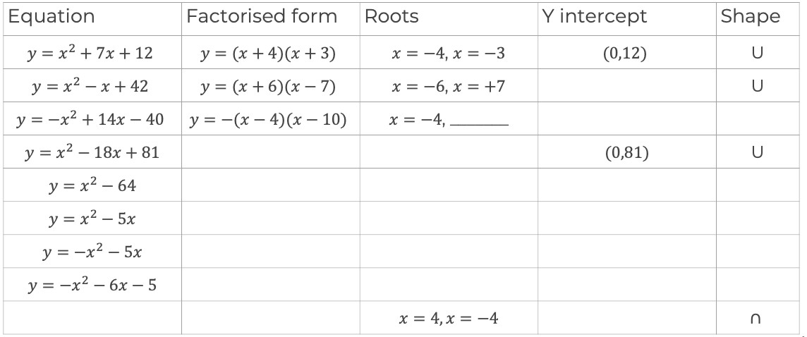
Independent task
1) Sketch the following quadratics, use the table to help you.
Equation | Factorised form | Roots | Y intercept | Shape
 |  |  |  | U
 |  |  |  | U
 |  |  |  | U
Notes:
These paths are of a movements going clockwise and anti clockwise from C. It might be a bit surprising to Ss that the totals aren’t equal. The other interesting thing is that the 6 bearings can be paired to make 6 sums of 360. Ss might be prompted to notice which pairs make 360 which is somewhat interesting too

Slide 4
Explore
(A,B) is the turning point. Can you find the missing points?
Notes:
Students may notice that 5/6 and 3/4 can also be compared by denominating by 12ths

