Slide 1
Reasoning with large whole numbers: Rounding 6-digit numbers to the nearest 1000, 10 000 or 100 000
Mathematics
Ms Jeremy

Slide 2
Pause the video to complete your task
Resume once you’re finished
Identify the closest smaller multiple.
Identify the closest larger multiple.
Identify the halfway point.
Which multiple is the number closest to?
403 576

Slide 3
Pause the video to complete your task
Resume once you’re finished
Round 651 298 to:
i) the nearest 1000
ii) the nearest 10 000
iii) the nearest 100 000
i) 651 000
ii) 650 000
iii) 700 000
651 298

Slide 4
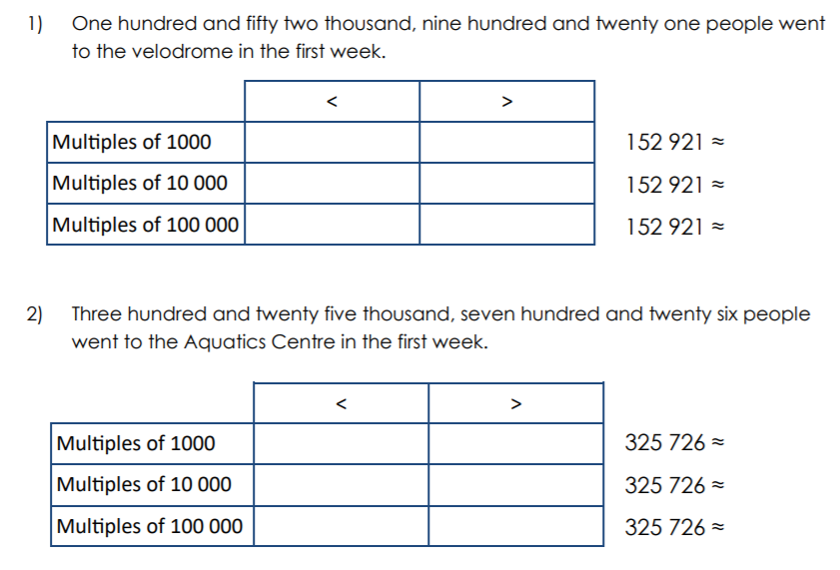
Independent Task
Pause the video to complete your task
Resume once you’re finished
3) 761 344
4) 130 871

