Slide 1
Independent Task
To plot specified points and draw sides to complete a given triangle
Maths
Mr Critchlow

Slide 2
To Start
Times tables speed challenge
 | 8 | 4 | 3 | 2 | 5 | 6 | 9 | 10 | 7
4
7
8
10
11
9
6
12
5

Slide 3
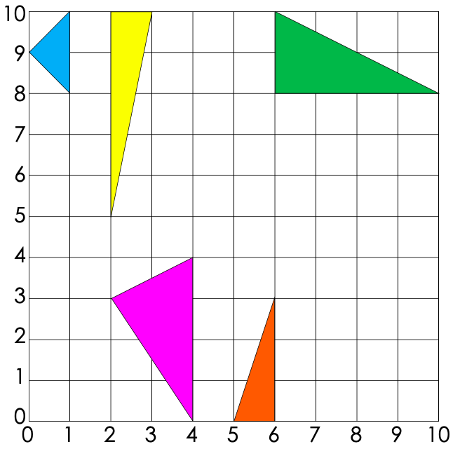
Moving on
Can you record the coordinates for each triangle?
B
A
E
Triangle | Coordinates
A
B
C
D
E
C
D

Slide 4
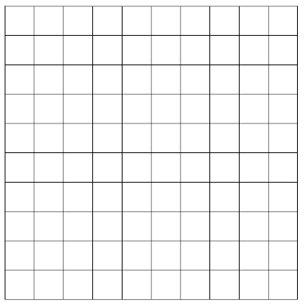
Main Task
What do you notice is missing from this grid?
Task 1
Label the x and the y axis from 0-10
Task 2
Draw the following triangles:
(0,4) (0,6) (3,5)
(3,6) (5,6) (3,9)
(2,0) (4,0) (1,3)
(7,0) (5,2) (10,3)
(5,4) (9,4) (7,5)
(8,9) (10,9) (9,5)

Slide 5
Main Task
Task 3
Leave the equilateral triangles blank
Make the isosceles triangles stripey
Make the scalene triangles spotty
Shade in the right angled triangles
Task
Mark any acute angles with the letter a
Mark any right angles with a square
Mark any obtuse angles with the letter o

