Slide 1
Explore one more within six.
Mathematics
Mrs Harris

Slide 2
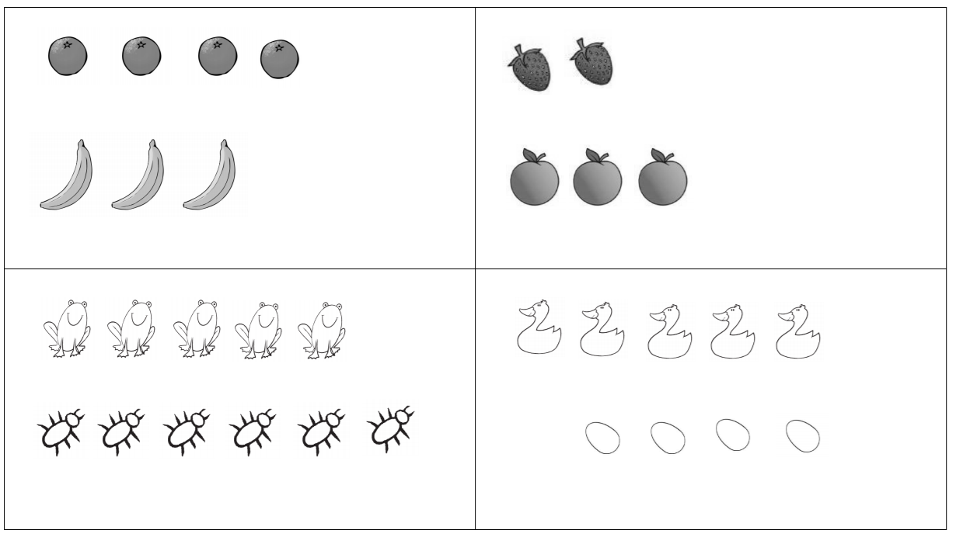
I

