Slide 1
Powers of powers
Maths
Mr Clasper

Slide 2
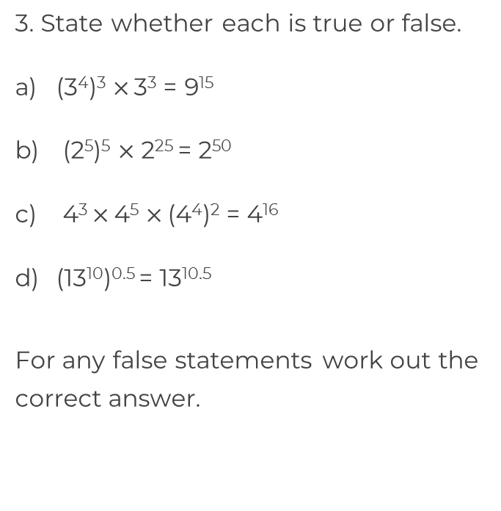
Powers of powers
1. Simplify each expression.
(2³)⁷
(13⁵)³
(1352⁶)⁸
(7¹⁰⁰)²
2. Write each expression as a single power of 5
(5⁶)⁻²
(5⁻²)⁷

Slide 3
Powers of powers
4. For each expression find the value of m.
(m³)⁴ = 19¹²
(12^{m})³ = 12⁶
(83⁻⁵)^{m} = 83¹⁵
(7⁹)^{m} = 7^{4.5}
5. A cube has a side length of 7⁹ mm. Calculate the volume of the cube.
Give your answer as a single power of 7
6. Show that = 6²⁸
7⁹ mm
4
6³

Slide 4
Answers

Slide 5
Powers of powers
1. Simplify each expression.
(2³)⁷
(13⁵)³
(1352⁶)⁸
(7¹⁰⁰)²
2. Write each expression as a single power of 5
(5⁶)⁻²
(5⁻²)⁷
2²¹
13¹⁵
False. 3¹⁵
1352⁴⁸
True
7²⁰⁰
True
False. 13⁵
5⁻¹²
5¹²
5⁻¹⁴
5²⁵

Slide 6
Powers of powers
4. For each expression find the value of m.
(m³)⁴ = 19¹²
(12^{m})³ = 12⁶
(83⁻⁵)^{m} = 83¹⁵
(7⁹)^{m} = 7^{4.5}
5. A cube has a side length of 7⁹ mm. Calculate the volume of the cube.
Give your answer as a single power of 7
6. Show that = 6²⁸
m = 19
m = 2
(7⁹)³ = 7²⁷ mm³
7⁹ mm
m = -3
m = 0.5
4
6³
(6⁷)⁴ = 6²⁸

