Slide 1
Solving equations involving adding two fractions
Miss Davies
Maths

Slide 2
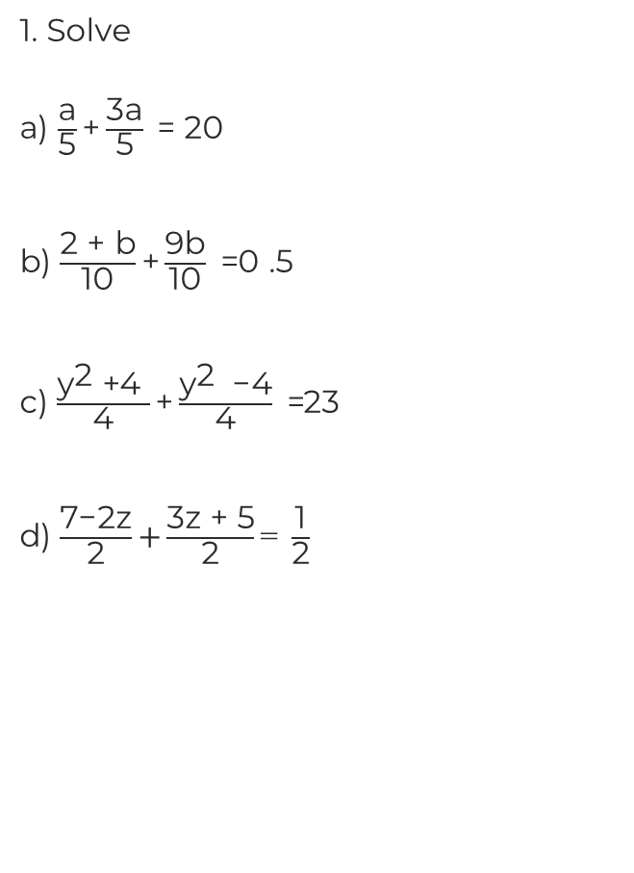
Solving equations involving adding fractions
2. The perimeter of the rectangle is 31 cm.
Calculate the length of side BC.
B
A
C
D

Slide 3
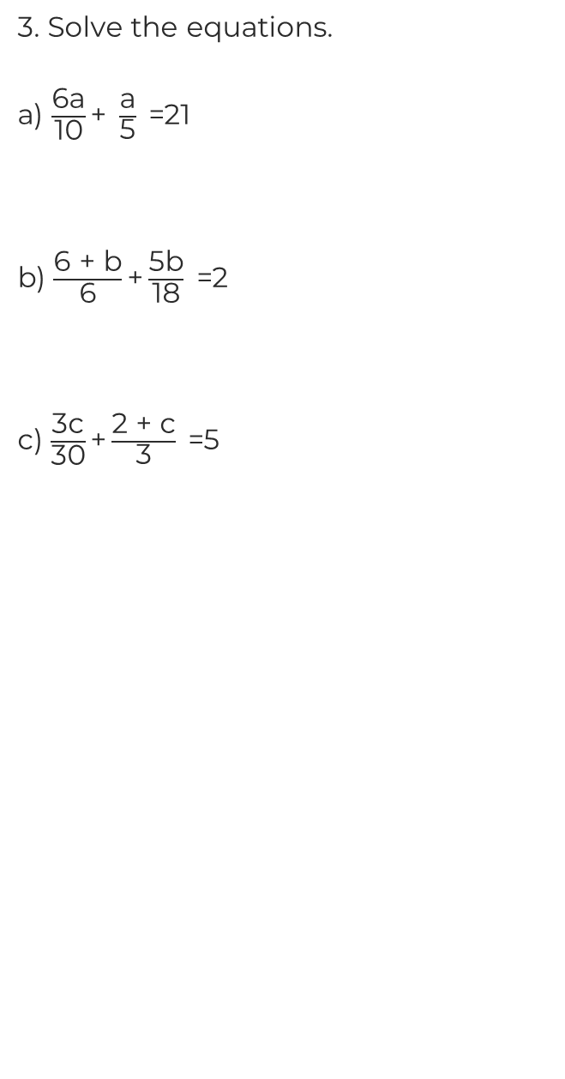
Solving equations involving adding fractions
4. The distance from B to D is 5 cm.
Find the distance from A to B.
A
B
C
D

Slide 4
Answers

Slide 5
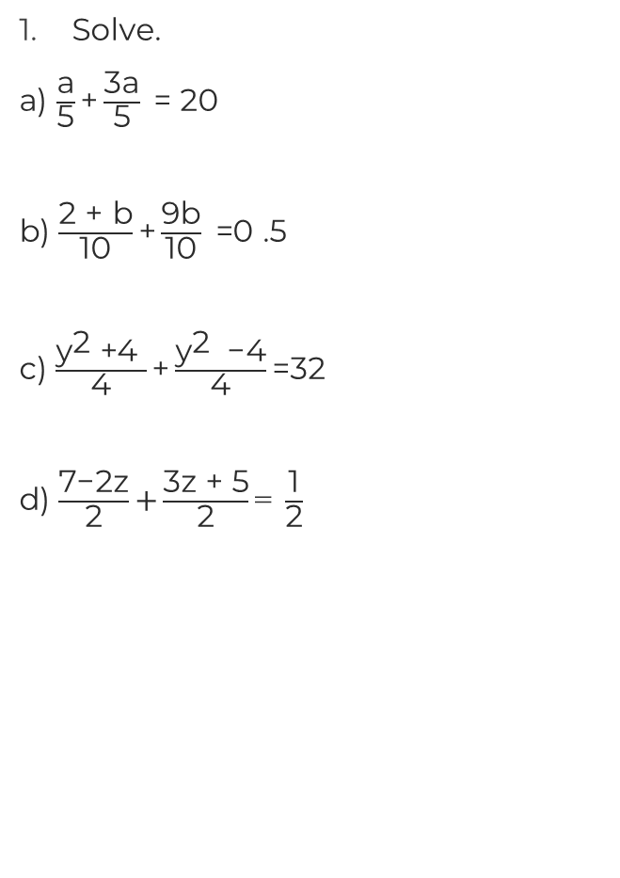
Solving equations involving adding fractions
2. The perimeter of the rectangle is 31 cm.
Calculate the length of side BC.
a = 25
B
A
b = 0.3
C
y = 8
D
z = -7
BC = 4.5 cm

Slide 6
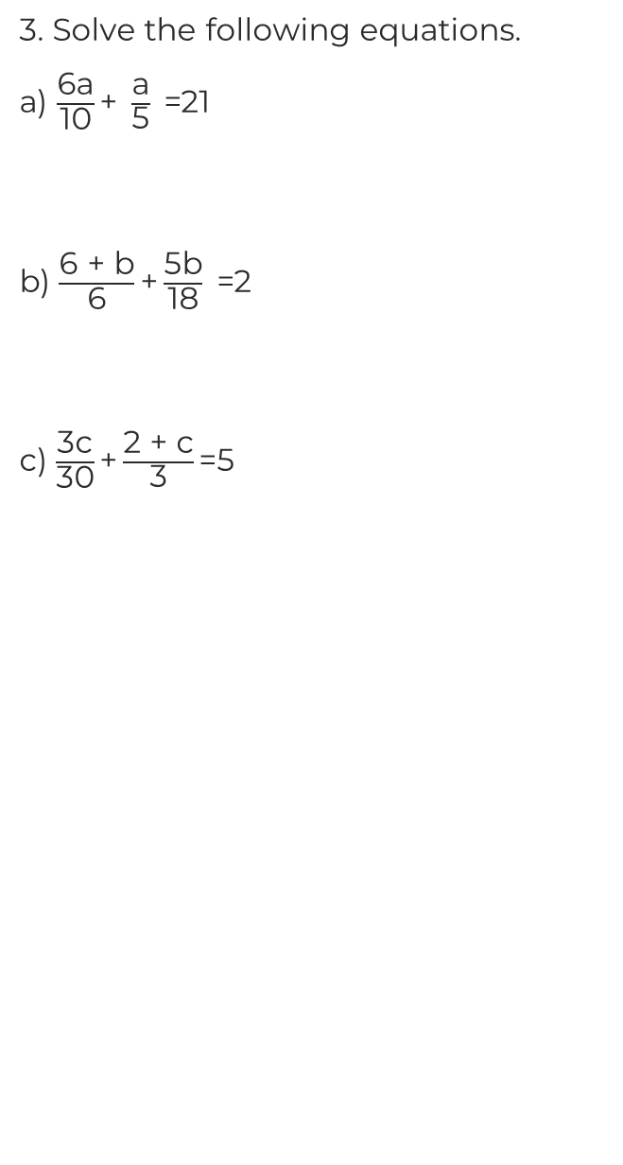
Solving equations involving adding fractions
4. The distance from B to D is 5 cm.
Find the distance from A to B.
a = 15
A
B
C
D
b = 2.25
c = 10
AB = 2.2 cm

