Slide 1
Simple vector diagrams
Maths
Miss Davies

Slide 2
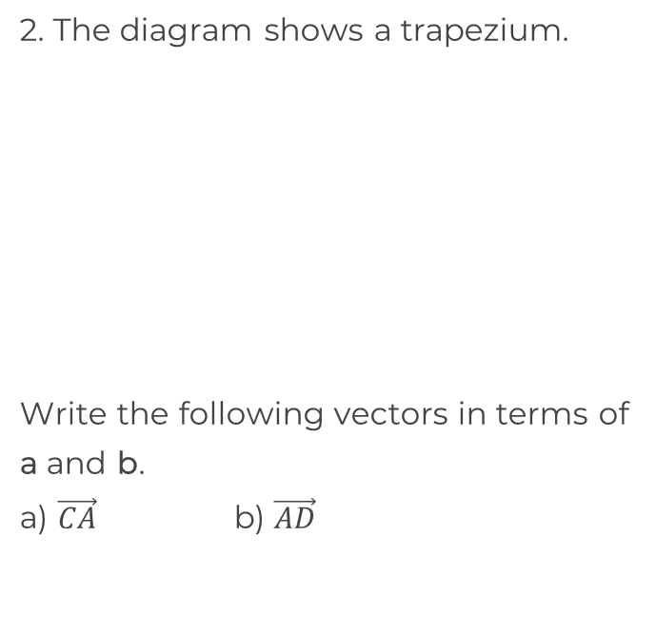
Simple vector diagrams
a
5a
A
B
C
A
B
b
D
E
F
3b
D
C
G
H
I
3a
‹#›

Slide 3
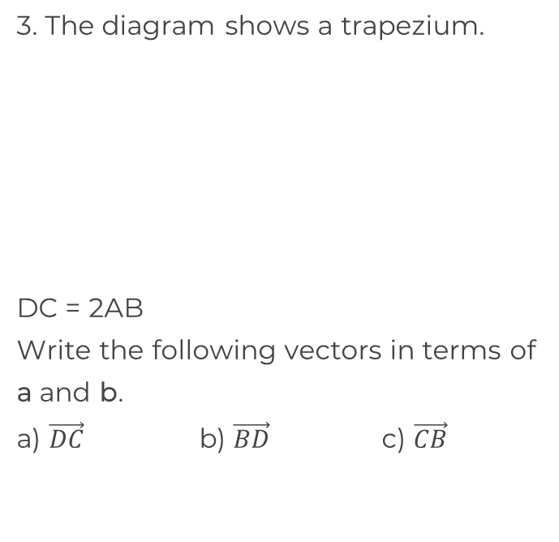
Simple vector diagrams
4a
A
B
a + b
D
C
‹#›

Slide 4
Answers

Slide 5
Simple vector diagrams
a
5a
A
B
C
A
B
b
D
E
F
3b
D
C
G
H
I
3a
a
2a
a - b
2a + b
5a + 3b
-2a - 3b
‹#›

Slide 6
Simple vector diagrams
4a
A
B
a + b
D
C
8a
-5a - b
-3a + b
‹#›

