Slide 1
Oak Specialist
Independent Living Unit 4- Community Living
Applying Learning

Slide 2
Unit 4 - Community Living
Lesson 1- Knowing which shop to buy from
Lesson 2- Putting shopping away
Knowing where to store food in the kitchen and other items.
Identifying a range of high street shops and knowing what they sell.
Lesson 4- Health support in the community
Option 3
Lesson 3- Best Value
Option 4
Comparing same items from different shop including price, quality and quantity.
Who can support us with health and where to find help in the community.
Option 3
Lesson 6- Travel in the community/ planning a journey
Lesson 5- People who help us
Option 4
Identifying emergency services and their roles.
Following steps to plan a journey and choose the correct mode of transport.
Notes:
Choose a lesson from the list

Slide 3
Lesson 6 - Travel in the community/ planning a journey

Slide 4
Teacher notes - Lesson 6
Travel in the community/planning a journey
Learning Intention: To plan a journey using public transport
Identify the different types of transport available to the public
Using Google Maps to plan a journey
Understanding a timetable
Buying a ticket
Planning your journey
Resources: paper and pen, visual support, access to the internet, examples of timetables
Notes:
Plan of the lesson.

Slide 5
Independent Living
Travel in the community/ planning a journey
Applying Learning

Slide 6
Lesson stages
What public transport can I get?
How to use Google Maps
Understanding a timetable
Buying a ticket
Planning your journey
Notes:
What are we doing in the lesson?
Read through each step with your learner.

Slide 7
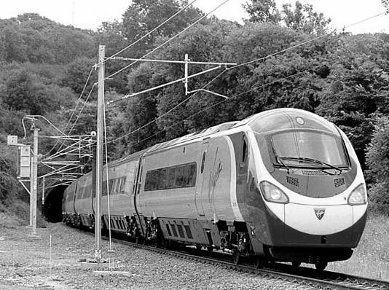
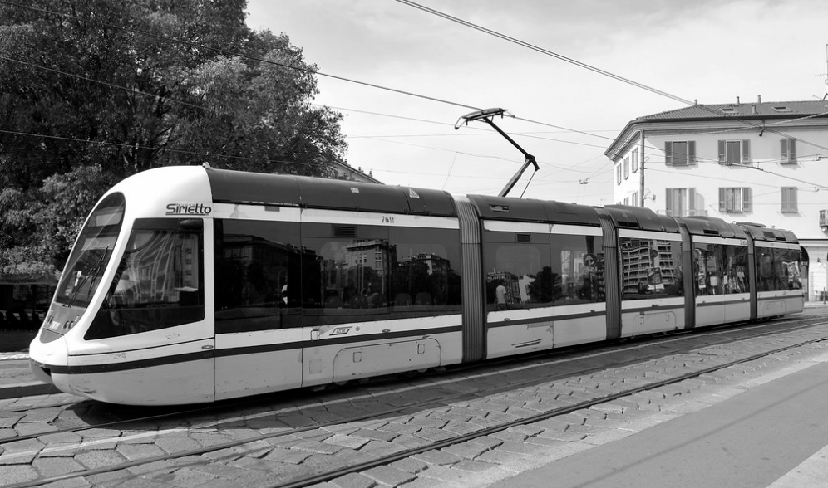
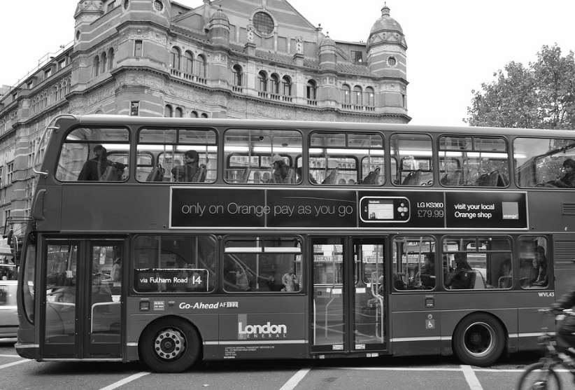
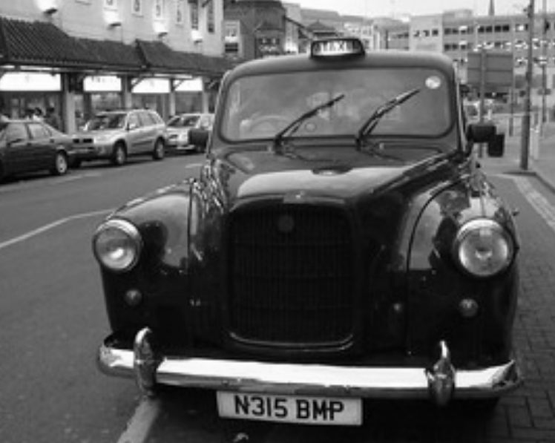
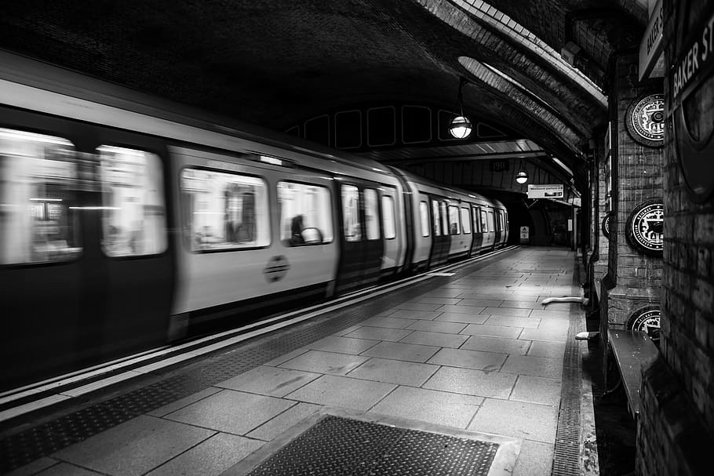
What public transport can I get?
Train
Tram
Bus
Taxi
Tube
Notes:
Look at the different pictures with your learner. Discuss what the mode of transport is.
Questions to ask:
Have you ever used any of them?
Are there any you haven’t used?
What cities in the UK can you find them?

Slide 8
Activity:
This activity requires the use of the internet. Please ensure you complete this activity with a parent or carer.
With a parent/carer visit Google Maps website online and complete the tasks below:
Enter a place you would like to visit in the search box.
Make a note of the distance it is away from where you live.
How long will the journey take?
Can you get to your chosen place by walking, cycling, or using public transport?

Slide 9
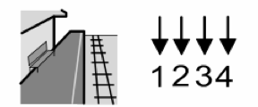
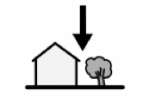
Understanding a timetable
There are lots of different timetables available to help you plan a journey.
What information does a timetable have?
Departure time
Platform number
Destination
Price of the ticket
Widgit Symbols © Widgit Software 2002-2020
Notes:
Read through the information with your learner.

Slide 10
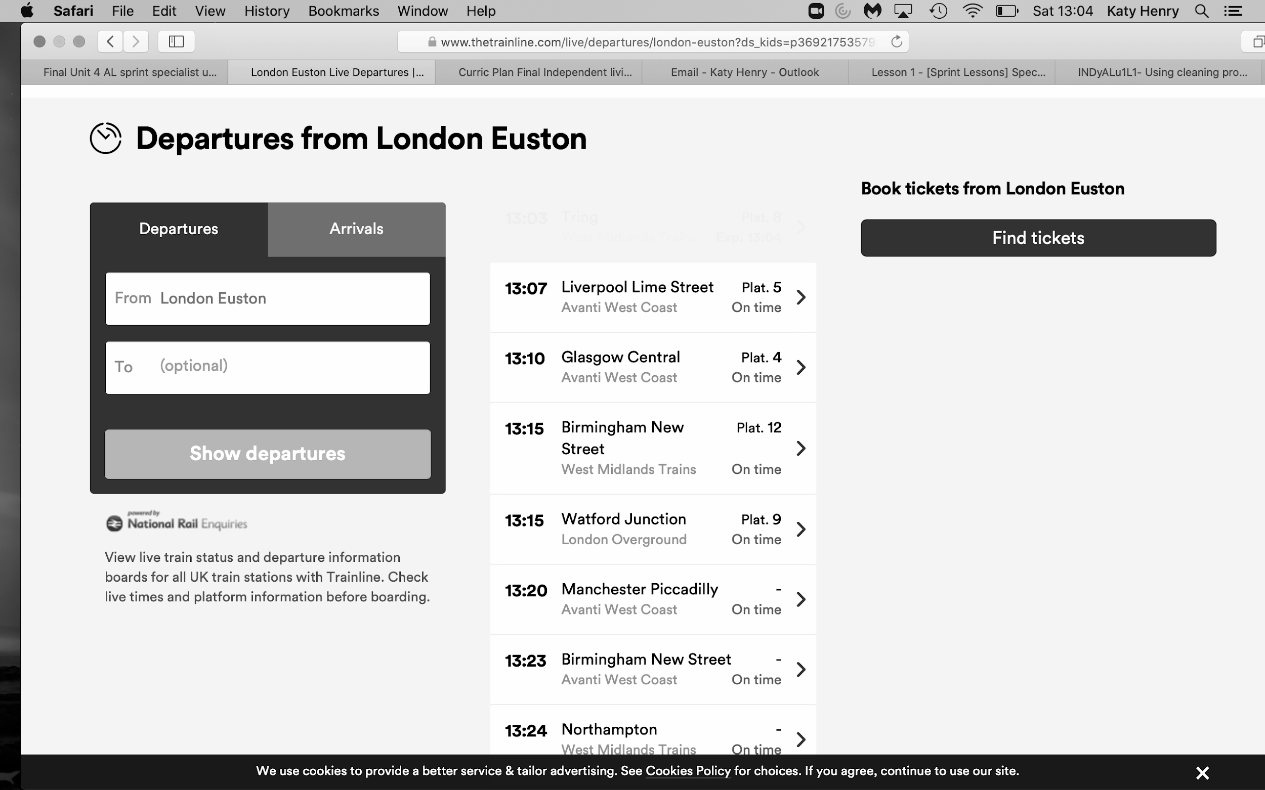
Train timetable:
The Trainline
Notes:
Look at the example train timetable.
Try and find the information for:
Departure times
Platform numbers
Destination

Slide 11
Bus timetable:
Traveline Scotland
Notes:
Look at the example bus timetable.
Try and find the information for:
Departure times
Length of journey- travel time
Destination

Slide 12
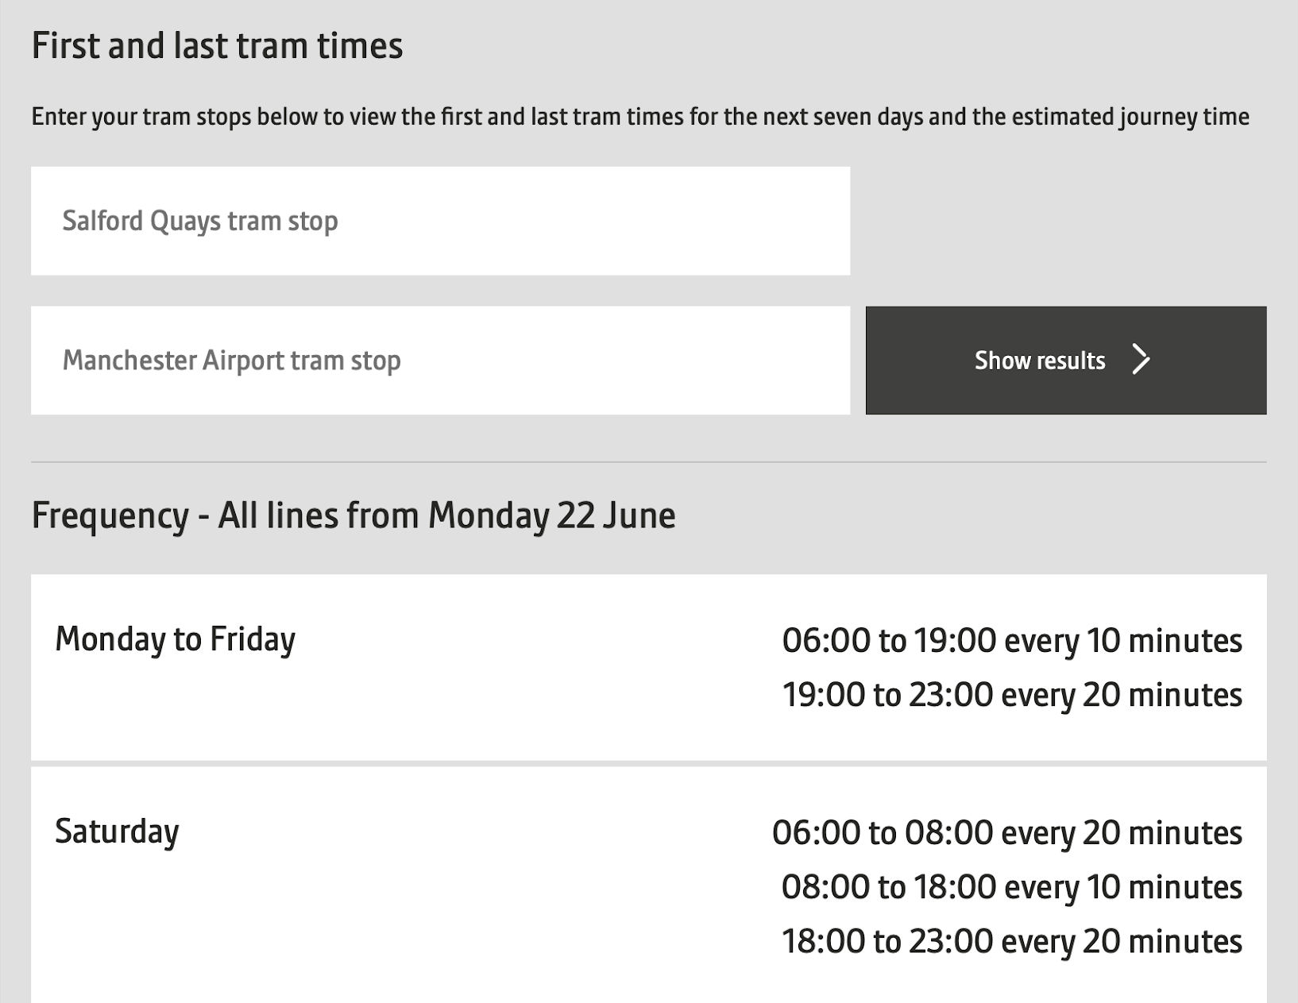
Tram timetable:
Transport for Greater Manchester
Notes:
Look at the example tram timetable.
Try and find the information for:
Departure times
Destination

Slide 13
Underground timetable:
Transport for London
Notes:
Look at the example underground timetable.
Try and find the information for:
Departure times
Length of journey- travel time
Destination
https://tfl.gov.uk/tube/timetable/piccadilly?fromText=Finsbury+Park+Underground+Station&toText=Piccadilly+Circus+Underground+Station&FromId=940GZZLUFPK&ToId=940GZZLUPCC&btnGo=Go&SelectedDate=mondayfriday&SelectedTime=0&direction=

Slide 14
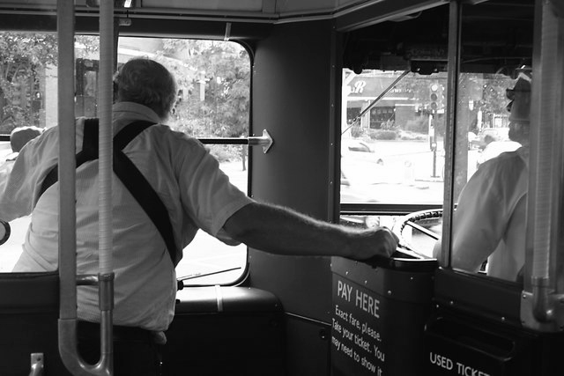
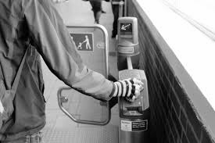
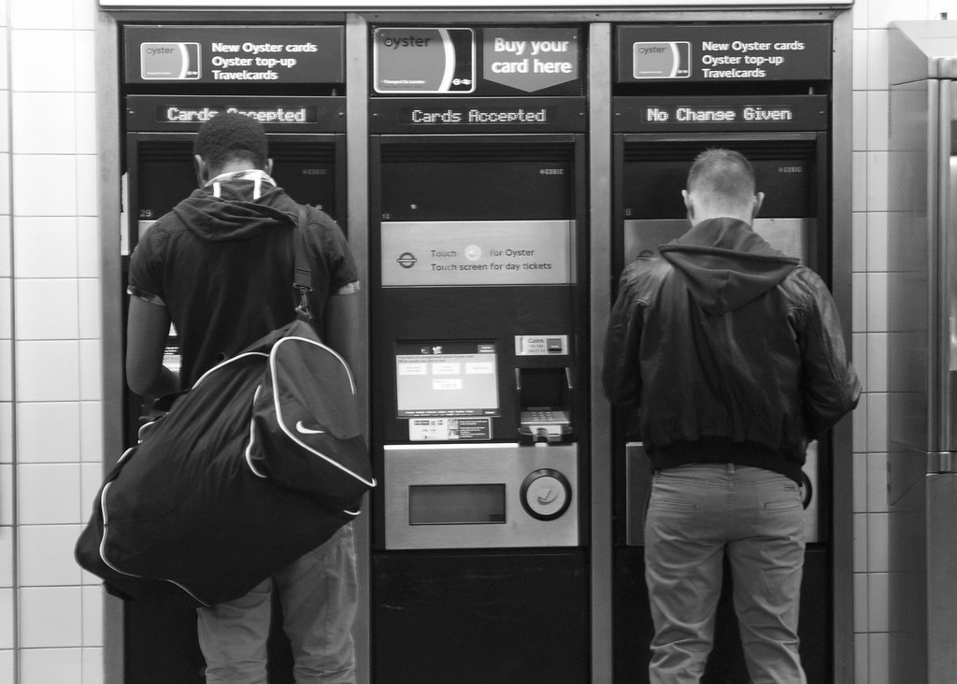
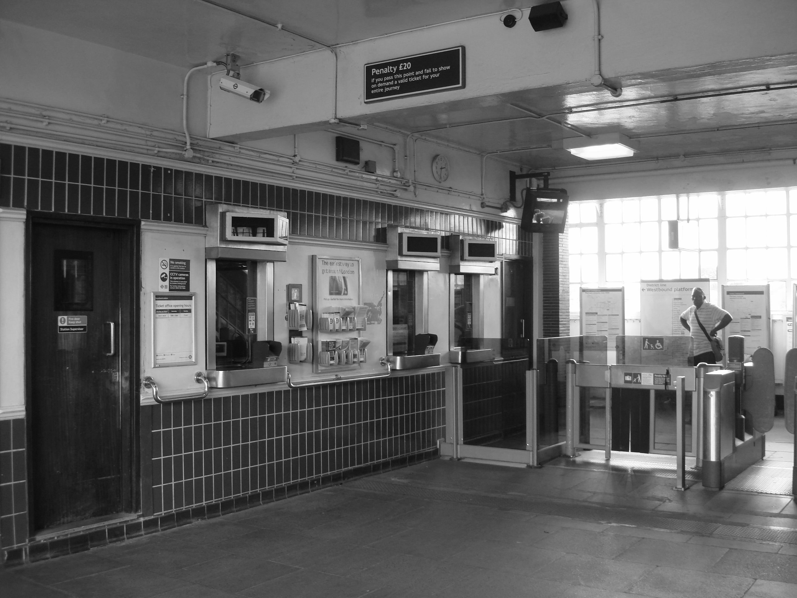
Buying a ticket:
Once you have planned where you are going and what mode of transport you will need, next you have to pay for your journey or buy a ticket.
Pay the driver
Tap a card
Self-service
Ticket office
Notes:
Discuss the different ways to pay for a journey:
Directly to the driver
Tapping a card/Oyster/ticket
Self service
At the ticket office
Role play the different ways of paying for a journey.

Slide 15
Planning your journey:
Follow the steps to plan your journey:
Agree on where you are going
Use Google Maps to help you decide how you will travel - bus, train, walk?
Where do you set off from?
What is your destination?
How long will it take?
Where will you buy a ticket or pay for your journey?
How much does it cost to travel?
Notes:
Read through the steps to plan a journey.
Ask your learner to make notes on each step.

Slide 16
Independent Living
Community Living
Travel in the community/ planning a journey
Make it easier
Make it harder
More ideas
Ask a parent or carer to help you collect physical copies of a variety of timetables from the train station or bus station and highlight desired routes.
Role play making a journey, taking it in turns to be the driver, ticket officer and customer.
Calculate the cost of a ticket and a return. Plan the journey for 2 or more people - how much will it cost now?
Ask a parent or carer to help you research online and discuss what other modes of transport are available:
Aeroplane
Bicycle
Boat/Ferry
Notes:
Suggested adaptations for teachers/parents.

Slide 17
Signposting
Independent Living:
Building Understanding- Transport (Unit 4)
Building Understanding- Planning a journey in the community (Unit 4)
Applying Learning- Preparing for a trip (Unit 3)
Applying Learning- Community safety (Unit 6)
Applying Learning- Safety on transport (Unit 6)

Slide 18
References
Slide 7-Virgin Trains Pendolino (UK),Luxury Train Club, Flickr Attribution 2.0 Generic (CC BY 2.0) / Tram, Comune di Milano, Flickr Attribution 2.0 Generic (CC BY 2.0)/Modern red London bus,Hendra Lee, Flickr Attribution 2.0 Generic (CC BY 2.0) / London taxi, Cabbie50, Flickr Attribution 2.0 Generic (CC BY 2.0) / Baker street tube, tube station, london tube, train, underground, platform, london, bakerloo line, TFL, subway, Pxfuel
Slide 8- Google maps, Pixabay
Slide 14-Tap card, Pexels/Londonist20,Andy Thornley, Flickr Attribution 2.0 Generic (CC BY 2.0) / Hornchurch tube station 6,Oxyman, Wikimedia Commons / Crew-operated bus approaching Bromley town centre, David Kemp, Creative Commons Licence

