Slide 1
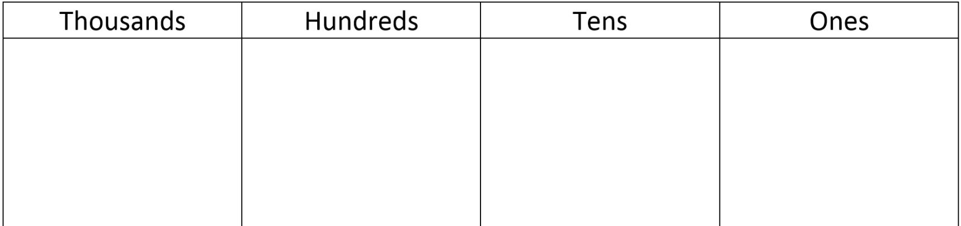
Independent Task
Question 1
Using the place value grid, complete the following equations.
Remember, draw on the Deines if it will help you!

Slide 2
Independent Task
Question 2
Using the place value grid, complete the following equations.
Remember, draw on the Deines if it will help you!

Slide 3
Independent Task
Question 3
Complete the following function machine!
6194
10

Slide 4
Independent Task
Question 4
Complete the following function machine!
4960
?
5060

Slide 5
Independent Task
Question 5
Finish the number line.
Remember, draw on the Deines if it will help you!

Slide 6
Independent Task
Question 6
Finish the number line.
Remember, draw on the Deines if it will help you!

