Slide 1
German
Family Relationships [3/ 3] - ‘mit’ + Dative with nouns and pronouns
Frau Driver

Slide 2
Family relationships and using ‘mit’ + dative with nouns and pronouns
Phonics focus – [z], [sp]
Introducing new vocabulary
Grammar: ‘mit’ + dative with nouns and pronouns
Listening activity
Revision vocabulary
Consolidating learning: Speaking
Summarising learning
Notes:
The plan for today’s lesson is as follows. Press return if you haven’t done the quiz, please do it now.
Bist du fertig? (bereit)? Los geht’s!

Slide 3
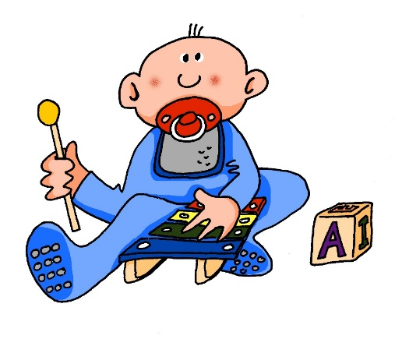
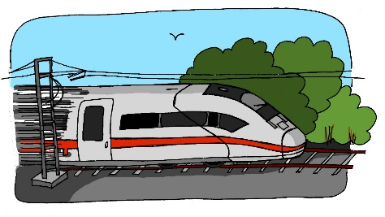
[z]
[sp]
Zug
spielen
Notes:
Phonics practice slide [Presentation slide when two SSC (sound-symbol correspondences) are presented together.] Timing: 1 minute Procedure: 1. Say the SSC sound 2. Ask student to repeat (use TL for ‘repeat’). Move to a clean slide with just the pink SSC on it. 3. Bring on (up to) five CLUSTER words which have the same sound. Ask student to pause the video (TL) to say them Then you say each word and leave space for the student to say them after you.
EI – frei. IE-Liebe. Wiederhole! An easy way to remember this in German is that you pronounce the second letter like the English alphabet letter. Let’s practise again with our source words – los gehts!

Slide 4
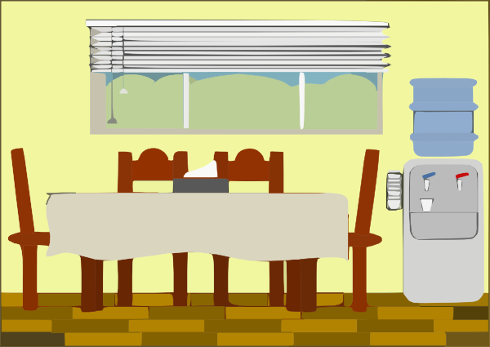
z
Zimmer
zehn
Zug
Arzt
sitzen
Platz
Notes:
Timing: 2 minutes
Aim: To introduce/consolidate SSC [z]
Procedure:
Introduce and elicit the pronunciation of the individual SSC [z] and then the source word again ‘Zug’ (with gesture, if using).
Then present and elicit the pronunciation of the five cluster words.
The cluster words have been chosen for their high-frequency, from a range of word classes, with the SSC (where possible) positioned within a variety of syllables within the words (e.g. initial, 2nd, final etc.). Additionally, we have tried to use words that build cumulatively on previously taught SSCs (see the Phonics Teaching Sequence document) and do not include new SSCs. Where new SSCs are used, they are often consonants which have a similar symbol-sound correspondence in English.
Word frequency (1 is the most frequent word in German): Zug [613]; Zimmer [609] zehn [314]; Arzt [614]; Platz [344]; sitzen [261]. Source: Jones, R.L. & Tschirner, E. (2006). A frequency dictionary of German: core vocabulary for learners. Routledge

Slide 5
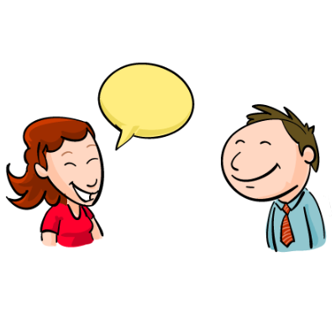
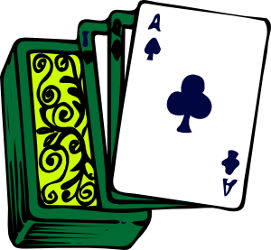
sp-
Spaß
Sprache
[fun] (noun)
spielen
sprechen
Spiel
Sport
Notes:
Timing: 2 minutes
Aim: To introduce/consolidate SSC [sp]
Procedure:
Introduce and elicit the pronunciation of the individual SSC [sp] and then the source word again ‘spielen’ (with gesture, if using).
Then present and elicit the pronunciation of the five cluster words.
The cluster words have been chosen for their high-frequency, from a range of word classes, with the SSC (where possible) positioned within a variety of syllables within the words (e.g. initial, 2nd, final etc.). Additionally, we have tried to use words that build cumulatively on previously taught SSCs (see the Phonics Teaching Sequence document) and do not include new SSCs. Where new SSCs are used, they are often consonants which have a similar symbol-sound correspondence in English.
Word frequency (1 is the most frequent word in German): spielen [197]; Spaß [666] Sprache [367]; sprechen [157]; Sport [845]; Spiel [500]. Source: Jones, R.L. & Tschirner, E. (2006). A frequency dictionary of German: core vocabulary for learners. Routledge

Slide 6
die Familienmitgliedern | family members
launisch | moody
genug | enough
die Zeit | time
Spass haben | to have fun / having fun
der Fernseher | television
genug | enough
das Zeugnis | report
bekommen | to get / getting
sauer | cross / annoyed
Notes:
Min font size = 28 for the words on the slide. Nothing below the acorn.
On the screen, you can see the new vocabulary together. Now, I’ll say the German again, but I will say them out of order. You say the correct translation out loud. If you want to challenge yourself - close your eyes, focus on what I’m saying and say the correct translation out loud.
toll, nett, aktiv, nervig, streng, benutzen, ausgehen, die Stiefschwester, die Halbgeschwister, die Groβeltern

Slide 7
‘mit’ + dative with nouns
‘mit’ is always followed by the dative case.
The table below shows the dative ending for ein, kein and possessive adjectives (mein, dein, sein, ihr, etc.)
 | Dative Case
Masc. | meinem Bruder
Fem. | meiner Schwester
Neut. | meinem Kind
Plural | meinen Eltern
Notes:
Style guide advice.
Optimum use of lesson time and key to learning/consolidation

Slide 8
‘mit’ + dative with pronouns
Remember that ‘mit’ is always followed by the dative case.
Pronouns replace nouns so that you don’t need to repeat them.
Pronouns change cases in the same way as the direct / indirect objects.
The table below shows the dative pronouns
Nom. | ich | du | er | sie | es
Dative | mir | dir | ihm | ihr | ihm
Notes:
Style guide advice.
Optimum use of lesson time and key to learning/consolidation

Slide 9
‘mit’ + dative with nouns and pronouns
‘mit’ is always followed by the dative case.
The table below shows the dative ending for ein, kein and possessive adjectives (mein, dein, sein, ihr, etc.) as well as the dative pronouns
 | Dative with nouns | Dative with pronouns
Masc. | meinem Bruder | ihm
Fem. | meiner Schwester | ihr
Neut. | meinem Kind | ihm
Plural | meinen Eltern | ihnen
Notes:
Style guide advice.
Optimum use of lesson time and key to learning/consolidation

Slide 10
Summarising Learning
your understanding of the near future ten se.
We use the dative case after ‘mit’ with articles and possessive adjectives:
We also use the dative case after ‘mit’ with pronouns.
Ich verstehen mich gut mit meiner Familie
Ich gehe mit meinen Freunden aus
Ich streite mich oft mit meinem Bruder
ich verstehen mich gut mit ihr
Ich gehe mit ihnen aus
Ich streite mich oft mit ihm
Notes:
sich verstehen mit
sich streiten mit
eifersüchtig auf
mit jemandem gut auskommen

