Slide 1
Lesson 3: RSC Merchandise
KS4 - Spreadsheets
Kashif Ahmed
Materials from the Teach Computing Curriculum created by the National Centre for Computing Education

Slide 2
Task 1 - Merchandise - part 1
Spend a short time investigating the types and prices of merchandise available for singers and bands.
Research the merchandise available for your favourite bands.
Complete the table on the next slide.
You can add more rows if needed by clicking the Tab key when the cursor is in the final cell.

Slide 3
Task 1 - Merchandise - part 2
Product | Artist | Price | Web address link

Slide 4
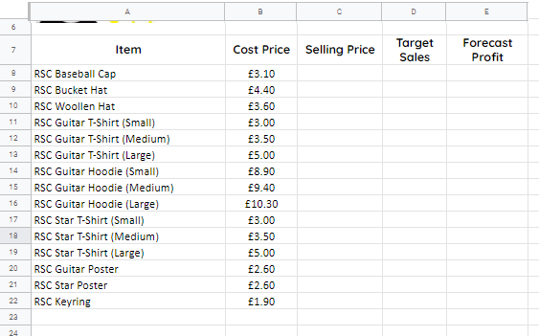
Task 2 - Complete the model
Open the RSC merchandise spreadsheet
Enter sale price for each item
Enter a target sales figure for each item
Forecast profit is selling price minus cost price multiplied by target sales
Enter a formula to calculate a forecast profit for each item
Example: =(C8-B8)*D8
Don’t forget to format cells that contain money as currency

Slide 5
Task 3 - Calculate forecast profit - part 1
In cell G5 use a SUM formula to add cells E8–E22. e.g. =SUM(E8:E22)

Slide 6
Task 3 - Calculate forecast profit - part 2
Add conditional formatting to cell G5
Select G5. Select Format -> Conditional Formatting
Select less than and input an appropriate value and select a fill colour of red.
Then Add another rule and select greater than or equal to and input an appropriate number and select a fill colour of green.

Slide 7
Task 4 - Format the spreadsheet
Add borders – thin and thick
Fill headings
Bold headings
Centre headings – horizontal and vertical
Wrap heading text
Cells C5–D5 could be merged

Slide 8
Task 5 - Can you make a profit?
Did you manage to meet the target profit?
Did you have to change the target profit to make a forecast profit?
Did your conditional formatting work?

