Slide 1
Overlapping circles 2 Worksheet
Mathematics
Miss Oreyomi
Miss Oreyomi

Slide 2
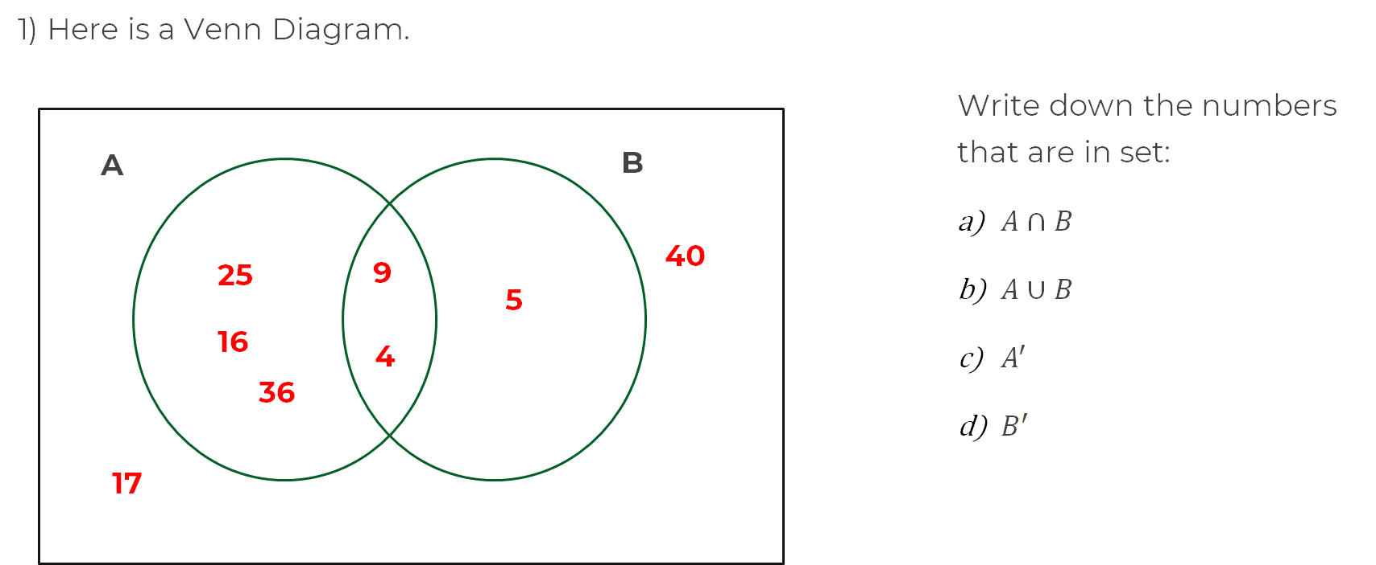
Questions

Slide 3
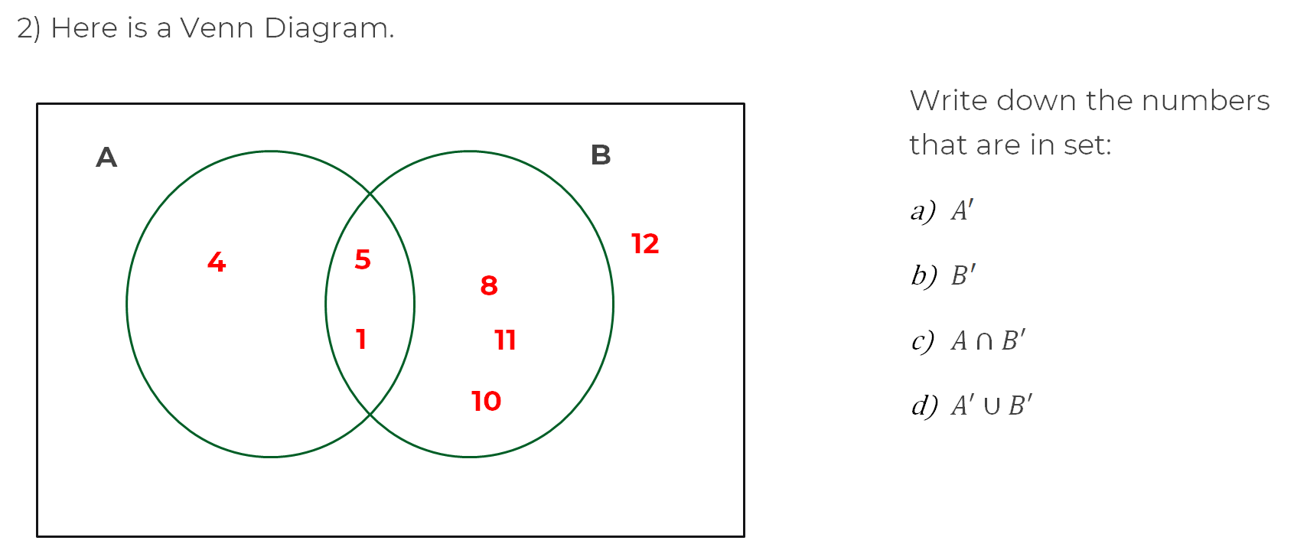
Questions

Slide 4
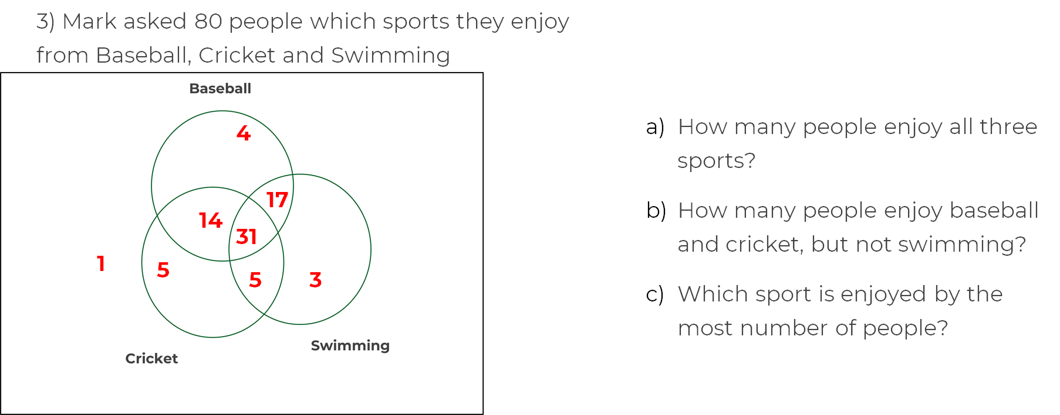
Questions

