Slide 1
Mathematics
Reading angles on a protractor part 1
Mr Kelsall

Slide 2
Develop learning: angle notation
a
a b
c
d
a
abc
∠abc
∡abc
a b
c

Slide 3
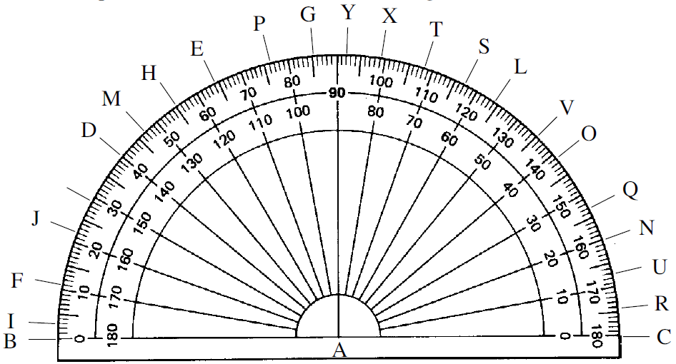
Develop learning: reading
Read the measurements off the protractor below.

Slide 4
Develop learning: reading
Read the measurements off the protractor below.
22° 2) 20° 3) 40° 4) 76° 5) 45°

Slide 5
Independent task
Read the measurements off the protractor below.
Source of all images : Mr Kelsall; Oak National Academy & 10ticks.co.uk

