Slide 1
Lesson 12 - Respiratory system
(Downloadable Student Document)
Science - Biology - Key Stage 3
Cell, Tissues and Organs
Miss Wickham

Slide 2
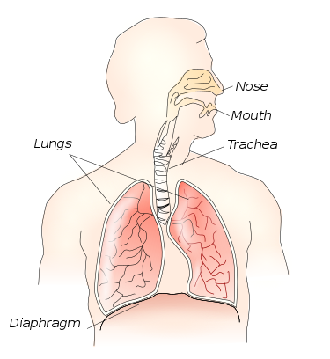
The respiratory system
Recap question
What is the job of the respiratory system?
Name the gases involved in the respiratory system.
Nose
Mouth
Lungs
Trachea
Diaphragm

Slide 3
The respiratory system
Recap question
What is the job of the respiratory system?
Name the gases involved in the respiratory system.
Gas exchange
Nose
Mouth
Lungs
Trachea
Oxygen and carbon dioxide
Diaphragm

Slide 4
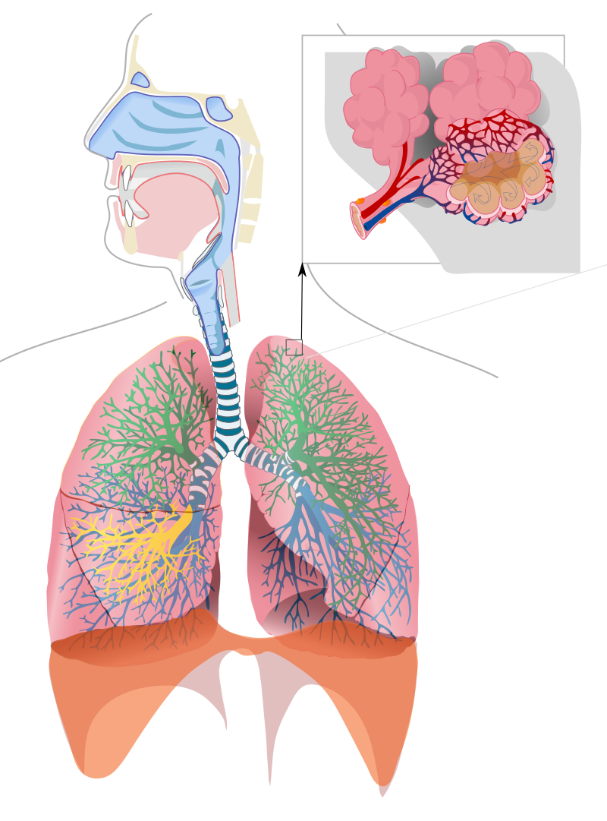
Label the diagram
Mouth and nasal cavity
7
1
Bronchioles
Bronchus
6
Diaphragm
2
Alveoli
3
Lungs
5
4
Trachea
Respiratory_system_complete_en.svg but without labels., JMarchn [Wikimedia Commons]

Slide 5
Label the diagram
Mouth and nasal cavity
7
1
Alveoli
Trachea
6
2
Bronchus
3
Bronchioles
Diaphragm
5
4
Lungs

Slide 6
Pause the video to complete your task
Complete the following gap fill activity:
The lungs are protected by _____________. Our body takes in _________________ and releases ______________ when breathing. The process of taking in oxygen into the lungs is known as _______________. The process of releasing carbon dioxide from the lungs is known as ______________. Alveolus are surrounded by _________________.
Key words: capillaries, oxygen, carbon dioxide, rib cage, exhalation, inhalation
Resume once you’re finished

Slide 7
Complete the following gap fill activity:
The lungs are protected by the rib cage.
Our body takes in oxygen and releases carbon dioxide when breathing.
The process of taking in oxygen into the lungs is known as inhalation.
The process of releasing carbon dioxide from the lungs is known as exhalation.
Alveoli are surrounded by capillaries.
Resume once you’re finished

Slide 8
Pause the video to complete your task
Describe how the parts of the digestive system and parts of the respiratory system work together.
Link to:
Respiration (explain in terms of reactants and products)
life processes (link to digestive and respiratory system)
Give specific example of organs in each system
The digestive system breaks down food molecules to make them small enough to diffuse into the…
The respiratory system involves inhaling oxygen…
Key words: energy, oxygen, carbon dioxide, water, glucose, inhale, exhale, alveoli
Resume once you’re finished

Slide 9
Describe how the parts of the digestive system and parts of the respiratory system work together.
The digestive system breaks down food molecules to make them small enough to diffuse from the small intestine into the bloodstream. Glucose is an example of a food molecule that will diffuse in the blood and be transported around the body. The respiratory system involves inhaling oxygen, which will diffuse into the bloodstream and be transported to cells. Glucose will react with oxygen in cells, producing energy, carbon dioxide and water. This is known as respiration. The carbon dioxide will diffuse from the cell into the blood, and will diffuse out of the bloodstream into the alveoli, into the lungs and will be exhaled. Therefore, linking the digestive system and the respiratory system as they are reliant on one another to fulfil the following life processes: nutrition and respiration.

