Slide 1
Combined science - Biology - Key stage 4
Ecology
Review 2
Dr Clapp

Slide 2
Independent practice
Place the following statements in order to describe the water cycle:
Transpiration happens in plants
The water then runs off the surfaces and collects as ground water or in bodies of water
Evaporation happens from the surface of the water
The water vapour rises into the atmosphere where clouds form
The water vapour condenses
Water falls as precipitation

Slide 3
Independent practice
Write out the word equations for the following processes and indicate where the carbon is found:
Photosynthesis
Combustion
Respiration

Slide 4
Independent practice - answers
Evaporation happens from the surface of the water
Transpiration happens in plants
The water vapour rises into the atmosphere where clouds form
The water vapour condenses
Water falls as precipitation
The water then runs off the surfaces and collects as ground water or in bodies of water

Slide 5
Independent practice - answers
Photosynthesis
carbon dioxide + water → glucose + oxygen
Combustion
fuel + oxygen → carbon dioxide + water
Respiration
glucose + oxygen → carbon dioxide + water

Slide 6
Independent practice
ExamBuilder: OCR, J250/10, Specimen
Gases such as methane and carbon dioxide absorb infrared radiation that is radiated by the Earth's surface. As a result, the Earth's surface is warmed. This is called the greenhouse effect.
Look at the graph.
It show how global temperatures have changes as a result of:
All factors
Anthropogenic factors
Natural factors
Notes:
Read through the text with the students

Slide 7
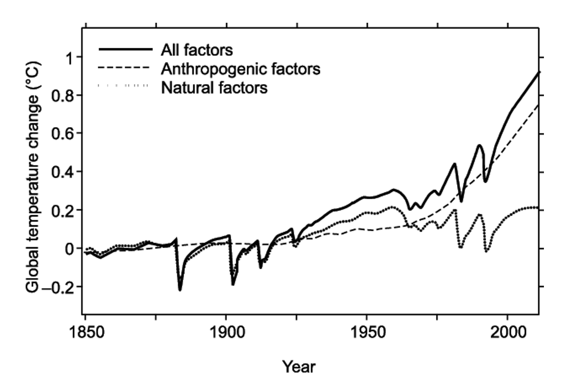
Independent practice
ExamBuilder: OCR, J250/10, Specimen
Evaluate the evidence that anthropogenic factors are contributing significantly to global temperature change. (2)
Notes:
Read through the text with the students

Slide 8
Independent practice - answers
ExamBuilder: OCR, J250/10, Specimen
Global temperatures have increased significantly since around 1975 along with anthropogenic factors (1)
However global temperatures have not increased with natural factors (1)
Notes:
Read through the text with the students

Slide 9
Independent practice
Describe how human activities have reduced biodiversity. (2)
Explain how breeding programs and introducing field margins have increased biodiversity. (2)
Notes:
Read through the text with the students

Slide 10
Independent practice - answers
Describe how human activities have reduced biodiversity. (2)
Human activities such as increased farming/deforestation/building/quarrying/ waste management/clearing peat bogs take up space which reduces habitat availability (1)
If there is less habitat then it is harder for organisms to survive and so biodiversity decreases (1)

Slide 11
Independent practice - answers
2. Explain how breeding programs and introducing field margins have increased biodiversity. (2)
Breeding programs have increased biodiversity by increasing the numbers of individuals of endangered species. (1)
Introducing field margins has increased biodiversity by providing more habitats for species to live in. (1)

