Slide 1
Find areas of similar shapes given corresponding lengths
Maths
Mr Chan

Slide 2
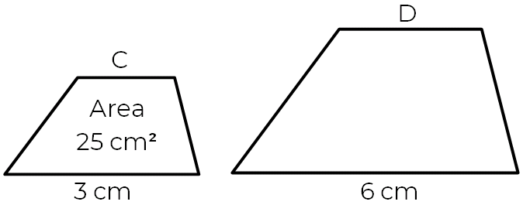
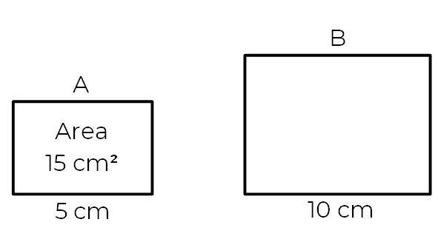
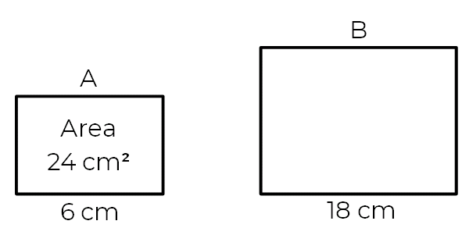
Find areas of similar shapes given corresponding lengths
1. Rectangles A and B are similar in each part.
a) Calculate the area of shape B.
b) Calculate the area of shape B.
2. Shape D is similar to shape C.
Work out the area of shape D.
3. Two similar triangles have heights of 5 cm and 15 cm. The area of the smaller triangle is 10 cm².
Calculate the area of the larger triangle.

Slide 3
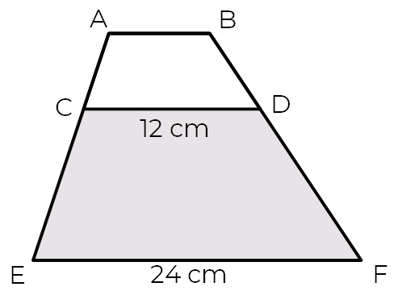
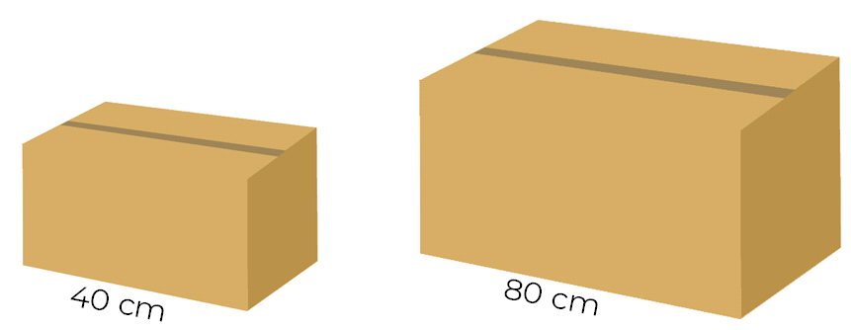
Find areas of similar shapes given corresponding lengths
4. Two boxes are mathematically similar.
The smaller box has a surface area of 6600 cm²
Alex says that the larger box will have twice the surface area 13,200 cm².
Show that Alex is wrong.
5.
Trapezium ABCD has an area of 27 cm²
Work out the area of trapezium CEFD.

Slide 4
Answers

Slide 5
Find areas of similar shapes given corresponding lengths
1. Rectangles A and B are similar in each part.
a) Calculate the area of shape B.
b) Calculate the area of shape B.
2. Shape D is similar to shape C.
Work out the area of shape D.
3. Two similar triangles have heights of 5 cm and 15 cm. The area of the smaller triangle is 10 cm².
Calculate the area of the larger triangle.
100 cm²
60 cm²
216 cm²
90 cm²

Slide 6
Find areas of similar shapes given corresponding lengths
4. Two boxes are mathematically similar.
The smaller box has a surface area of 6600 cm²
Alex says that the larger box will have twice the surface area 13,200 cm².
Show that Alex is wrong.
5.
Trapezium ABCD has an area of 27 cm²
Work out the area of trapezium CEFD.
108 cm²
Length SF = 2 6600 x 2² = 26,400 cm²

