Slide 1
Matching Symbols to Sequence Story
Communication and Language - Our World - Building Understanding
Katherine Shearer

Slide 2
For this lesson you will need:
‘We’re Going on a Lion Hunt’ by David Axtell, a sensory story resource.

Slide 3
Sequencing instructions
In this lesson we are going to sequence the ‘We’re Going on a Lion Hunt’ story by David Axtell. This lesson should be used alongside that resource to extend learning.
Adult support will be required.
Images from Pixabay.com

Slide 4
Getting ready
We are learning about putting a story sequence in order

Slide 5
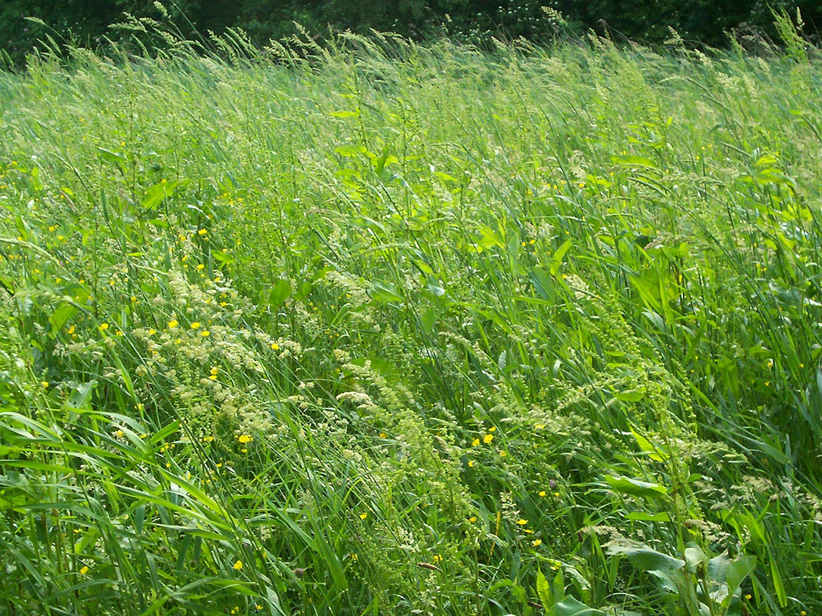
Activity 1
Can you match the picture and the symbol for this part of the story?

Slide 6
Can you match the picture and the symbol for this part of the story?

Slide 7
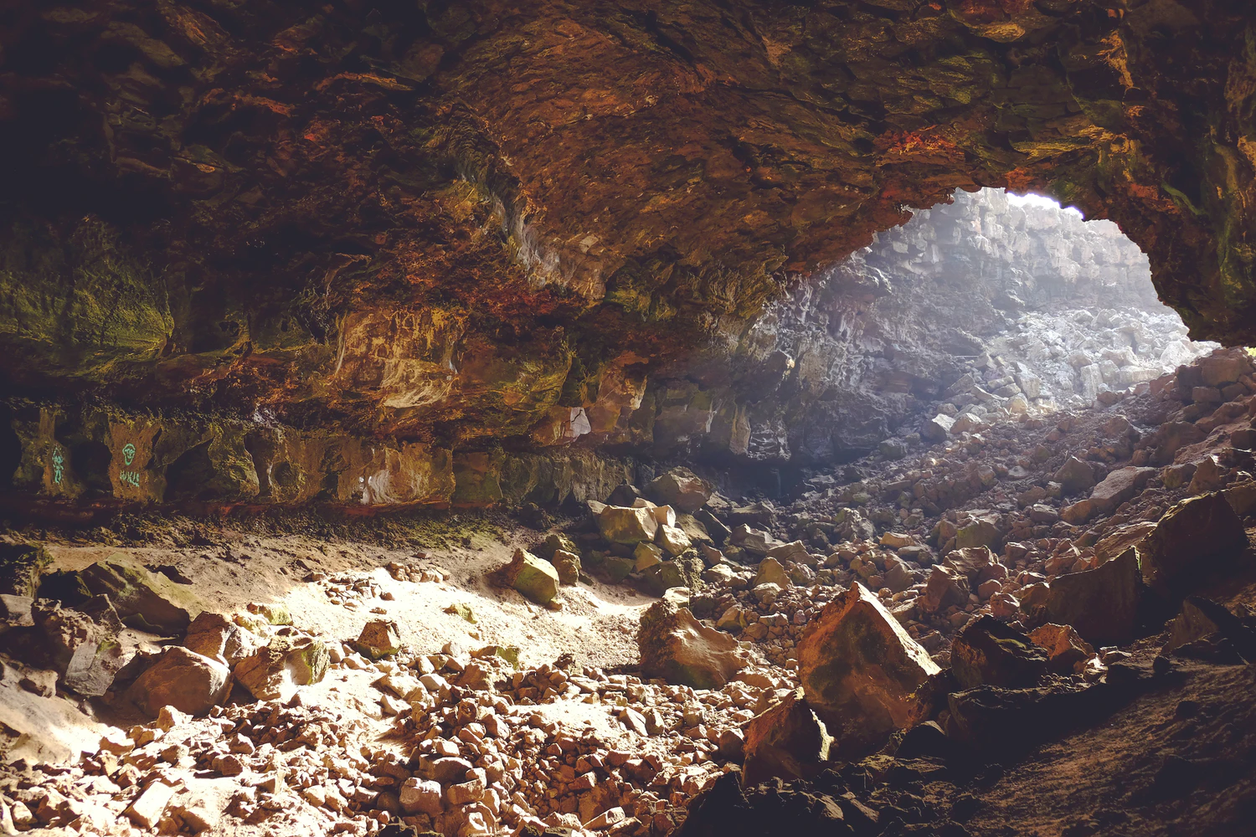
Which symbol goes with this part of the story?

Slide 8
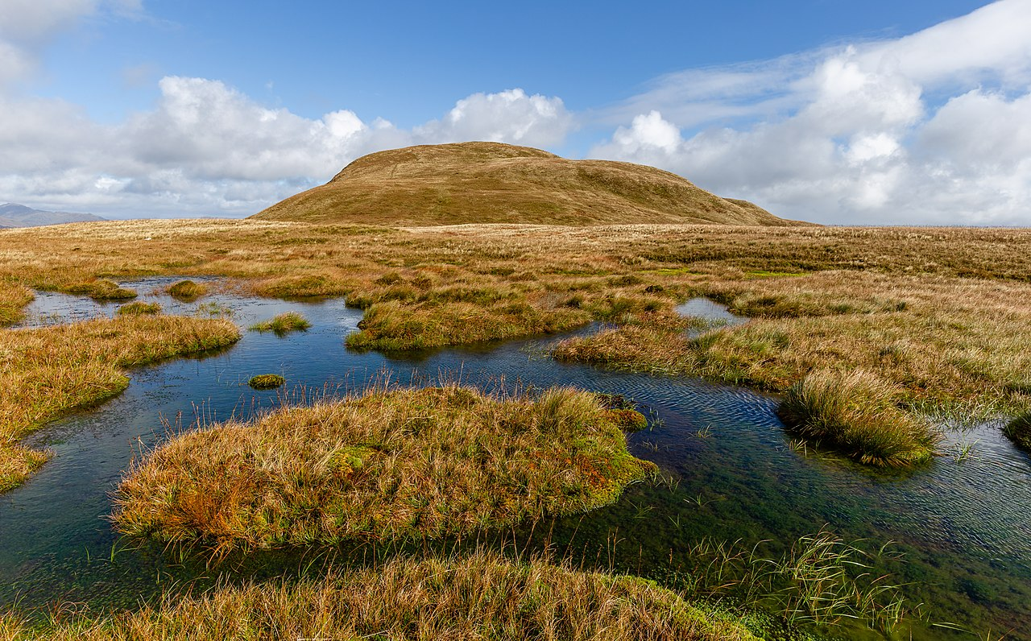
Can you match the picture and the symbol for this part of the story?

Slide 9
Activity 2: Identifying first and last
Where did the girls go first?

Slide 10
Activity 2: Identifying first and last
Where did the girls go last?

Slide 11
Activity 3: Putting events in order
In what order did the girls visit these places in the story?

Slide 12
Make it easier
Make it harder
More ideas
Use photos rather than symbols and accompany them with actual objects to make the activity more tangible. Use simple language and offer a choice of two.
Encourage the learner to use symbols and to complete the activities with independence.
Try making your own version of the Lion Hunt with places around your home!

Slide 13
Share your work with Oak National
If you'd like to, please ask your parent or carer to share your work on Instagram, Facebook or Twitter tagging @OakNational and #LearnwithOak

Slide 14
References
Slide 6: (Unmowed) grass 1 - Natubico - Wikimedia Commons (Attribution-ShareAlike 3.0 Unported (CC BY-SA 3.0))
Slide 7: Cusheon Lake in the early morning, Saltspring Island, British Columbia, Canada - Michal Klajban - Wikimedia Commons (Attribution-ShareAlike 4.0 International (CC BY-SA 4.0))
Slide 8: Illuminated rocky cavern - Ksenia Kudelkina - Unsplash
Slide 9: A peat bog below the top of Doune Hill, Luss Hills, Scotland - Michal Klajban - Wikimedia Commons (Attribution-ShareAlike 4.0 International (CC BY-SA 4.0))

