Slide 1
The Heart
(Downloadable student document)
Combined Science - Biology - KS4
Organisation
Mr Humphries

Slide 2
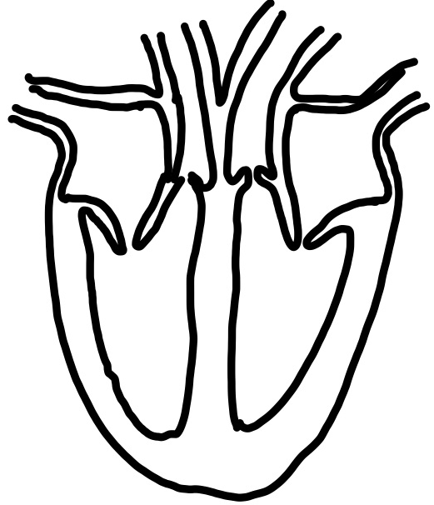
Independent Task
A
E
B
F
C
G
D
H
Image created by R Humphries
Notes:
The digestive system is an organ system which allows us to absorb nutrients from food into the blood. Food passes through the digestive system and then reaches the small intestine. This is where nutrients are absorbed.

Slide 3
Independent Task
Complete the sentences
Oxygenated blood returns to the heart via the pulmonary _______
It then enters the heart at the left __________ and is pumped into the left ventricle
The blood is pumped to the body via the ________
Deoxygenated blood returns to the heart via the vena _______
It enters the heart at the right _________ and is pumped into the right ______________
The blood travels back to the lungs via the pulmonary _________
Notes:
The digestive system is an organ system which allows us to absorb nutrients from food into the blood. Food passes through the digestive system and then reaches the small intestine. This is where nutrients are absorbed.

Slide 4
Independent Task
A patient has a heart rate of 60 bpm and a stroke volume of 90 cm³. Work out the cardiac output.
Correct equation
Identify variables
Solve
Final answer and units
Notes:
The digestive system is an organ system which allows us to absorb nutrients from food into the blood. Food passes through the digestive system and then reaches the small intestine. This is where nutrients are absorbed.

Slide 5
Independent Task
A patient has a heart rate of 70 bpm and a stroke volume of 70 cm³. Work out the cardiac output.
Correct equation
Identify variables
Solve
Final answer and units
Notes:
The digestive system is an organ system which allows us to absorb nutrients from food into the blood. Food passes through the digestive system and then reaches the small intestine. This is where nutrients are absorbed.

Slide 6
Independent Task
A patient has a heart rate of 90 bpm and a stroke volume of 40 cm³. Work out the cardiac output.
Correct equation
Identify variables
Solve
Final answer and units
Notes:
The digestive system is an organ system which allows us to absorb nutrients from food into the blood. Food passes through the digestive system and then reaches the small intestine. This is where nutrients are absorbed.

