Slide 1
What makes something a mixture?
Worksheet
Science
Miss Couves

Slide 2
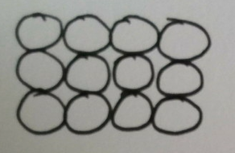
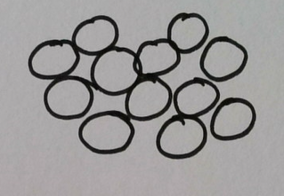
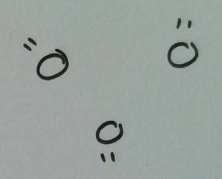
Which state of matter does each diagram represent?

Slide 3
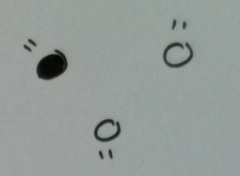
Which diagram shows a pure gas?

Slide 4
What do the particles in squash look like?
Squash contains sugar particles and water particles.
What state of matter is squash in?
How are the particles arranged?
How many different types of particle are there?

Slide 5
What is a mixture?
1. Draw a diagram to represent a pure solid.
2. Draw a diagram to represent a mixture of gases.
3. Give an example of a solid mixture.
4. Give an example of a liquid mixture.
5. Give an example of a gaseous mixture.

Slide 6
What do the particles in white gold look like?
White gold contains gold particles and platinum particles.
What state of matter is white gold in?
How are the particles arranged?
How many different types of particle are there?

Slide 7
What is an alloy?
1. What is the difference between a pure metal and an alloy?
2. Which metals make the alloy bronze?
3. How is bronze different from the pure metals?
4. How do you know that bronze is a mixture?

Slide 8
Mixing oil and water?
1. What happens when you mix oil and water together?
2. What is it called when two liquids do not mix?
3. What happens when you add soap?
4. What is it called when two liquids do mix?

