Slide 1
To identify and explain parallel lines
Maths
Miss Brinkworth

Slide 2
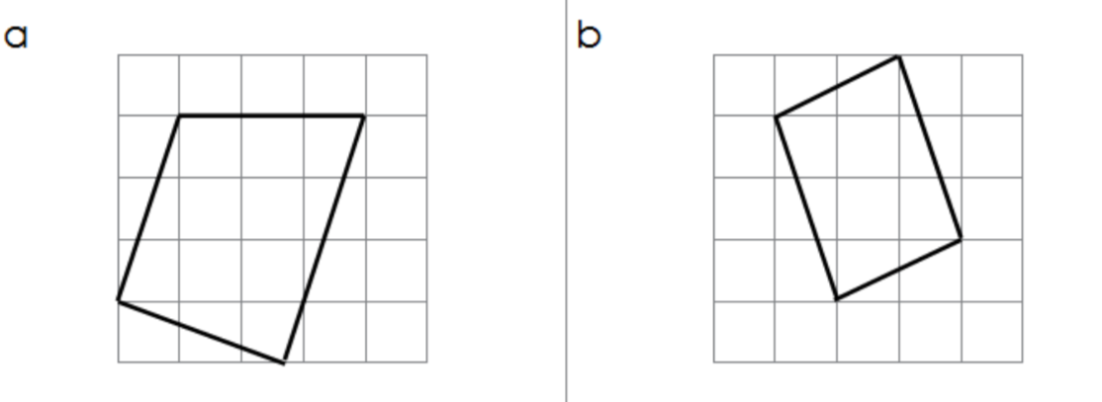
Part A
1. Which of these lines are parallel?
2. Spot the parallel lines in these shapes

Slide 3
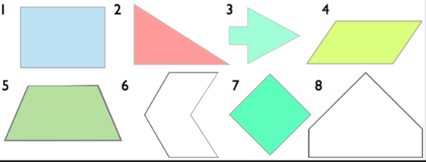
Part B
Spot the parallel lines in these shapes
2. True or false?
“Any pair of straight lines is called parallel”

Slide 4
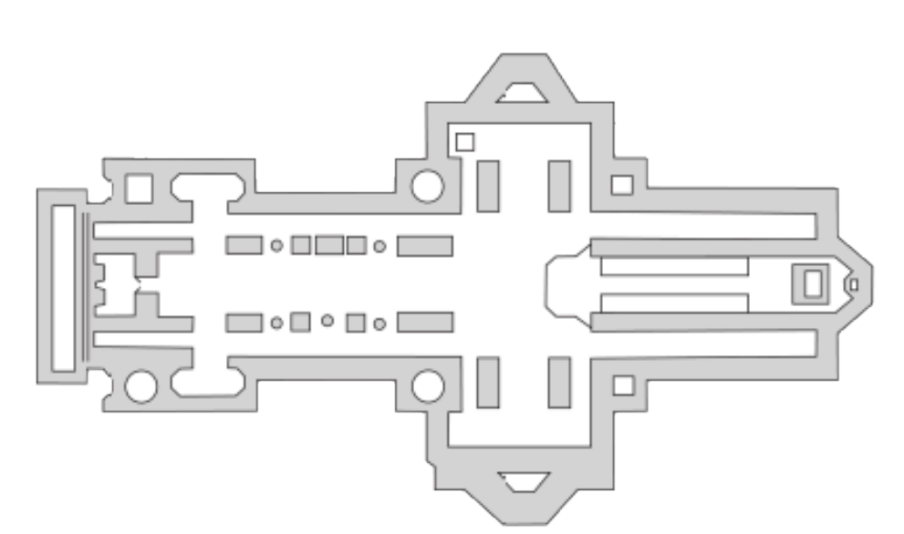
Part C
Challenge -
Can you spot all of the parallel lines in this picture?

