Slide 1
Powers of 10 Worksheet
Mathematics
Miss Oreyomi
Miss Oreyomi

Slide 2
Questions

Slide 3
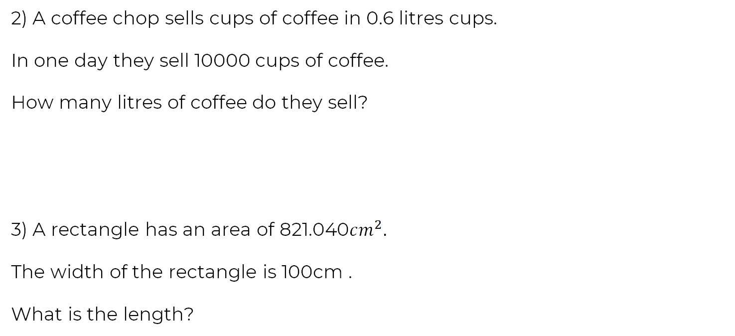
Questions

Slide 4
Questions

