Slide 1
Required Practical - Temperature Change Part 2
Combined Science - Chemistry - Key Stage 4
Energy Changes
Mrs. Begum

Slide 2
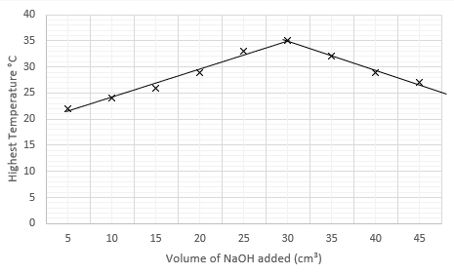
Independent task – describe and explain the results
Remember:
Use the axes titles.
Describe the patterns.
Include data to support.
Explain means say why.
Notes:
Here are the results for our investigation. There are two trends or patterns, so we’ll need to include both of them in our conclusion.

Slide 3
Independent task answers
As the volume of NaOH added increases, the more the temperature of the solution increases. For example, when 5 cm³ of NaOH was added, the temperature was 26ºC, but when 15 cm³ was added, the temperature rose to 32ºC. After 35 cm³ has been added, the temperature decreases.
This is because, when NaOH is added to the solution, an exothermic reaction occurs and the temperature increases. However, after 35 cm³, the reaction is complete, so the temperature can not increase any further. As more NaOH is being added the temperature decreases.
Notes:
Pause the video and check your conclusion. It doesn’t need to have exactly the same data to support, but should contain the same points that this one does. There were two trends on our graph, so you need to have described them both. Make sure you have described and explained.

Slide 4
Independent task – exam style question
A student carried out an investigation into the energy changes involved when magnesium and hydrochloric acid react.
10 cm³ acid was placed into a beaker and a 2 cm strip of magnesium added.
The temperature at the start and end were recorded using a thermometer.
Suggest 2 ways of improving the equipment used. Explain why each is an improvement.
Suggest one way of improving the method.
Explain what is meant by the term ‘repeatable’.

Slide 5
Independent task answers
Use a polystyrene cup or insulate the beaker, so that energy loss to the surroundings is reduced.
Add a lid to the beaker, so that energy loss to the surroundings is reduced.
Use a digital thermometer or temperature probe, so that the temperature readings are more accurate or have greater resolution.
Repeat the experiment and calculate a mean.
When the experiment has been repeated several times and the repeated readings are the same or very similar.

