Slide 1
Independent Task
To solve problems based on quadrilaterals and triangles
Maths
Year 4
Mr Critchlow

Slide 2
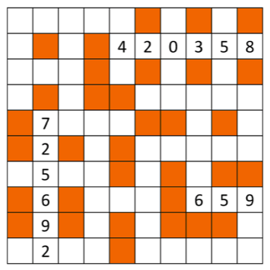
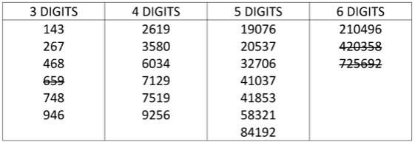
To Start
Can you complete the number grid by putting the numbers into the correct places. It’s like a crossword but with numbers not letters.

Slide 3
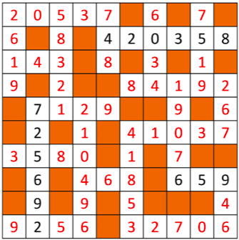
To Start
Answers

Slide 4
Shape Properties
Can you complete the properties of these 2-D shapes? An example has been done for you.
Draw it | Name it | Parallel sides | Features of sides | Angles/ Vertices
 | square | 2 sets of parallel sides | All 4 sides are equal | 4 equal angles right angles
 | oblong
 | trapezium
 |  |  | All 3 sides are equal

Slide 5
Shape Properties
Can you complete the properties of these 2-D shapes? An example has been done for you.
Draw it | Name it | Parallel sides | Features of sides | Angles/ Vertices
 | Scalene triangle
 | parallelogram
 |  | none | 2 of 3 sides are equal

Slide 6
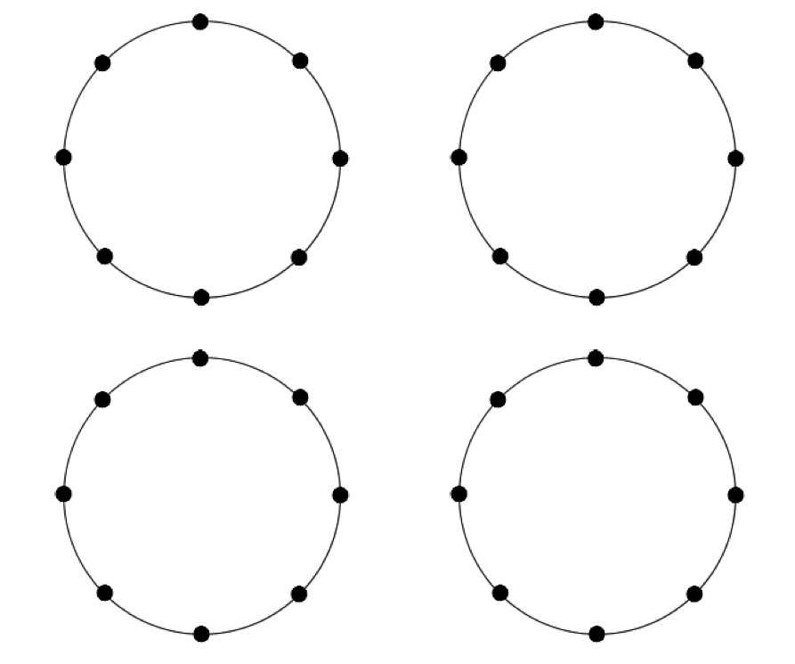
Quadrilateral investigation
How many different quadrilaterals can you make by joining 4 dots on the outside of a circle. When you create the shape, can you name it? Use straight lines only.
EG:

Slide 7
Quadrilateral investigation
How many different quadrilaterals can you make by joining 4 dots on the outside of a circle. When you create the shape, can you name it? Use straight lines only.
EG:

Slide 8
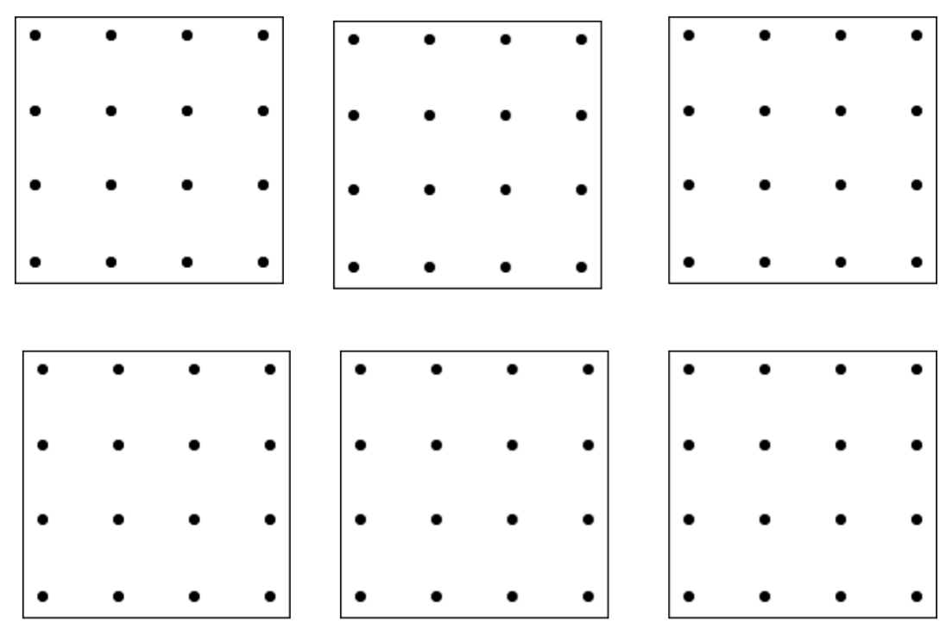
Triangles investigation
How many different triangles can you make that have a single dot in the middle of them, using the dotty grids below?
EG:

Slide 9
Triangles investigation
How many different triangles can you make that have a single dot in the middle of them, using the dotty grids below?
EG:

Slide 10
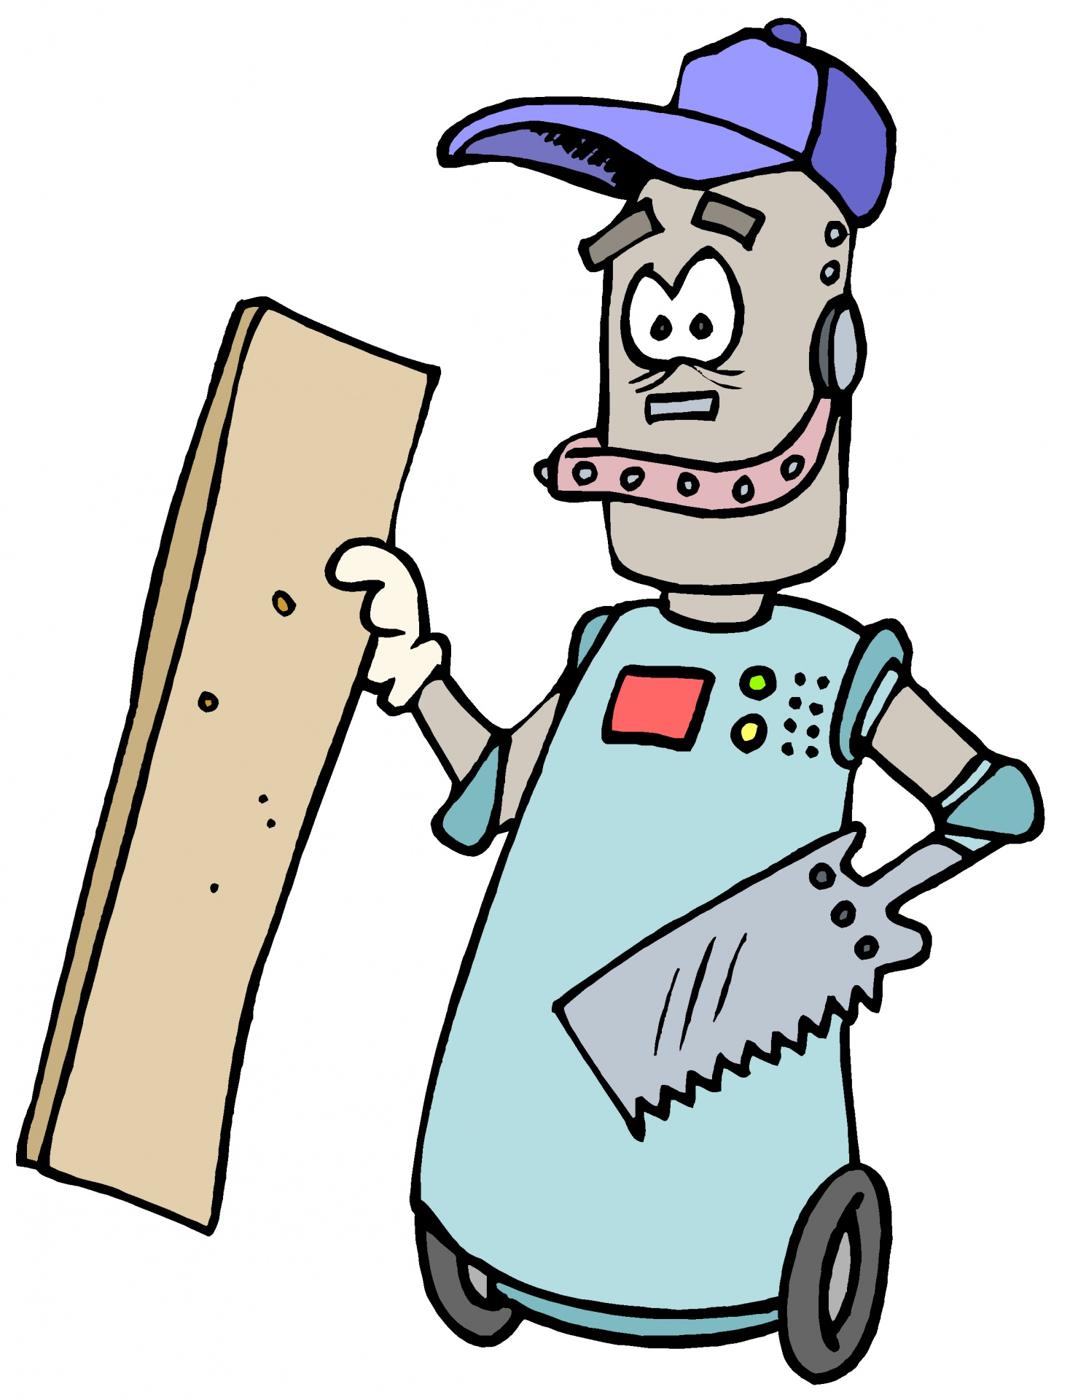
Challenge
Exploring shapes by folding
Take a piece of rectangular paper (A4 is best).
How small can you make it by folding?
How many different sorts of triangle can you produce by folding?
Can you produce four identical triangles?
What is the quickest way to produce a square?
Can you make other quadrilaterals by folding?

