Slide 1
Oak Specialist
Independent Living Unit 1- Home Management
Building Understanding

Slide 2
Independent Living: Home Management
Lesson 1- Cleaning in the home
Lesson 2- Setting the table
Recognising common cleaning equipment and where to use it.
Counting equipment needed and using a visual to set the table.
Option 3
Lesson 3- Organising clothes
Option 4
Lesson 4- Clothes for occasions
Sorting clothes by category and folding correctly.
Identifying different items of clothing dependent on the occasion or weather.
Option 3
Lesson 5- Sorting in the kitchen
Option 4
Lesson 6- Using a washing machine
Recognising kitchen appliances and what we use them for.
Following step by step instructions to use a washing machine.
Notes:
Depending on how many lessons for each unit, there could be a 2nd page for lesson 5…etc

Slide 3
Lesson 3- Organising clothes

Slide 4
Teacher notes- Organising clothes
Learning Intention: To manage clothes in a functional way
The lesson content is shared as four individual activities to follow and practice at your own pace and in context where possible.
Matching clothes to their label e.g. there are different types of t-shirts but they are all labelled ‘t-shirts’. Can your learner identify each clothing item to their label?
Sorting clothes depending on the category, e.g for washing; lights and darks, for family members, by colour, by item.
Folding clothes before putting them away and learning how to teach this.
Hanging clothes in different ways including how to use a coat hanger in the wardrobe.
-Additional resources needed to complete lesson: clothes, hangers, clothes airer or washing line

Slide 5
Home Management
Organising Clothes
Building Understanding

Slide 6
Lesson activity stages
Matching clothes
Sorting clothes
Folding clothes
Hanging clothes
Notes:
Lesson 1 breakdown of the lesson. Repeat for each lesson.

Slide 7
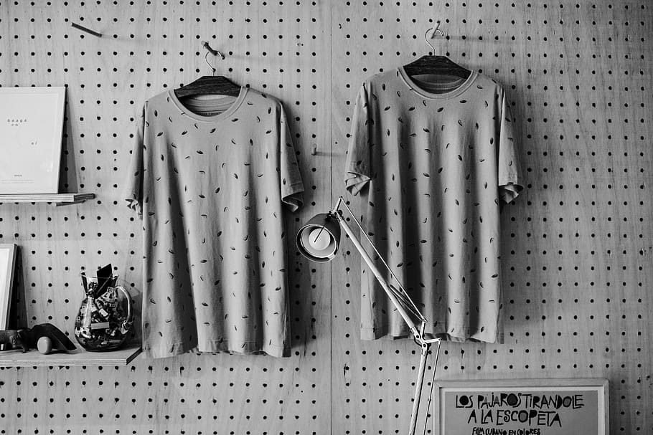
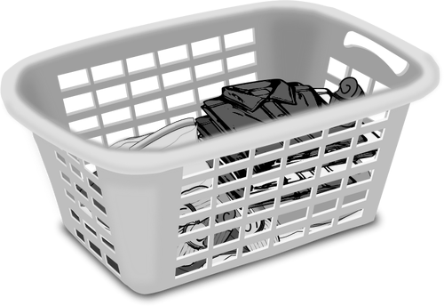
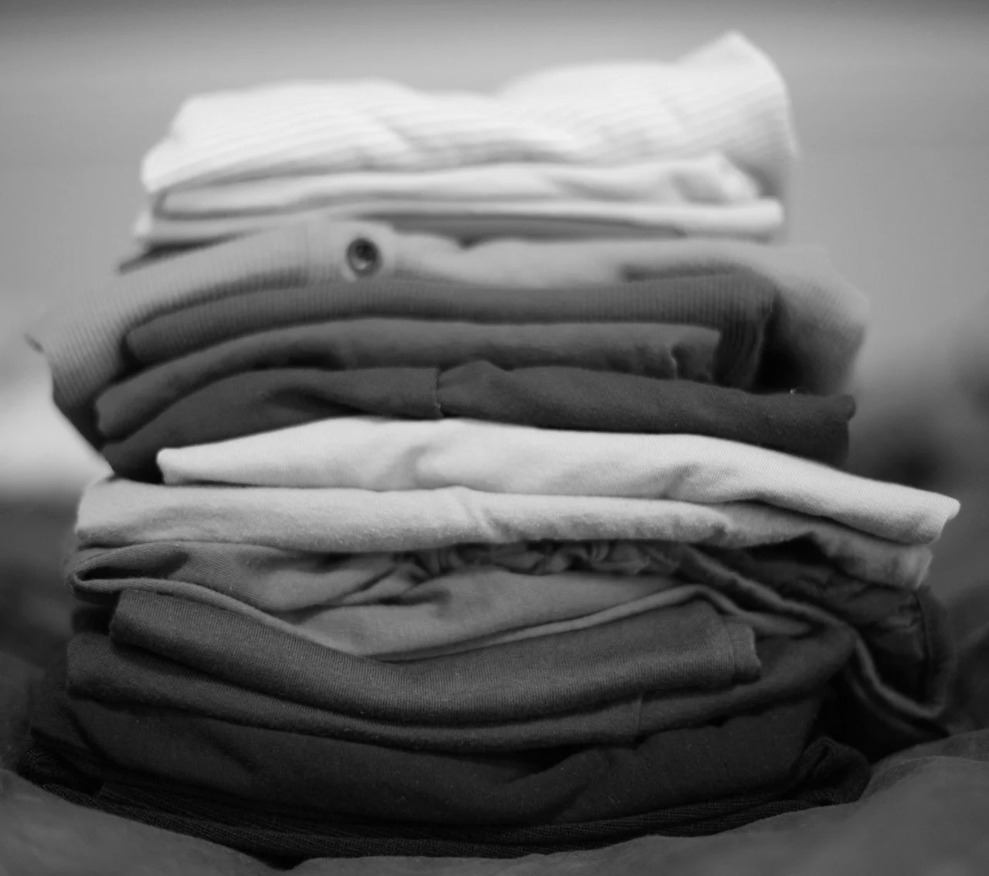
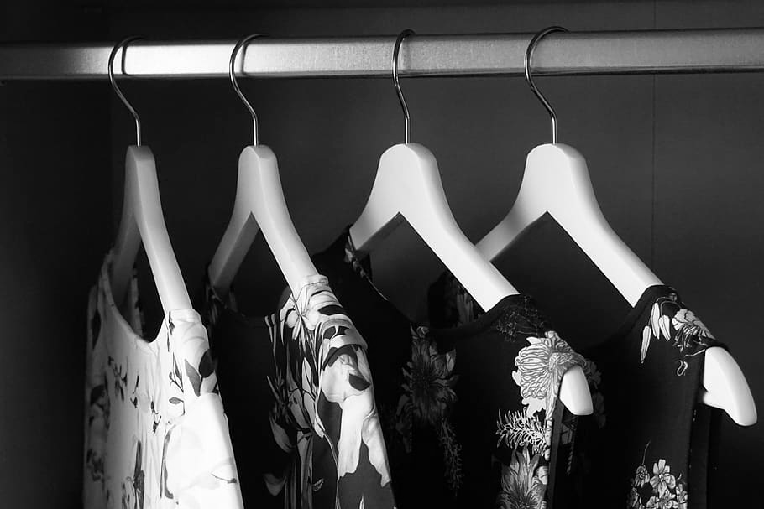
Lesson activities for managing and organising clothes
Matching | Sorting
Folding | Hanging
Notes:
These are four lesson activities for teaching how to manage and organise clothes- matching clothes, sorting clothes, folding clothes and hanging clothes. The lesson ideas involve using real clothing items and are best taught in the bedroom or place where you keep your clothes. Follow the teaching steps for each activity however you may want to adapt to suit your learners needs.

Slide 8
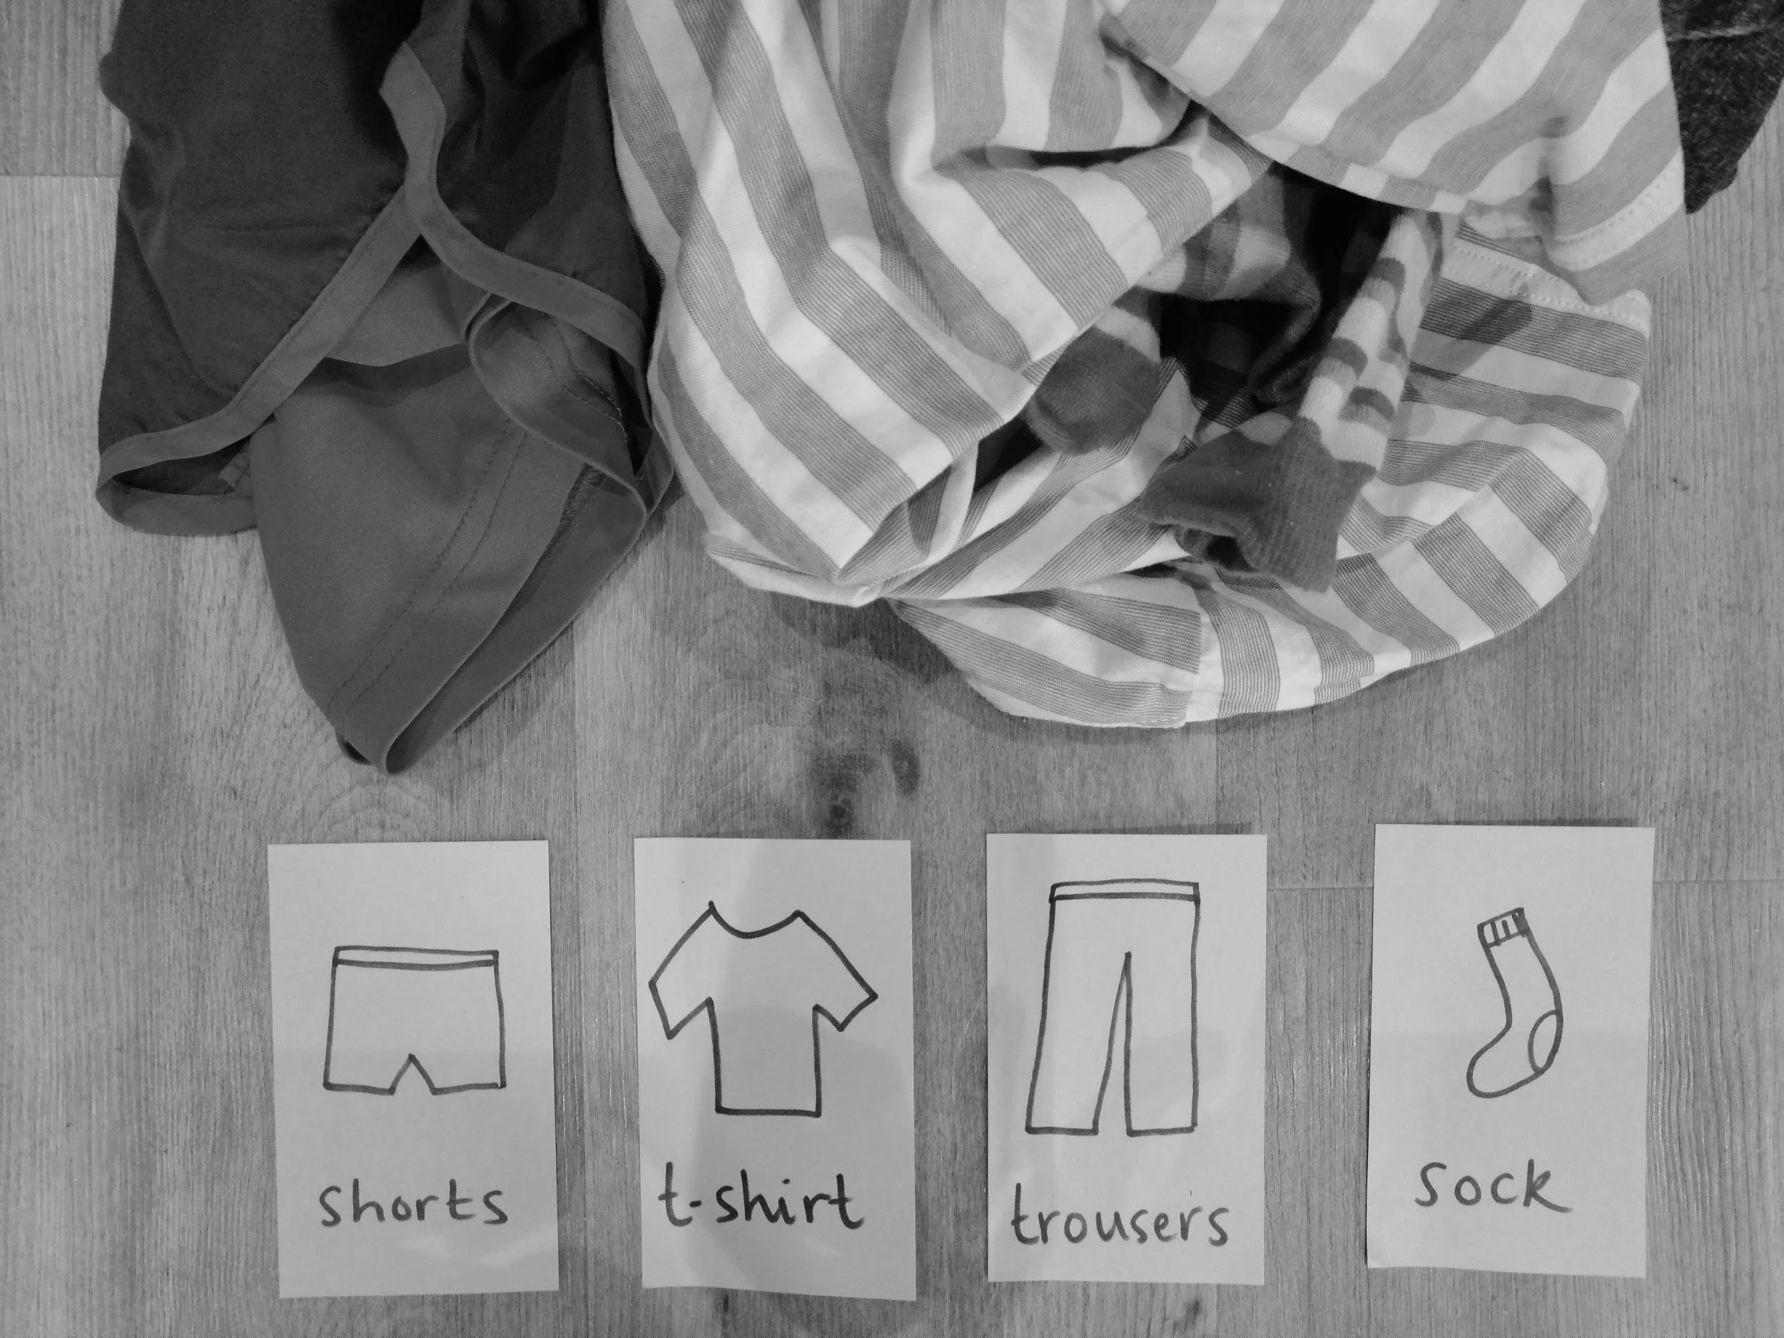
Matching clothes
Image teacher’s own

Slide 9
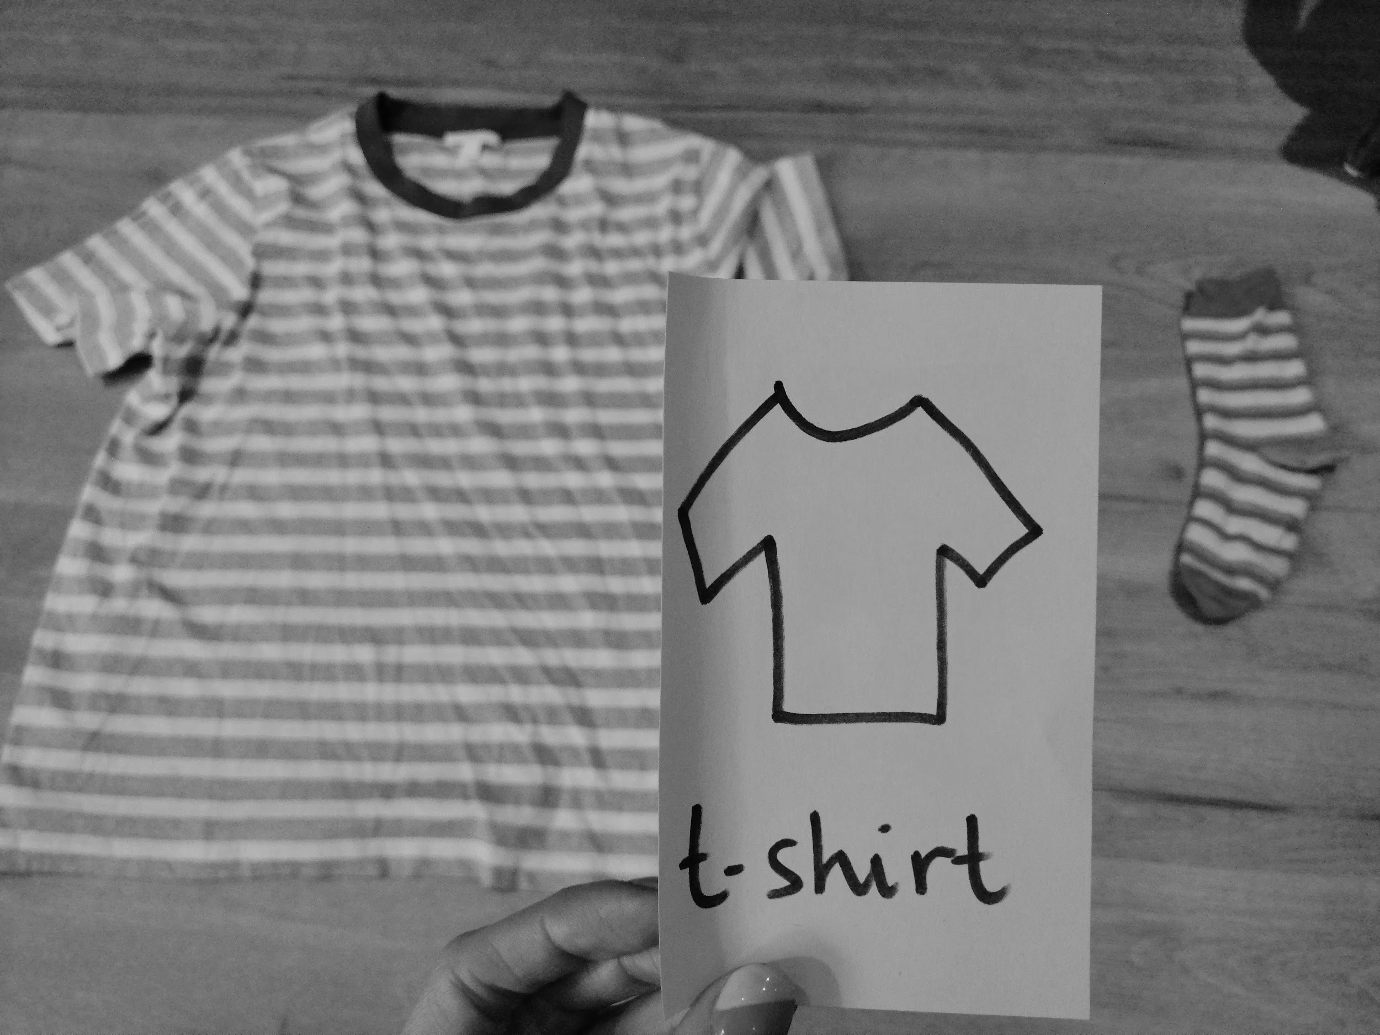
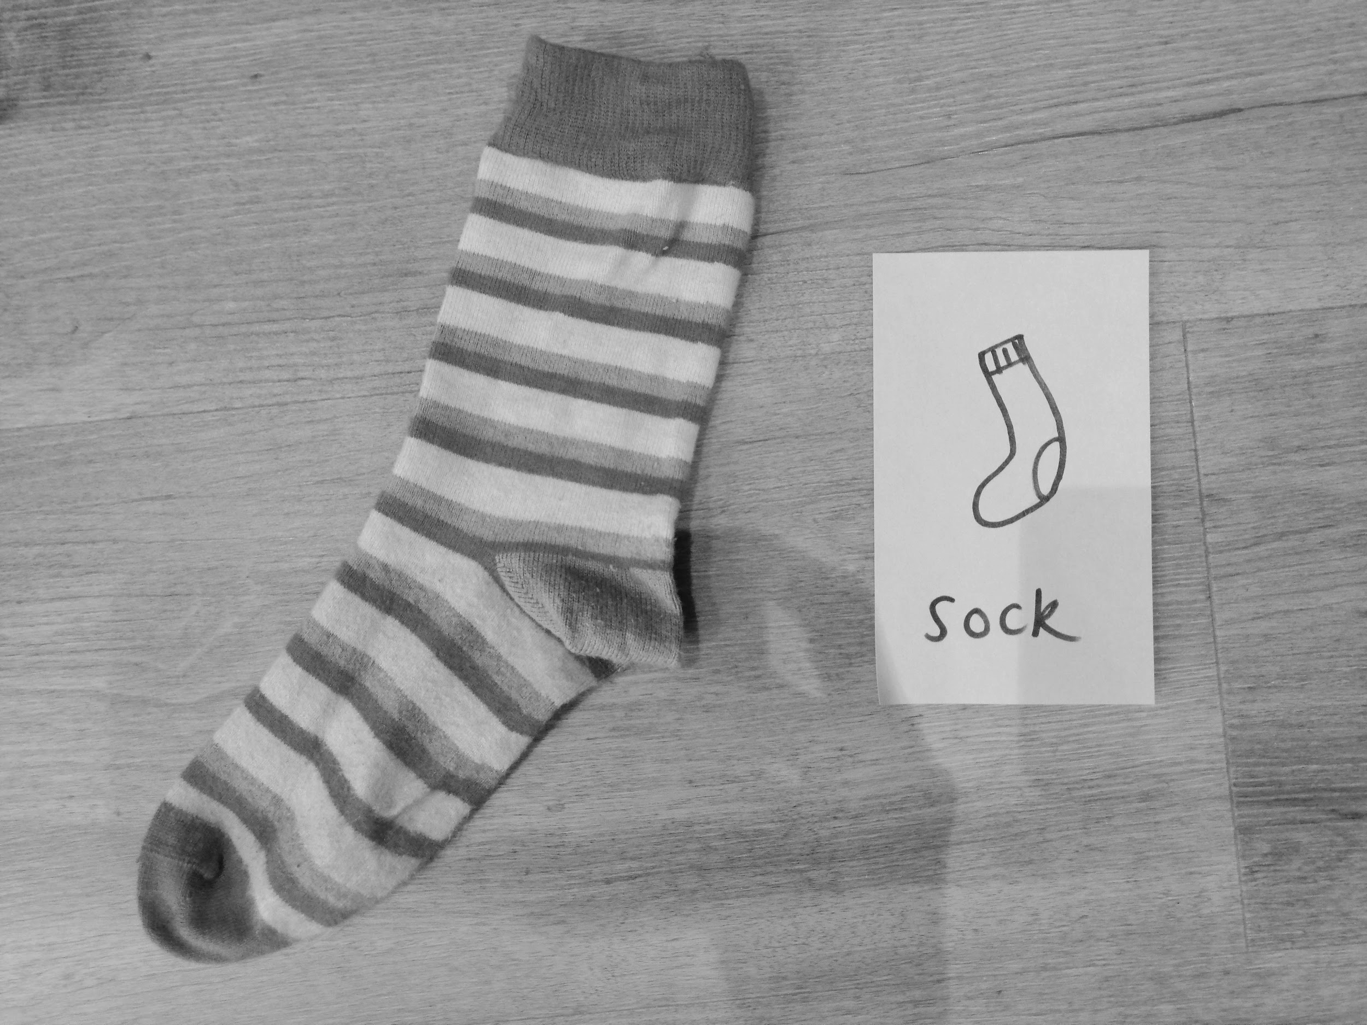
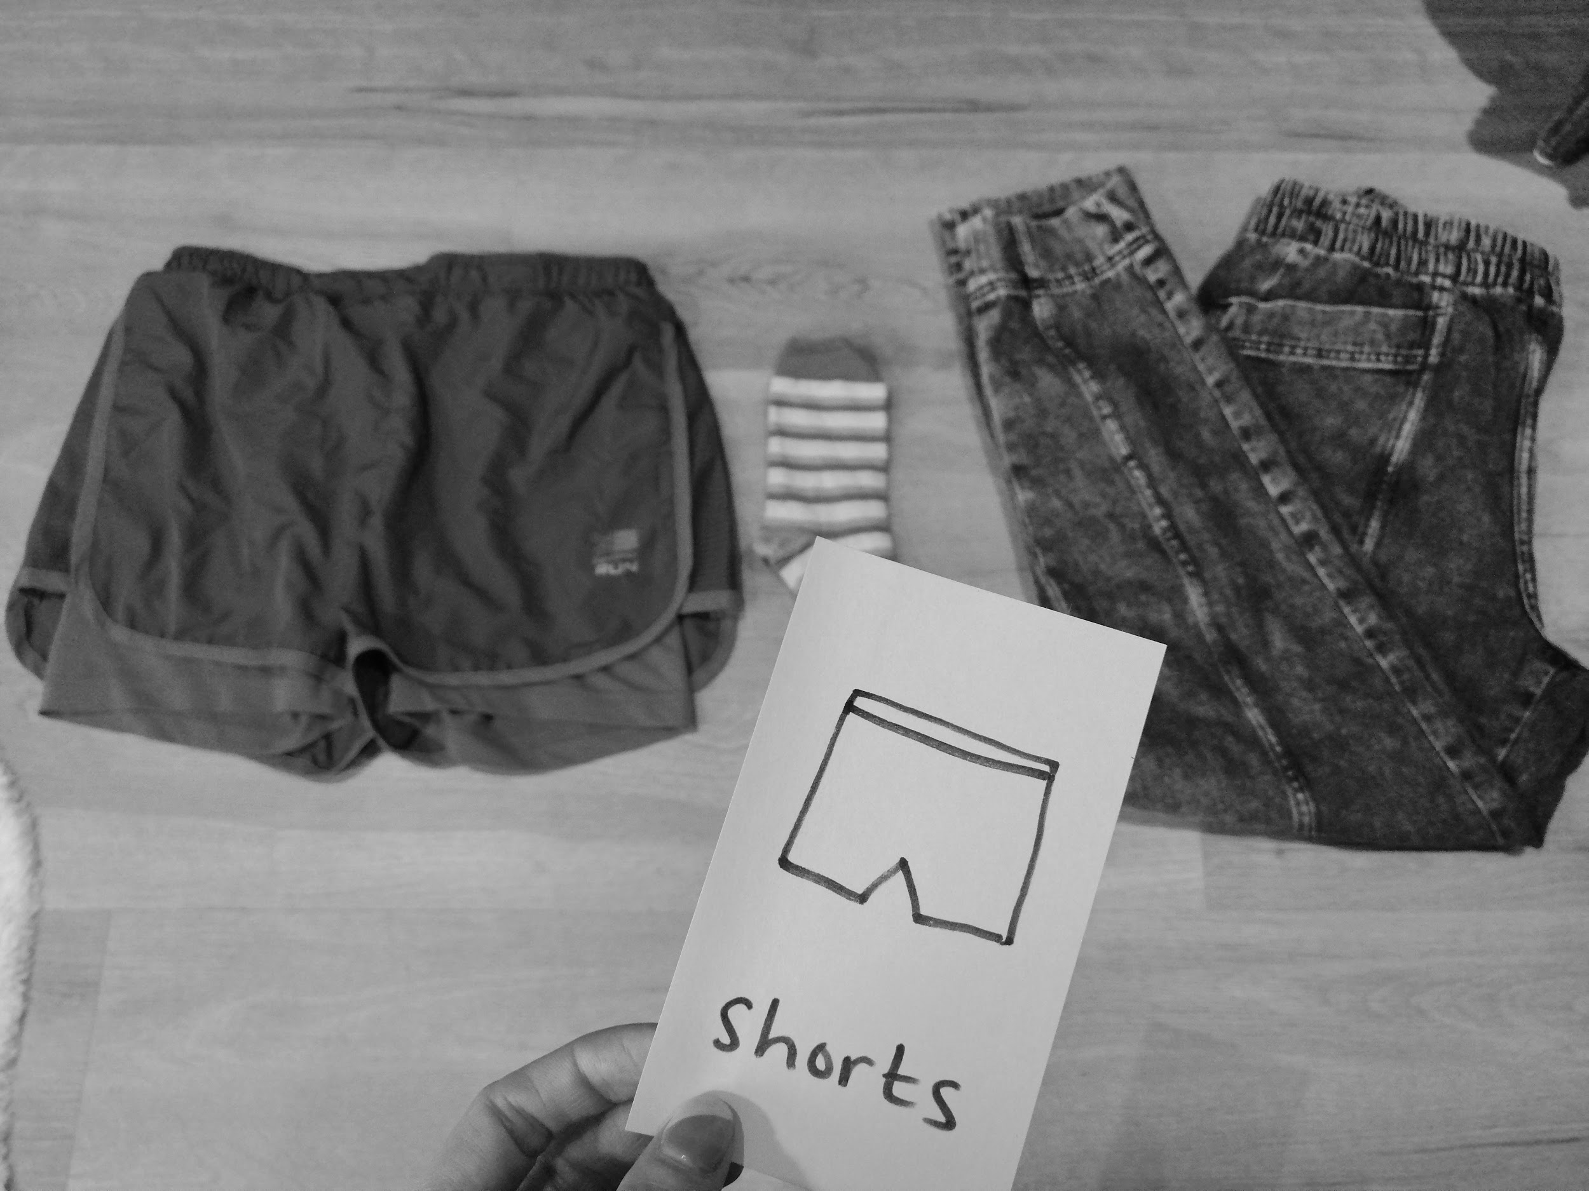
Matching clothes
Images teacher’s own
Notes:
Draw a simple image of common clothing items familiar to your learner e.g. T-shirt, trousers, sock, shorts.
Collect one of each of the items you’ve drawn. Lay at least two (or more if appropriate for your learner) in front of your leaner and hold one of your images up. Ask your learner ‘where is the t-shirt?’ Or ‘find t-shirt’. Increase the number of items for level of challenge. Can you leaner find the T-shirt when there are more items to choose from? Complete activity in the bedroom if possible. Change items e.g. different t-shirts.

Slide 10
2. Sorting clothes
By item e.g. t-shirts, jumpers, dresses | By colour e.g. all the blue clothes together
For washing e.g. lights and darks | By size
By family member e.g. which clothes belong to Mum/brother? | By weather e.g. summer/winter/rainy

Slide 11
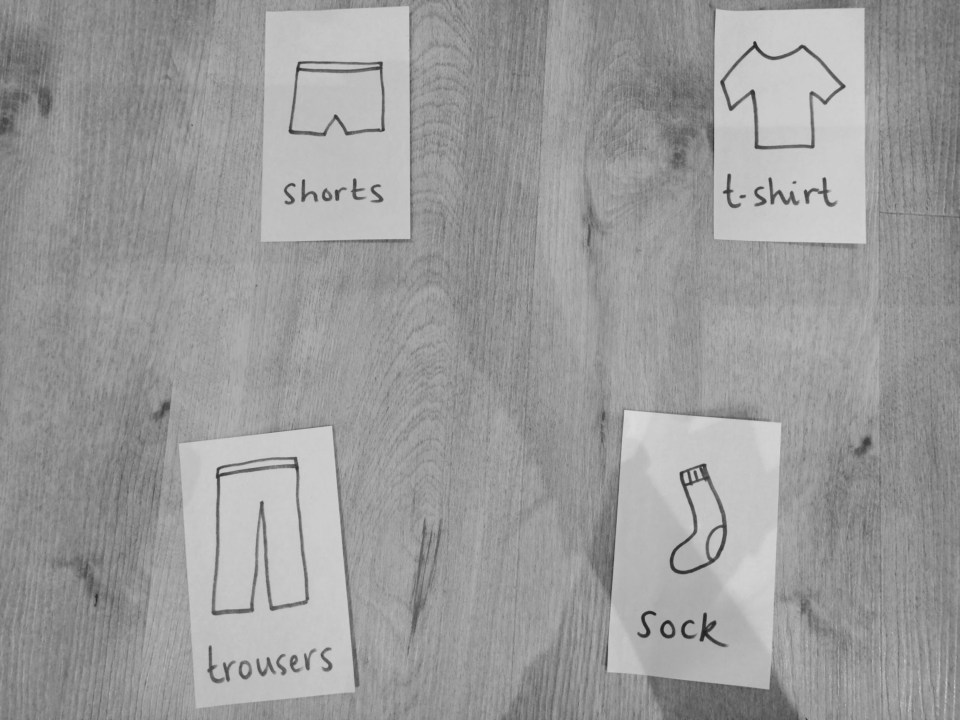
Sorting clothes
Notes:
You can choose to sort clothes into categories that best suit your learner and their understanding and independence. It is a good idea to start sorting clothes by item e.g. putting all the t-shirts together, all the trousers together etc. Use the images you have drawn for the matching tasks to support the learning. Use the table on the previous slide to try sorting by different categories.

Slide 12
3. Folding clothes
If you are unsure how to fold your clothes, get a parent or carer to show you first, then have a go by yourself.
Notes:
Collect t-shirts and clothing items that are easy to fold. Use the video linked to this lesson to learn how to teach folding clothes.

Slide 13
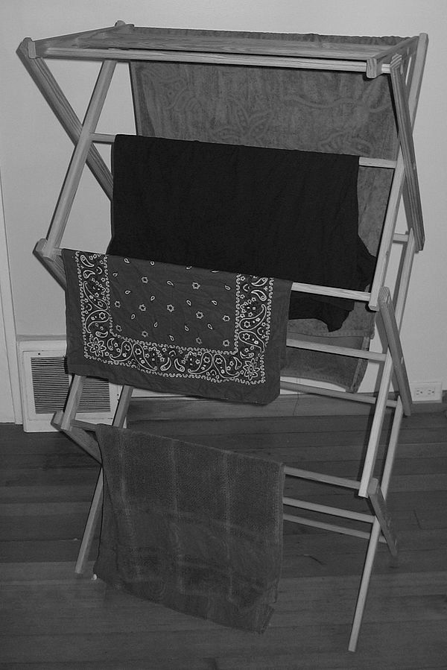
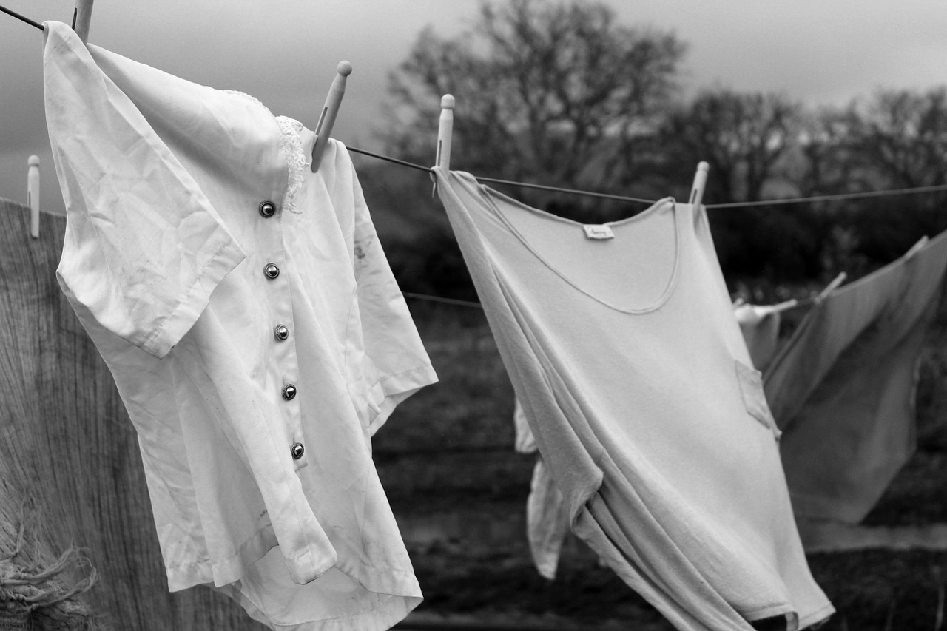
4. Hanging clothes
coat hanger
airer
washing line
Notes:
Talk about how there are different ways to hang clothes. How do you hang your clothes at home? Can you practice hanging clothes like the examples on the slide?

Slide 14
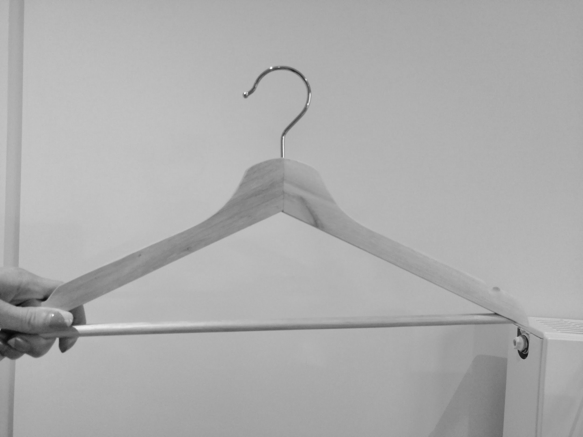
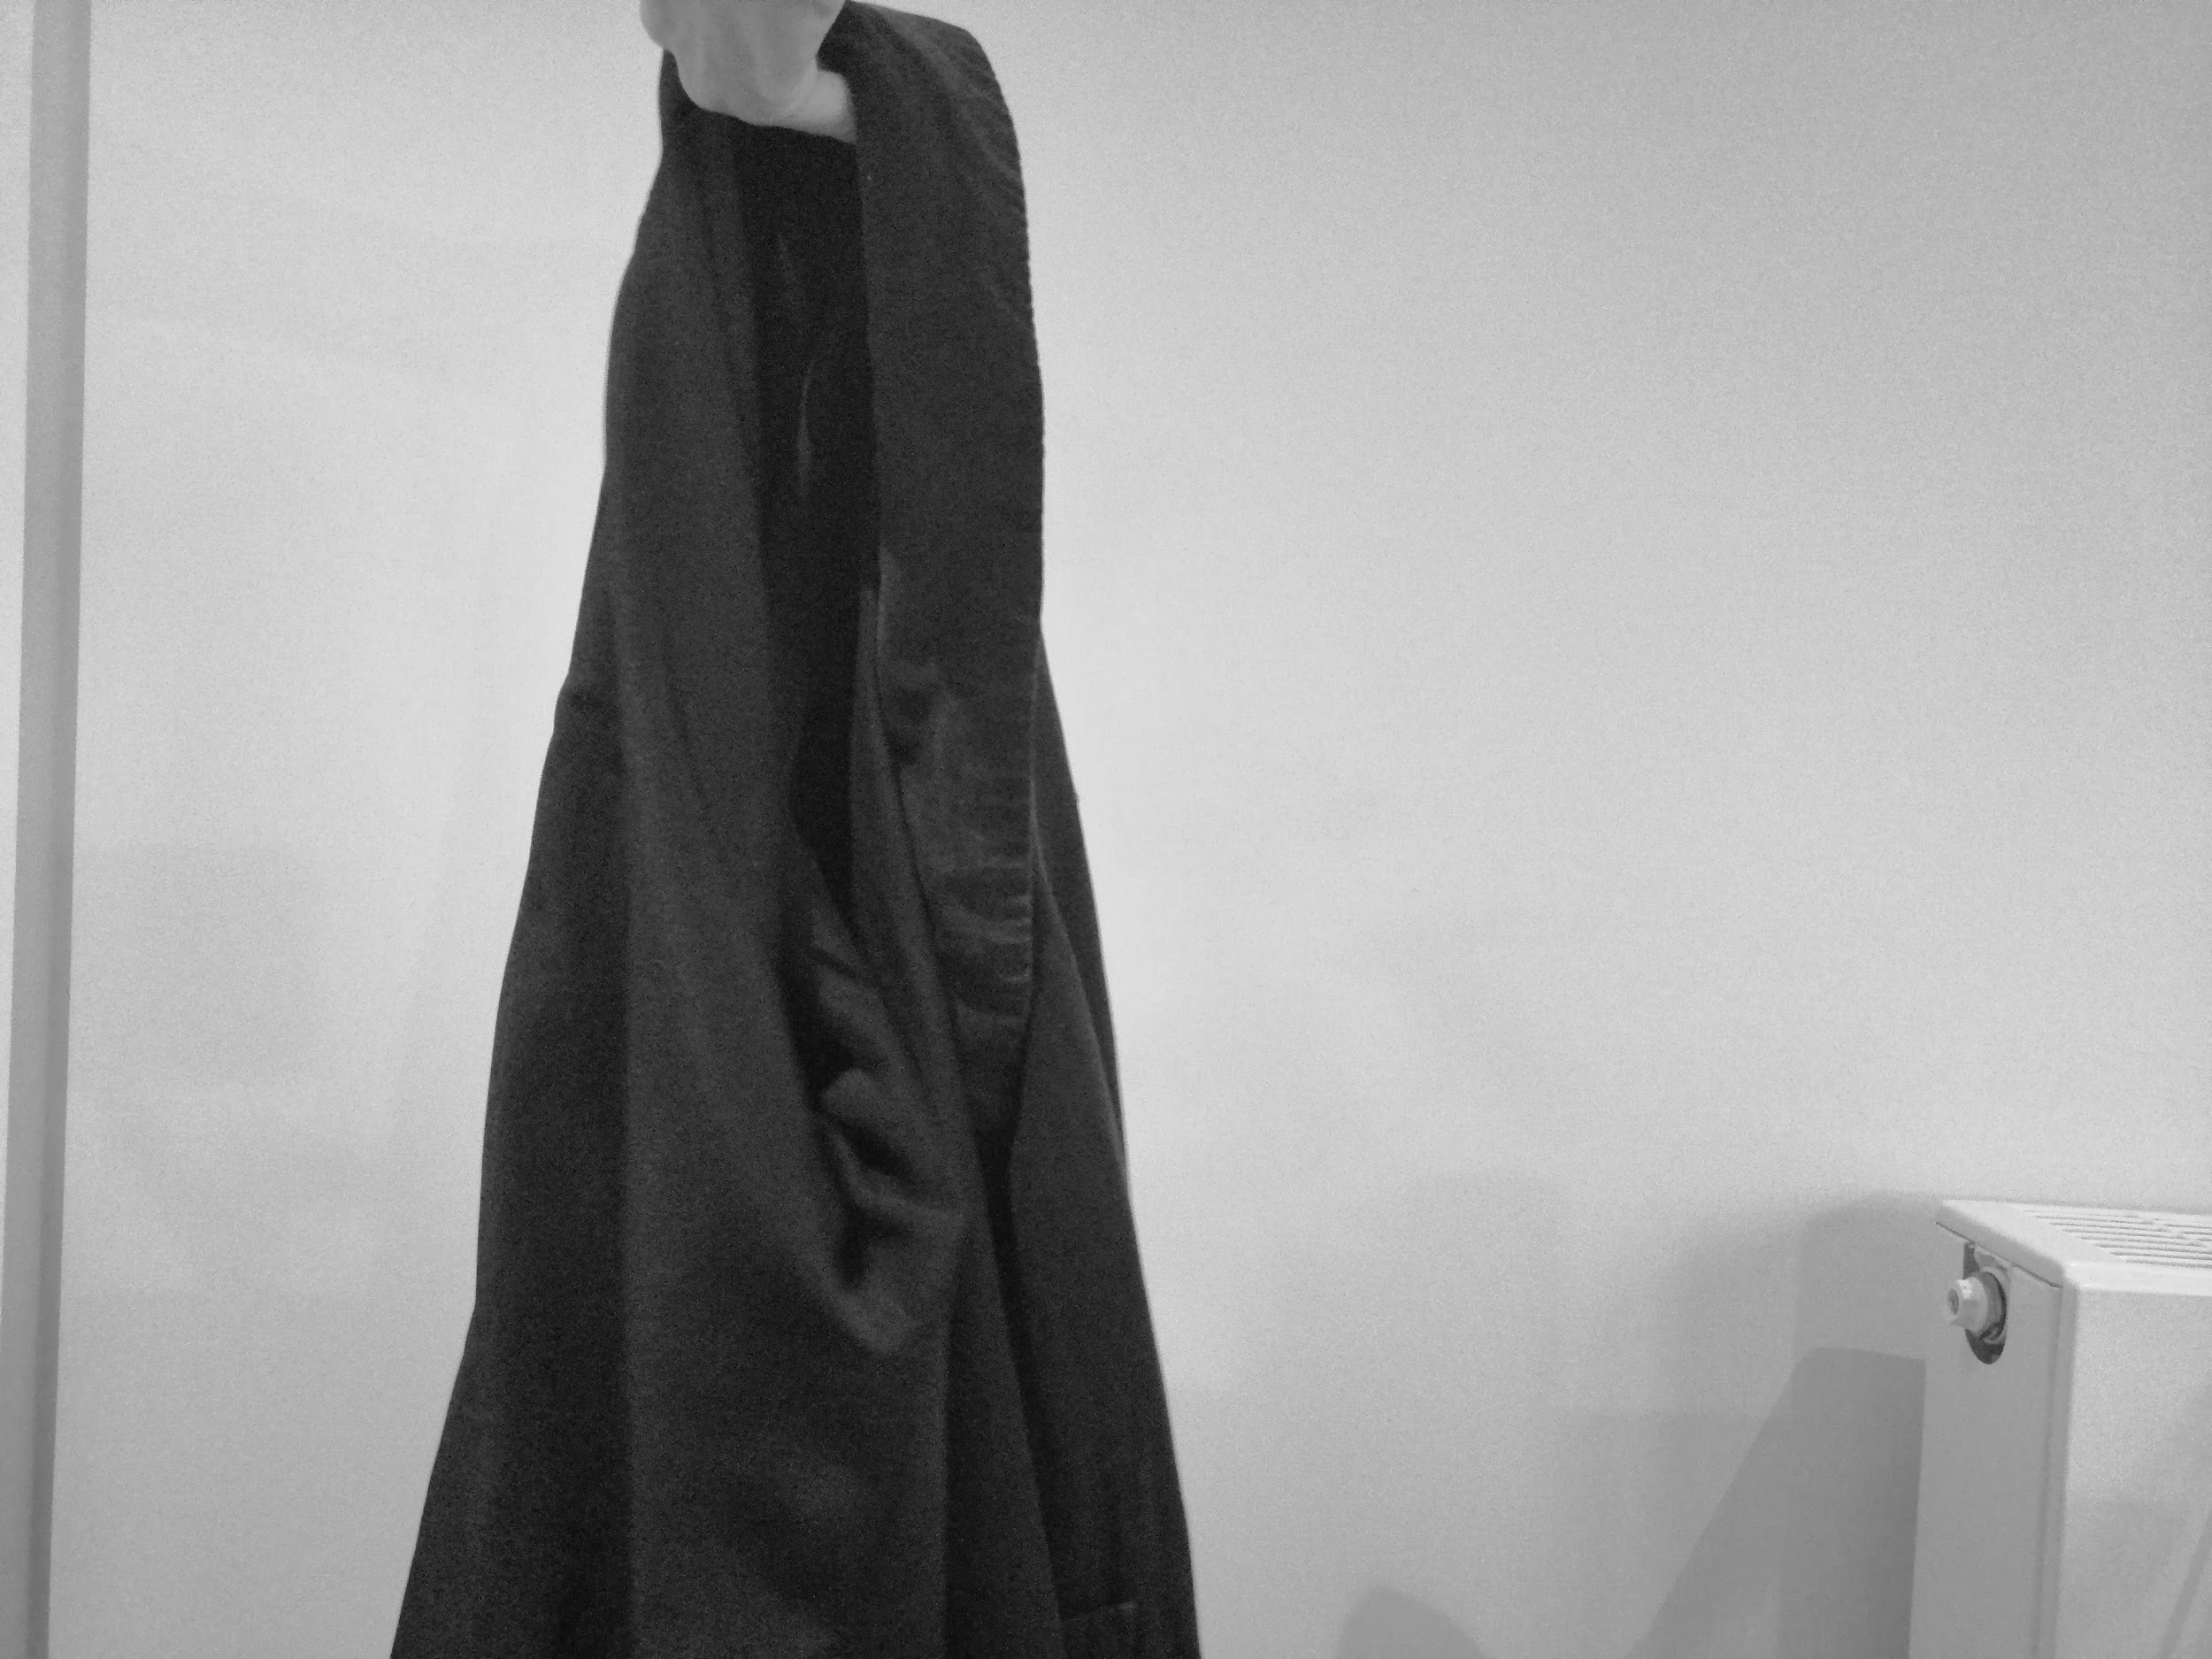
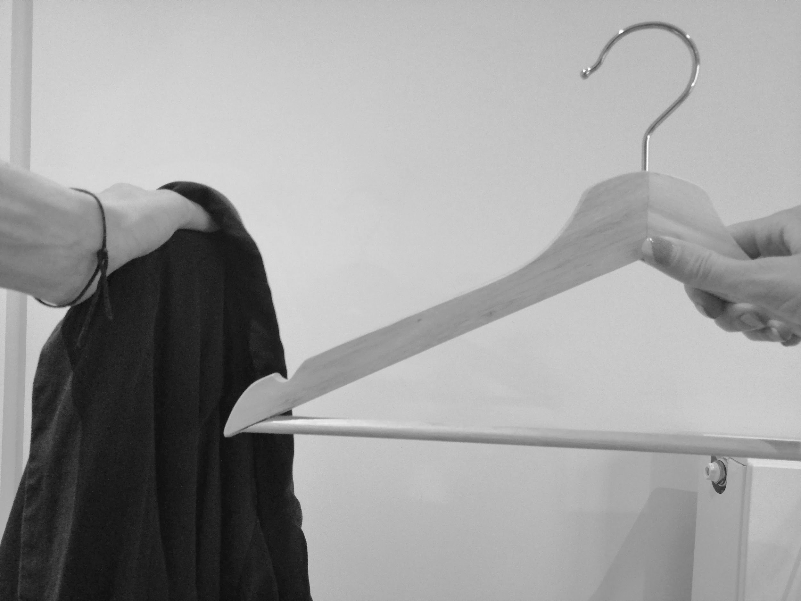
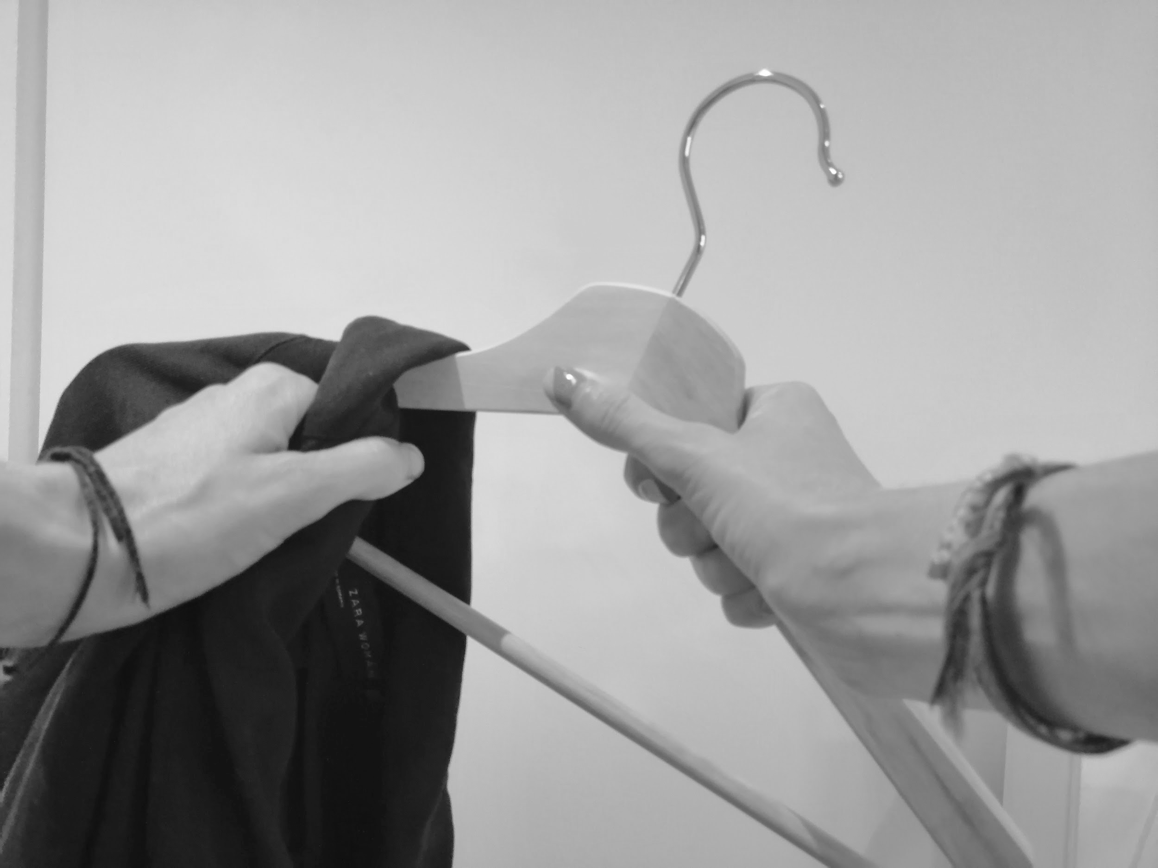
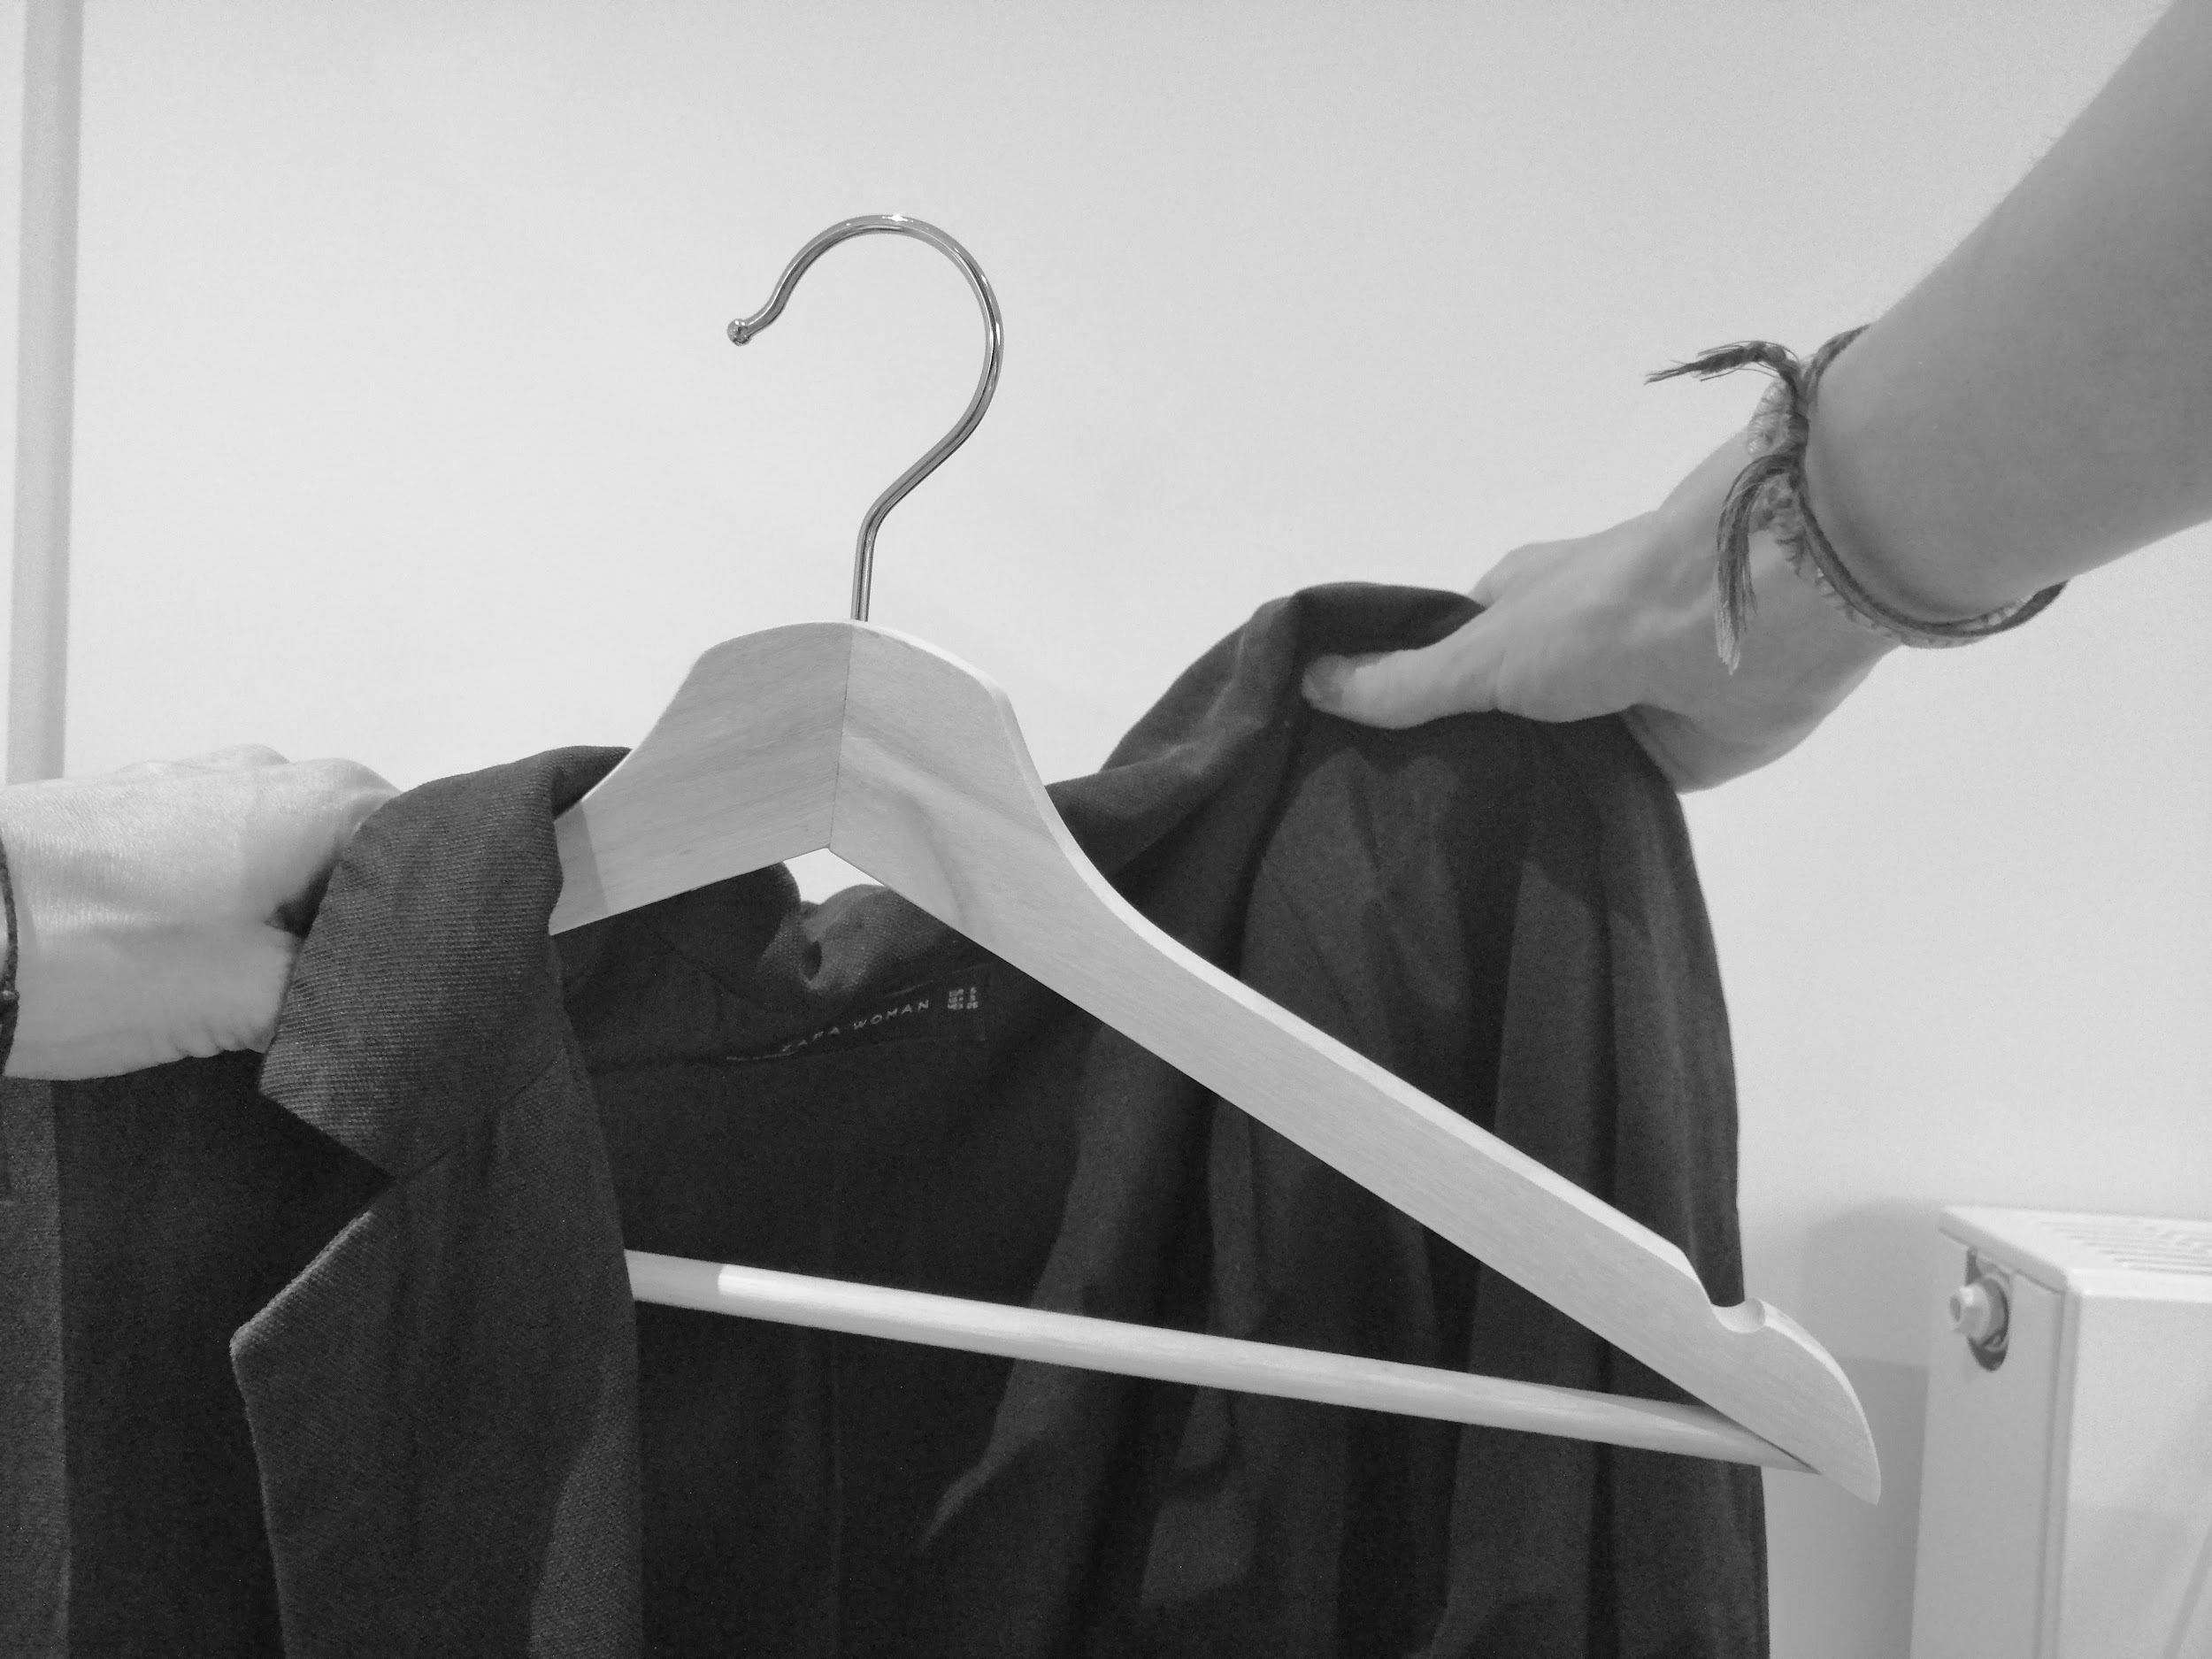
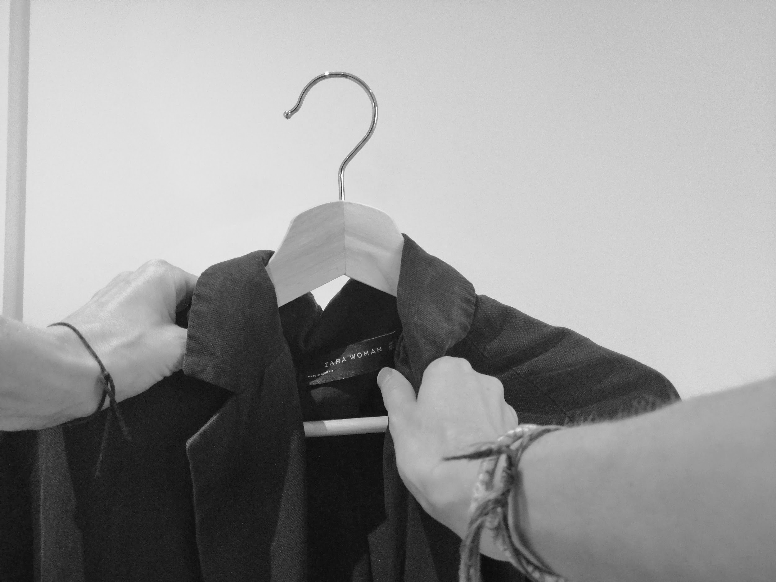
Hanging clothes
1. Get hanger | 2. Get jacket | 3. Put jacket in one hand and hanger in the other
4. Put hanger into the jacket | 5. Hold jacket and hanger with one hand | 6. Pull jacket round to the front of the hanger
Images teacher’s own
Notes:
Collect hangers and jackets which are easy to hang. Create a sequence in which to hang a jacket on a coat hanger. E.g. how many steps? Repeat this sequence when teaching. If your learner is unable to complete the full sequence from the beginning, complete the first steps yourself and they can complete the rest. Learners can build independence by completing less steps with support over time so that they are completing more and more of the sequence.
You could print this page use the images to support each step.

Slide 15
Independent Living Home Management
Organising clothes
Make it easier
Make it harder
More ideas
Start with matching or sorting clothes and build independence within the tasks.
Collect pairs of socks and mix them up individually. Can you match the socks together?
Collect the washing from the washing machine and practice hanging wet washing either on an airer or washing line.
If safe to do so, introduce the iron and ironing board.
Use natural contexts to practice and develop these skills e.g. after taking clothes off for bed can you fold them back into the drawers or sort them into clean and dirty?
Notes:
Final slide of the lesson. Suggest adaptations for teachers/parents.

Slide 16
Further Learning with Oak National
Independent Living:
Applying Learning- Organising clothes (Unit 1)
Applying Learning- Preparing for a trip (Unit 3)
Building Understanding- Clothes for occasions (Unit 1)
Communication and Language:
Building Understanding/ Applying Learning- Clothes and fashion (Unit 3)
Notes:
Insert info for subject/lesson name/stage (if appropriate)

Slide 17
References
Slide 7- Two red-and-black foliage crew-neck T-shirts hanging on hanger, Wallpaper Flare / Wardrobe coat hanger, Pxfuel / Basket with dirty laundry, Free SVG / Alison Krejci, Folded laundry stack, Pixabay
Slide 13- Clotheshorse, Trollderella, Wikimedia Commons / Wire hanger silhouette, Public Domain Vectors / Washing line, Pixabay
Slide

