Slide 1
Structures and Bonding
Giant covalent structures: Graphene
Worksheet
Combined Science - Chemistry - Key Stage 4
Mr Robbins

Slide 2
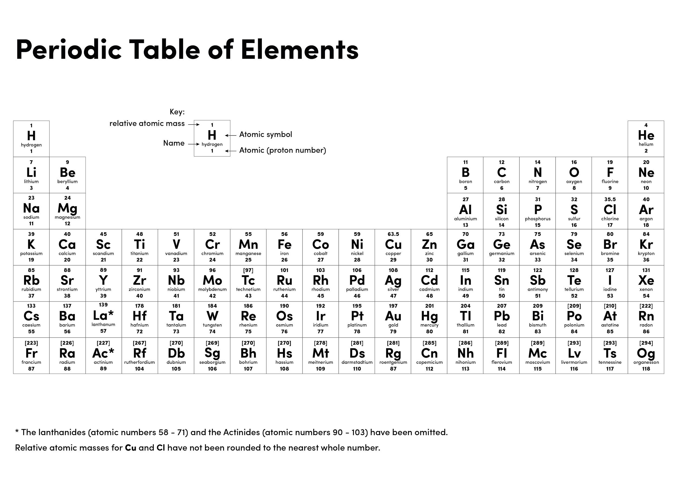

Slide 3
1. (a) This part of the question is about graphene. Choose the correct answer to complete each sentence.
(i) The bonds between the atoms in graphene are .............................................(1)
(ii) Graphene is made of .................................................... atoms. (1)
(iii) In graphene each atom bonds to ...................... other atoms. (1)
(b) This part of the question is about graphite. Graphite is used in pencils. Explain why (2)
2. Graphite is a non-metal. Explain why graphite conducts electricity. (3)
3. Lightweight handlebars for bicycles are made from materials containing carbon nanotubes. Carbon nanotubes are lightweight but very strong.
(a) Complete each sentence.
(i) Carbon nanotubes are similar to graphite because each carbon atom is joined to ________ other carbon atoms.
(ii) The carbon atoms are joined by ______ bonds
(iii) Carbon nanotubes are very strong because the ________________ are hard to break
(b) An airplane contains many miles of electrical wiring made from copper. This adds to the mass of the airplane. It has been suggested that the electrical wiring made from copper could be replaced by lighter carbon nanotubes.
(i) What does the term ‘nano’ tell you about the carbon nanotubes? (1)
(ii) Like graphite, each carbon atom is joined to three other carbon atoms. Explain why the carbon nanotube can conduct electricity. (2)

Slide 4
Answers
(a)
(i) covalent bonds
(ii) carbon
(iii) three
Graphite is made of layers. Between the layers there are delocalised electrons Which can flow.
(a)
(i) three
(ii) covalent
(iii) covalent bonds
(b)
(i) they are very small
(ii) They have delocalised electrons. Which can flow

Slide 5
Practice question
Carbon nanotubes are made from a single layer of graphite. Carbon nanotubes have a high melting point, are good conductors and incredibly strong in tension
Use your knowledge of structures and bonding to explain these properties [3 marks]
Sentence starters:
Carbon nanotubes have a high melting point because…..
Carbon nanotubes are strong because…
Carbon nanotubes are good conductors of electricity becasue….
Notes:
Pause and write

Slide 6
Practice question
Carbon nanotubes are made from a single layer of graphite. Carbon nanotubes have a high melting point, are good conductors and incredibly strong in tension
Use your knowledge of structures and bonding to explain these properties [3 marks]
Answer
Carbon nanotubes have a high melting point because they have strong covalent bonds which take a lot of heat energy to break
Carbon nanotubes are are also very strong because of these strong covalent bonds
Carbon nanotubes are good conductors of electricity because they have delocalised electrons which are able to flow through the tube

