Slide 1
Decrease by a Percentage
Mathematics
Mr Millar

Slide 2
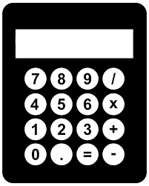
Order the results in size.
Decrease 300 by 40%
Increase 150 by 30%
Decrease 260 by 20%
Decrease 250 by 15%
Increase 180 by 6%
Decrease 200 by 4%

Slide 3
Yasmin and Zaki are arguing over what happens when you increase and then decrease a number by the same amount
If I increase a number by 20%, and then decrease it by 20%, I will get the same number I started with.
I disagree, if you try it with 100 you get a lower number than what you started with

Slide 4
Answers
Answers

Slide 5
Order the results in size.
Decrease 300 by 40%
Increase 150 by 30%
Decrease 260 by 20%
300 x 0.6 = 180
150 x 1.3 = 195
260 x 0.8 = 208
Decrease 250 by 15%
Increase 180 by 6%
Decrease 200 by 4%
250 x 0.85 = 212.5
180 x 1.06 = 190.8
200 x 0.96 = 192

Slide 6
Yasmin and Zaki are arguing over what happens when you increase and then decrease a number by the same amount
If I increase a number by 20%, and then decrease it by 20%, I will get the same number I started with.
If you increase 100 by 20% you get 120 (100 x 1.2)
If you then decrease 120 by 20% you get 96 (120 x 0.8)
Yasmin is correct!
I disagree, if you try it with 100 you get a lower number than what you started with

