Slide 1
Further chromatography
Worksheet
Combined Science - Chemistry - Key Stage 4
C8 Chemical Analysis
Mr Robbins

Slide 2
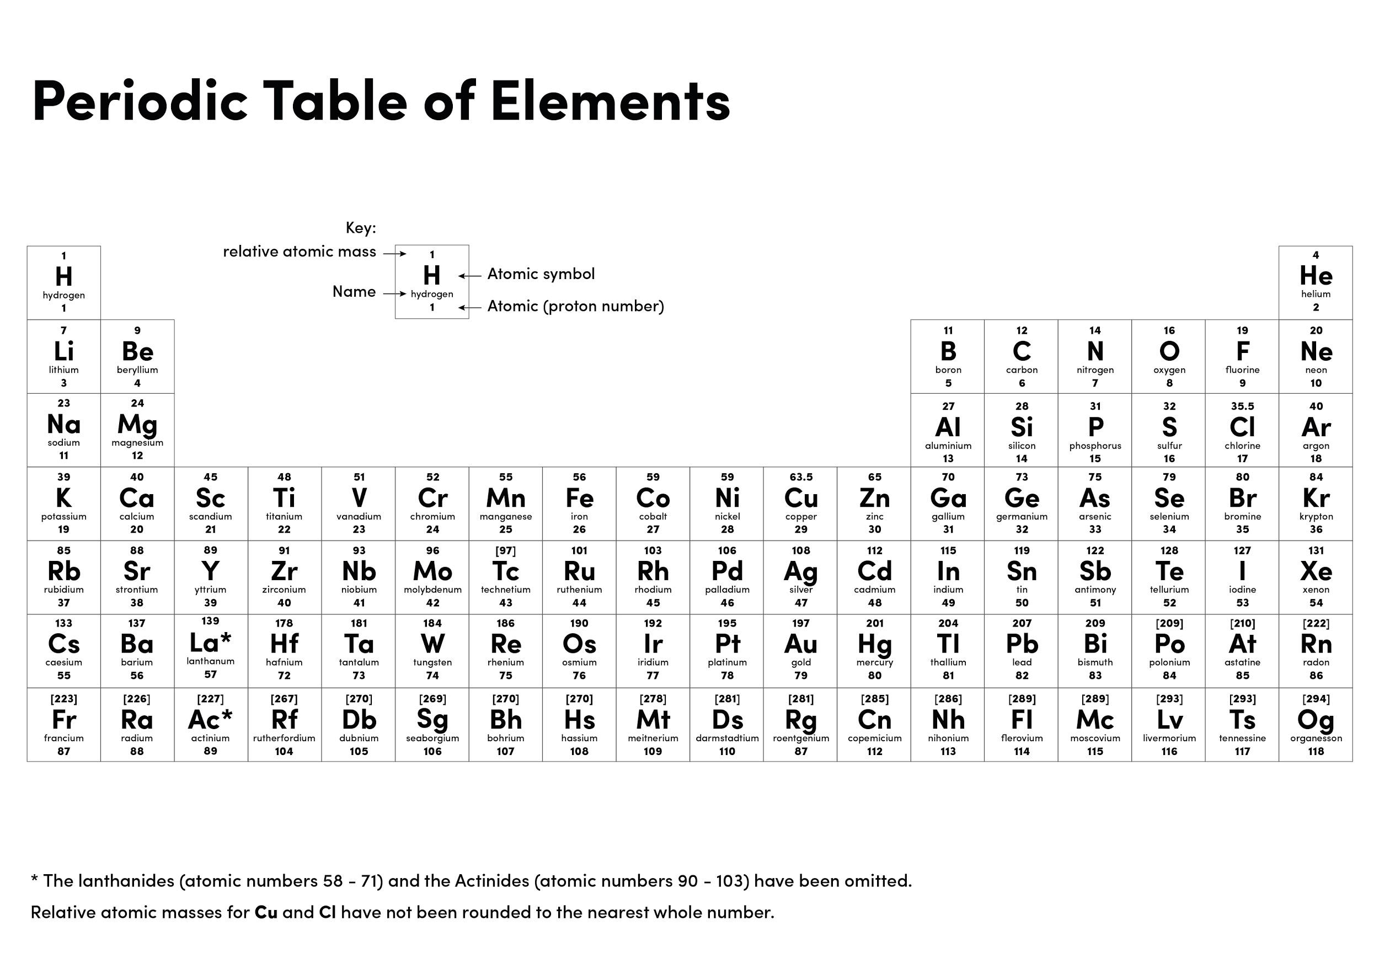

Slide 3
Why do we use a pencil to draw the line in chromatography?
What has to be added to the equipment to ensure ethanol does not evaporate?
What do we call the line made by the solvent when we take it out the beaker?
What is the formula for calculating the Rf value?
Calculate the Rf values of A, B, C.
17cm
20cm
11cm
8cm

Slide 4
So it does not smudge and ruin the chromatogram
A lid
Solvent line
Distance travelled by the spot ÷ Distance travelled by the solvent
Calculate the Rf values of A, B, C.
A = 17/20 = 0.85
B = 8/20 = 0.40 (must be 2d.p.)
C = 11/20 = 0.55
17cm
20cm
11cm
8cm

Slide 5
Calculating Rf
Calculate the Rf for A
12 cm
10 cm

Slide 6
Calculating Rf
2. Calculate the Rf for B
12 cm
4 cm

Slide 7
Calculating Rf
3. Calculate the Rf for C
12 cm
6 cm

