Slide 1
Filament Lamps
Worksheet
Combined Science - Physics - Key Stage 4 - Electricity
Miss Walrond

Slide 2
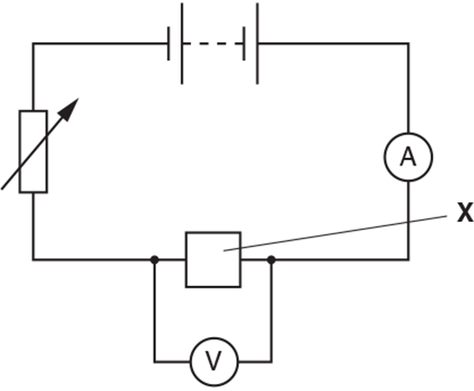
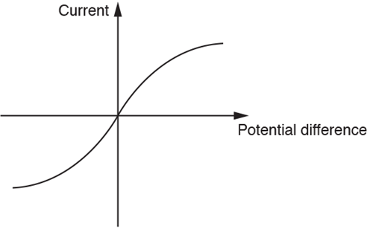
Q1.
A student builds a circuit to investigate the resistance of component X.
The student uses the circuit to take current and potential difference readings.
The student plots a graph of her results.
i. Look at the graph. What is component X in the circuit?
[1]
ii. The resistance of component X varies as the potential difference changes. Describe how the graph shows this and explain why this happens.
[3]
OCR, Gateway Physics B, Paper j249/03, June 2018

Slide 3
Answers

Slide 4
Q1 Answers
i. Filament bulb / filament lamp 1
ii. Gradient / slope of the the graph changes as potential difference changes) 1 Resistance increases as potential difference increases 1 This is because the temperature increases. 1

Slide 5
In lesson questions

Slide 6
Independent Task - Practical - Measuring the resistance of a filament lamp
Name the pieces of apparatus used to measure the current and potential difference.
Describe how we collect a set of data (pairs of different current and potential difference values).
Describe what happened to the brightness of the lamp:
As the potential difference increased the brightness of the lamp …..

Slide 7
Independent Task - Calculating Resistance
Potential Difference (V) | Current (A) | Resistance (𝛀)
2.79 | 0.20 | 14.0
1.76 | 0.16
0.89 | 0.11
0 | 0
-0.89 | -0.10
-1.80 | -0.17
-2.78 | -0.20

Slide 8
Independent Task - The Filament Lamp
Explain how the resistance of the filament lamp changes as potential difference increases. Use the sentence starters below:
As the potential difference increases the delocalised electrons collide …..
When the delocalised electrons collide they transfer …..
This transfer of energy causes the filament wire to heat up and the ions ……..
These vibrations mean that it is harder for the electrons ………
This results in the resistance ……..

Slide 9
Independent Task - I-V Graph
Sketch the I-V graph shown on the right.
Describe how the steepness of the line is related to the resistance.
When the line is steep the resistance is ….
When the line is shallow….
Describe how the resistance varies for a filament lamp as the potential difference changes.

Slide 10
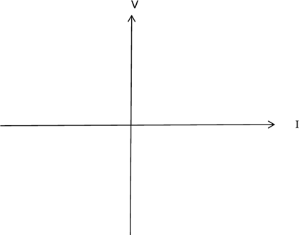
Worked Example
i. Draw a circuit diagram that could be used to find out how the resistance of a filament bulb changes with current.
Describe the readings you need to take.
[4]
ii. Sketch the shape of the graph using the axes below.
State how this graph can be used to calculate resistance at any specific value of current.
[2]
OCR, Gateway Physics B, Paper j249/03, Specimen

Slide 11
Answers

Slide 12
Review: Practical - Measuring the resistance of a resistor
Name the pieces of apparatus used to measure the current and potential difference.
The current is measured with an ammeter.
The potential difference is measured with a voltmeter.
Describe how we collect a set of data (pairs of different current and potential difference values).
We collect a set of data pairs by adjusting the variable resistor to vary the current.
Describe what happened to the brightness of the lamp:
As the potential difference increased the brightness of the lamp increased.

Slide 13
Review: Independent Task - Calculating Resistance
Potential Difference (V) | Current (A) | Resistance (𝛀)
2.79 | 0.20 | 14.0
1.76 | 0.16 | 11.0
0.89 | 0.11 | 8.1
0 | 0 | 0
-0.89 | -0.10 | 8.9
-1.80 | -0.17 | 10.6
-2.78 | -0.20 | 13.9

Slide 14
Review: Independent Task - The Filament Lamp
As the potential difference increases the delocalised electrons collide more often with the ions in the filament wire.
When the delocalised electrons collide they transfer energy.
This transfer of energy causes the filament wire to heat up and the ions vibrate more.
These vibrations mean that it is harder for the electrons to pass through the filament wire.
This results in the resistance increasing.

Slide 15
I-V Graph for Lamp
2) When the line is steep the resistance is low.
When the line is shallow the resistance is high.
3) When the potential difference is low the resistance is low, but as the potential difference increases the resistance of the filament lamp also increases.

