Slide 1
Negative Indices Worksheet
Mathematics
Miss Oreyomi
Miss Oreyomi

Slide 2
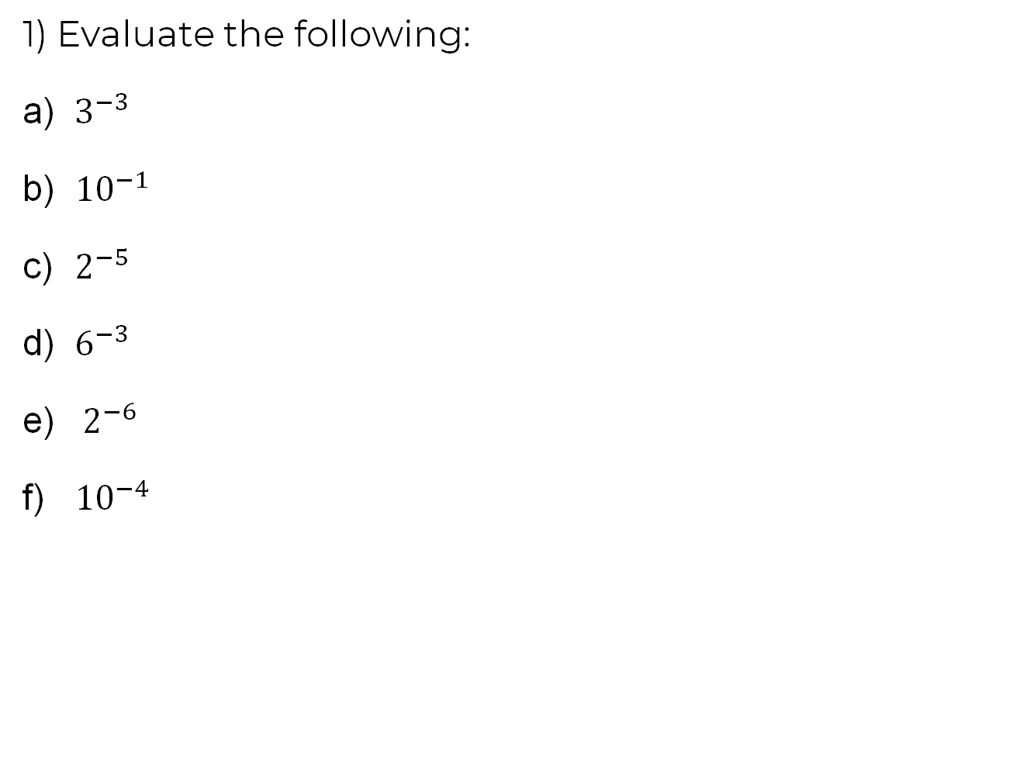
Questions

Slide 3
Questions

Slide 4
Questions

