Slide 1
Use known multiplication facts to derive our 6 times table
Maths
Miss Brinkworth

Slide 2
Part A
Use your 3 times tables to answer these questions.
8 x 6 =
10 x 6 =
12 x 6 =
5 x 6 =
Tim needs more space in his restaurant so he is opening a new room upstairs. He has plenty of tables but not enough chairs. He has 4 large tables big enough for 6 chairs each. How many chairs should he buy?
3

Slide 3
Part B
From today’s learning, what do you think about these statements?
3
How can you prove it?

Slide 4
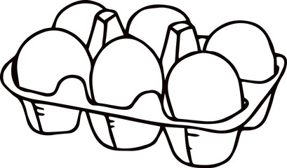
Part C - challenge (Tip: drawing pictures or diagrams might help).
3

