Slide 1
Review 1
Chemistry - Key Stage 4
Organic Chemistry
Miss Mason

Slide 2
Recap
Keywords: fractions, mixture, saturated, unsaturated, double bonds, single bonds, plastic, polymers, fuel, viscous, flammable, boiling point, long chain, short chain.
What is crude oil?
What is the difference between an alkane and an alkene?
What is fractional distillation used for?
Describe the conditions at the bottom of a fractionating column and what is collected there.
Describe the conditions at the top of a fractionating column and what is collected there.
Write out a word equation demonstrating what happens in cracking.
Identify one use of an alkane and one use of an alkene.
If an alkane contains 5 carbon atoms, how many hydrogen atoms will it contain?
If an alkene contains 5 carbon atoms, how many hydrogen atoms will it contain?
Suggest some of the properties of the crude oil fraction, bitumen.

Slide 3
Key word practise
Match up the following key words to their correct definition
Mixture of hydrocarbons with similar boiling points
Crude oil
b) How thick or runny something is
2. Fraction
c) A type of hydrocarbon that contains double bonds and is ‘unsaturated’
3. Hydrocarbon
d) A mixture of hydrocarbons produced from the remains of ancient biomass
4. Alkane
e) A type of hydrocarbon that contains only single bonds and is ‘saturated’
5. Alkene
f) A compound made up of only carbon and hydrogen atoms
6. Cracking
7. Viscosity
g) The process of breaking down long chain alkanes into shorter chain alkanes and alkenes

Slide 4
Fractionating column
Image source: Miss Mason

Slide 5
Which type of cracking is used most in industry and why?

Slide 6
Exam-style questions
What is a hydrocarbon? OR Name 2 elements that can be found in a hydrocarbon

Slide 7
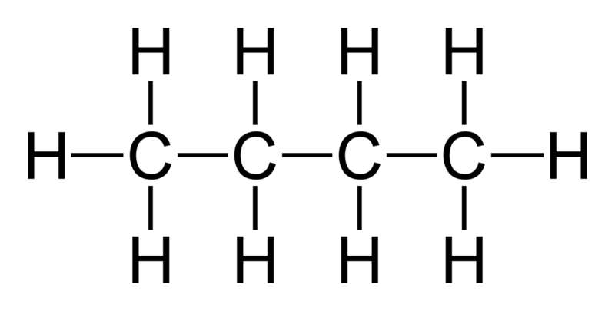
Exam-style questions
What is the chemical formula of this molecule?
[Wikimedia Commons] - [Butan Lewis] - Butane-2D-flat

Slide 8
Exam-style questions
Complete the equation for the reaction during the cracking of C₂₀H₄₂.
C₂₀H₄₂ → C₁₂H₂₆ + _______
b) Heptane is one of the hydrocarbons extracted during fractional distillation.
It has 7 carbon atoms.
What is the formula for heptane?
Notes:
You may also be asked to predict the formula of different hydrocarbons.

Slide 9
Exam-style questions
Describe how increasing the number of carbon atoms within a hydrocarbon can have an effect on its viscosity and flammability.

Slide 10
Exam-style questions
Describe how fractional distillation is used to separate out the different fractions of crude oil.
Gas
<20°C
Petrol
20-70°C
70-160°C
Naphtha
Kerosene
160-250°C
Diesel
250-350°C
Bitumen
>350°C
Image source: Miss Mason

Slide 11
Exam-style questions
Suggest why petrol is more useful as a fuel than bitumen.
Gas
<20°C
Petrol
20-70°C
70-160°C
Naphtha
Kerosene
160-250°C
Diesel
250-350°C
Bitumen
>350°C
Image source: Miss Mason

Slide 12
Exam-style questions
Describe 2 differences between fractional distillation and catalytic cracking.

