Slide 1
Find terms of a linear sequence
Maths
Mr Chan

Slide 2
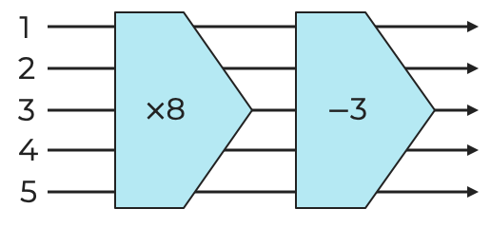
Find terms of a linear sequence
3. Complete the table.
Jack says ‘I will substitute to get the 50th term, then just double it to get the 100th term’.
Comment on Jack’s strategy.
First five terms | nth term | 50th term | 100th term

Slide 3
Find terms of a linear sequence
6. The labels on this Venn diagram are the nth term of linear sequences.
Complete with the numbers 1 - 20
Look at the intersection of the two sets, what sequence are the numbers the first three terms of?

Slide 4
Answers

Slide 5
Find terms of a linear sequence
3. Complete the table.
Jack says ‘I will substitute to get the 50th term, then just double it to get the 100th term’.
Comment on Jack’s strategy.
First five terms | nth term | 50th term | 100th term
5
13
21
29
37
-5, -3, -1, 1, 3
93
193
-4n + 1
-199
-399
3.6, 5.2, 6.8, 8.4, 10
82
162
-4, 1, 6, 11, 16
5, 1, -3, -7, -11
4.2, 5.4, 6.6, 7.8, 9
-0.7, -1.2, -1.7, -2.2, -2.7
This will also double the constant in the nth term and give an incorrect answer.

Slide 6
Find terms of a linear sequence
6. The labels on this Venn diagram are the nth term of linear sequences.
Complete with the numbers 1 - 20
Look at the intersection of the two sets, what sequence are the numbers the first three terms of?
2
12
1
7
9
All terms have 4 or 9 ones and 217 has 7 or
Every term is 1 less than the 5 times table and 217 is 3 less.
3
4
13
11
14
5
10
15
6
19
18
16
17
8
20
A positive integer solution indicates it is in the sequence, it’s the 58th term.

