Slide 1
Area of rectangles, parallelograms and triangles
Maths
Mr Chan

Slide 2
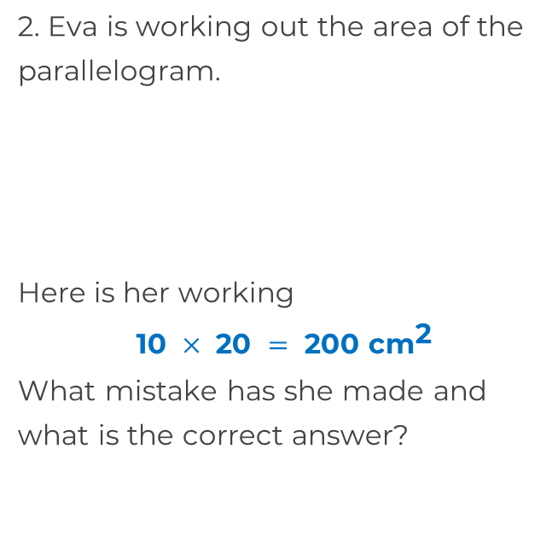
Area of rectangles, parallelograms and triangles
1. Calculate the area of rectangles.
a)
b)
4.5 m
10 cm
8 cm
300 cm
20 cm
5 km
12000 m

Slide 3
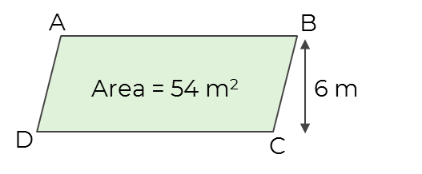
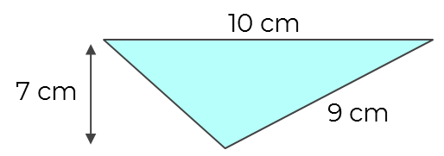
Area of rectangles, parallelograms and triangles
3. Find the length AB.
4. Circle the correct answer for the area of the triangle.
70 cm² 31.5 cm² 45 cm² 35 cm²
5. Which shape has the greatest area?
10 cm
8 cm
4 cm
15 cm
5 cm
4 cm
8 cm
5 cm
7 cm

Slide 4
Answers

Slide 5
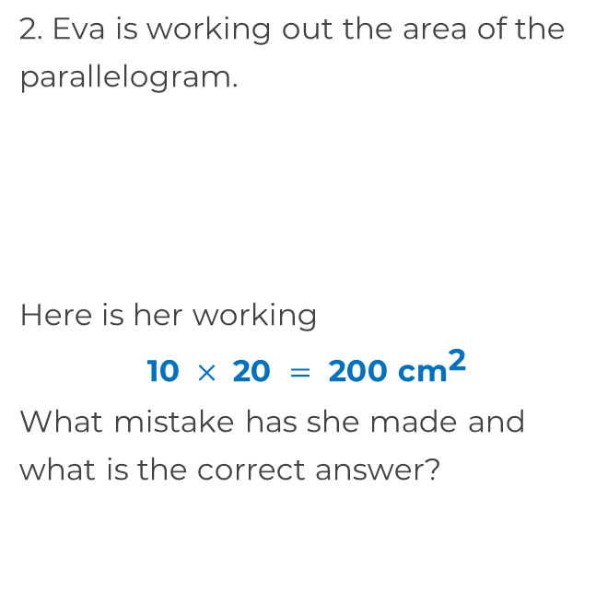
Area of rectangles, parallelograms and triangles
1. Calculate the area of rectangles.
a)
b)
4.5 m
10 cm
8 cm
13.5 m²
300 cm
20 cm
60 km²
5 km
12000 m
She has not multiplied by the perpendicular height (8cm) 160cm²

Slide 6
Area of rectangles, parallelograms and triangles
3. Find the length AB.
4. Circle the correct answer for the area of the triangle.
70 cm² 31.5 cm² 45 cm² 35 cm²
5. Which shape has the greatest area?
9 m
10 cm
8 cm
4 cm
30 cm²
15 cm
5 cm
4 cm
32 cm²
8 cm
5 cm
35 cm²
7 cm

