Slide 1
To compare items using mathematical vocabulary:
Lesson 3 of 4
Numeracy: Measurement - Applying Learning
James

Slide 2
What am I learning today?
Objectives
To identify containers which are ‘empty’ and ‘full’.
To identify items which are ‘light’ and ‘heavy’.
Vocabulary
full empty
heavy light

Slide 3
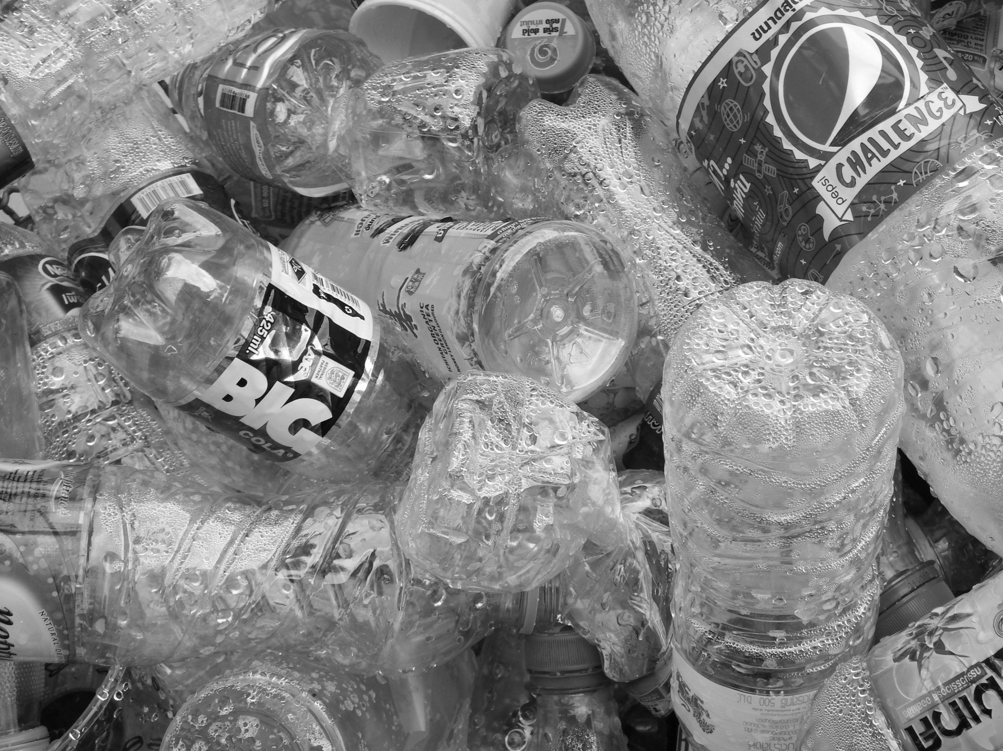
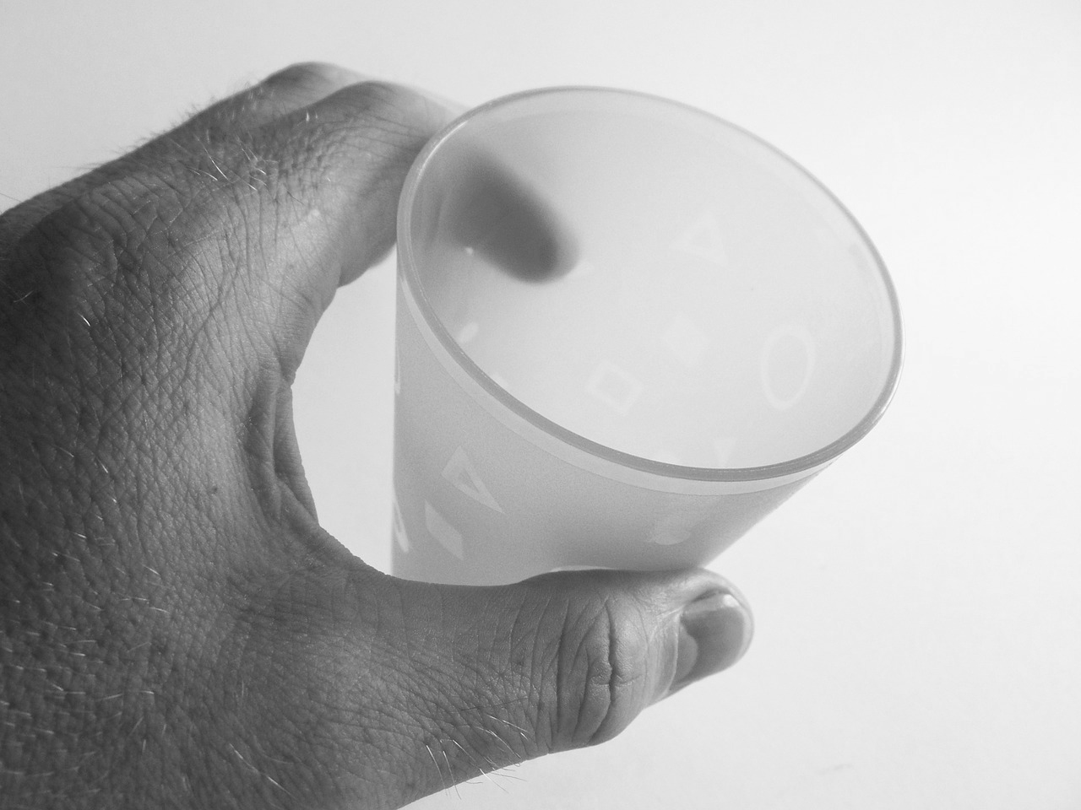
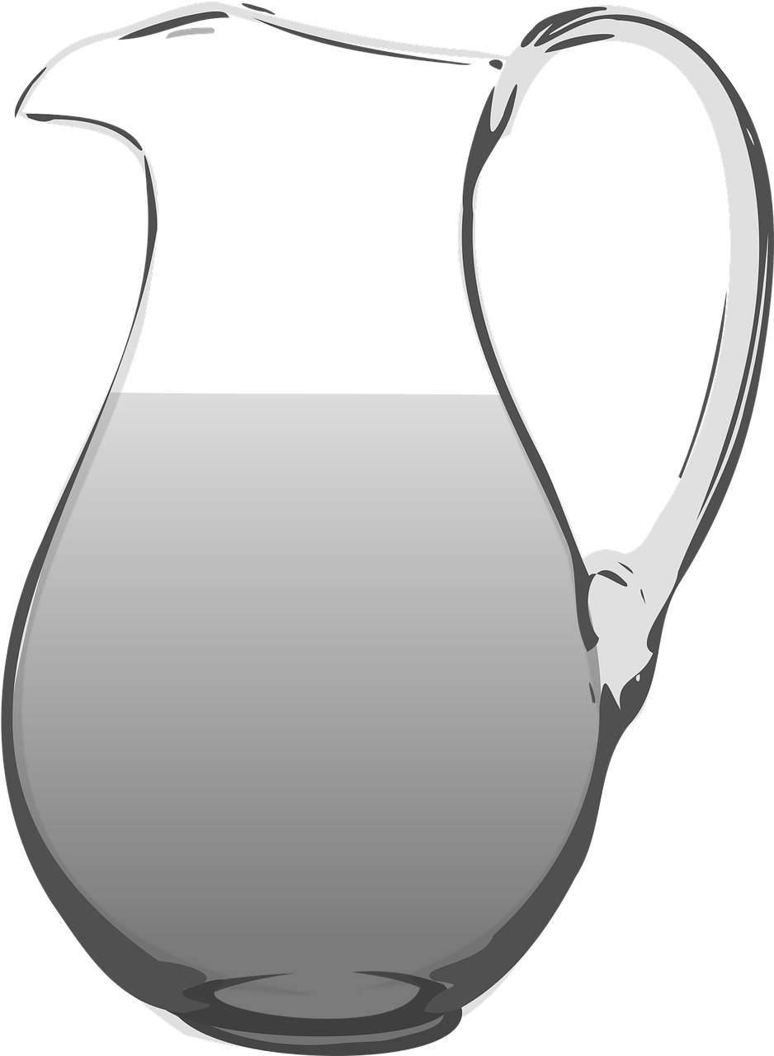
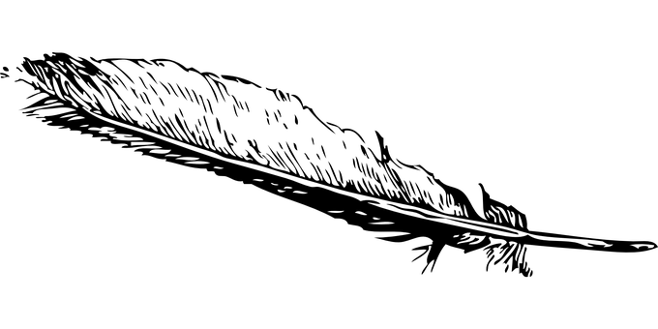
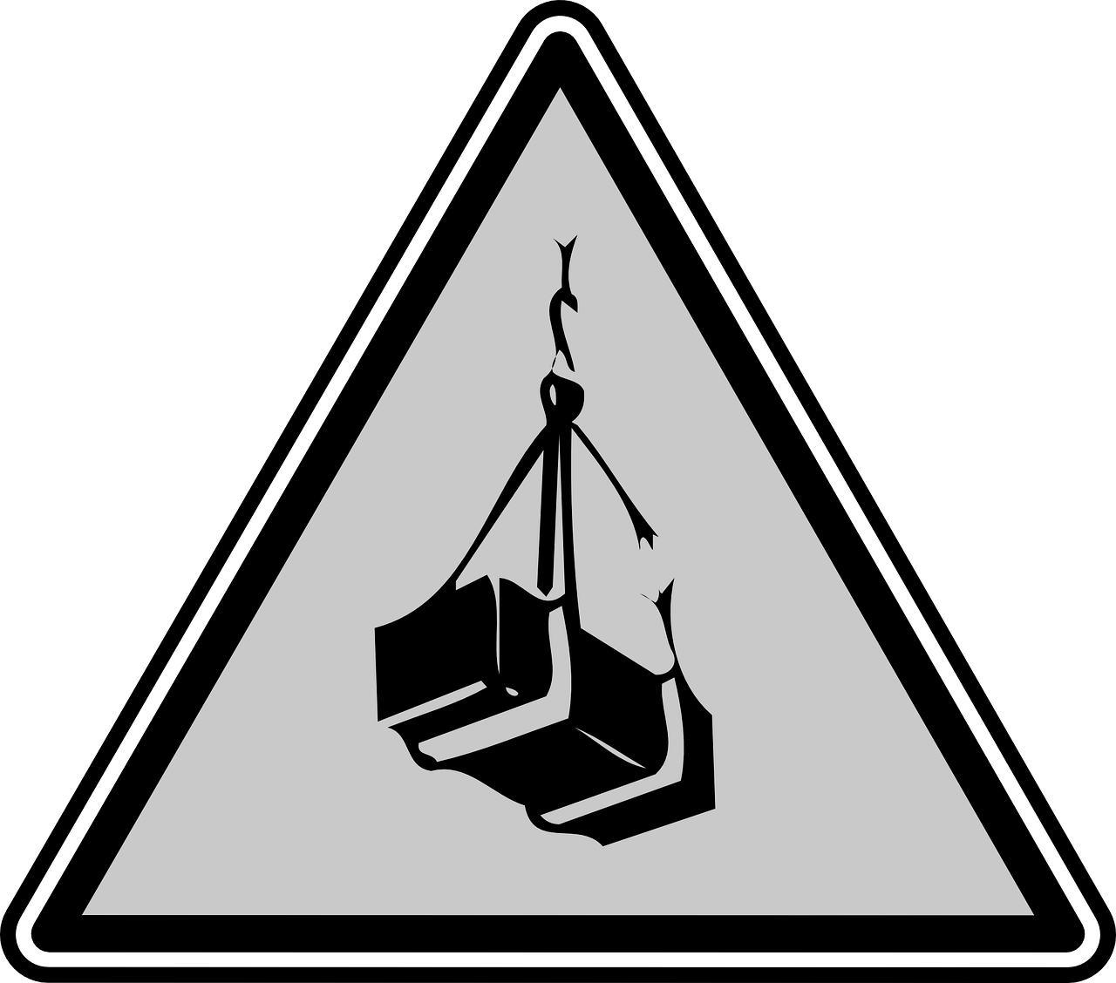
For this lesson, you will need:
Plastic bottles
Water
Cups
Heavy items
Light items
Jugs

Slide 4
Which cup is full?
Credit: Teacher owned image

Slide 5
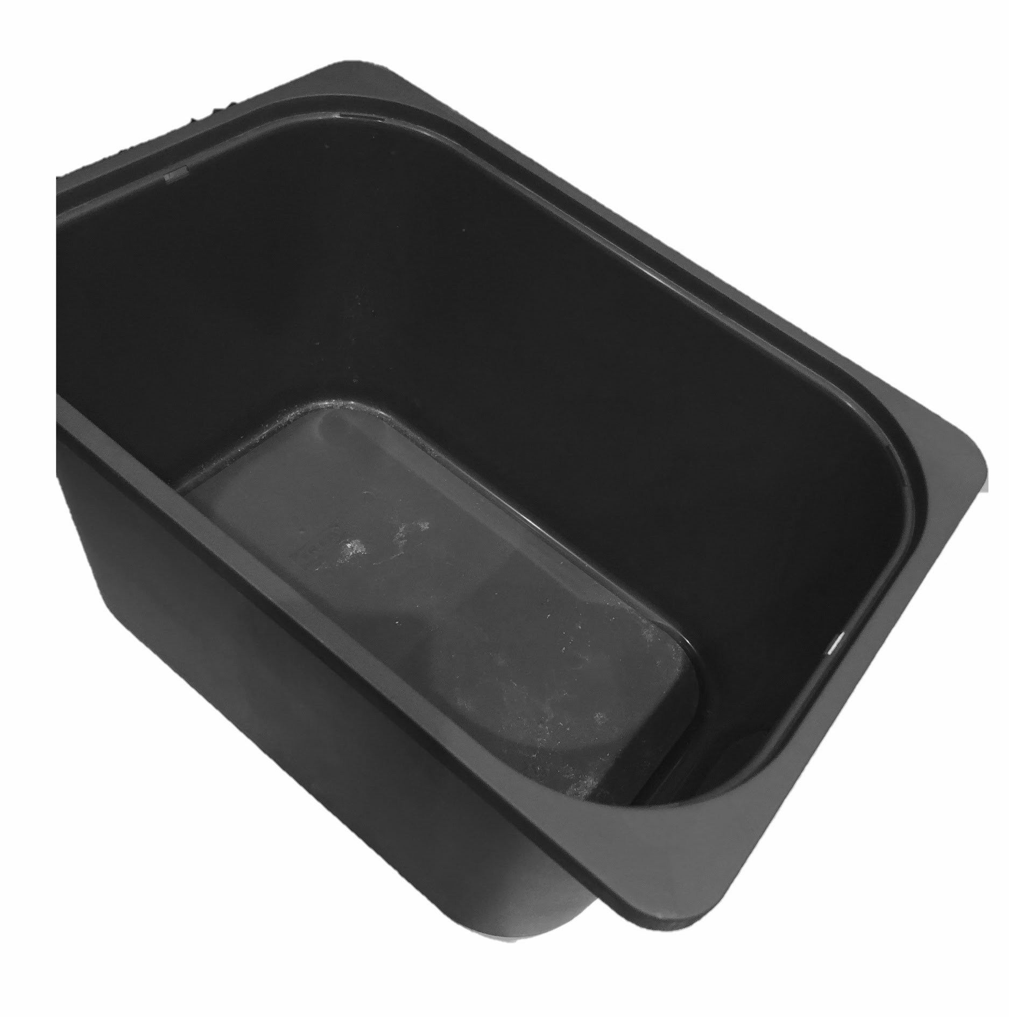
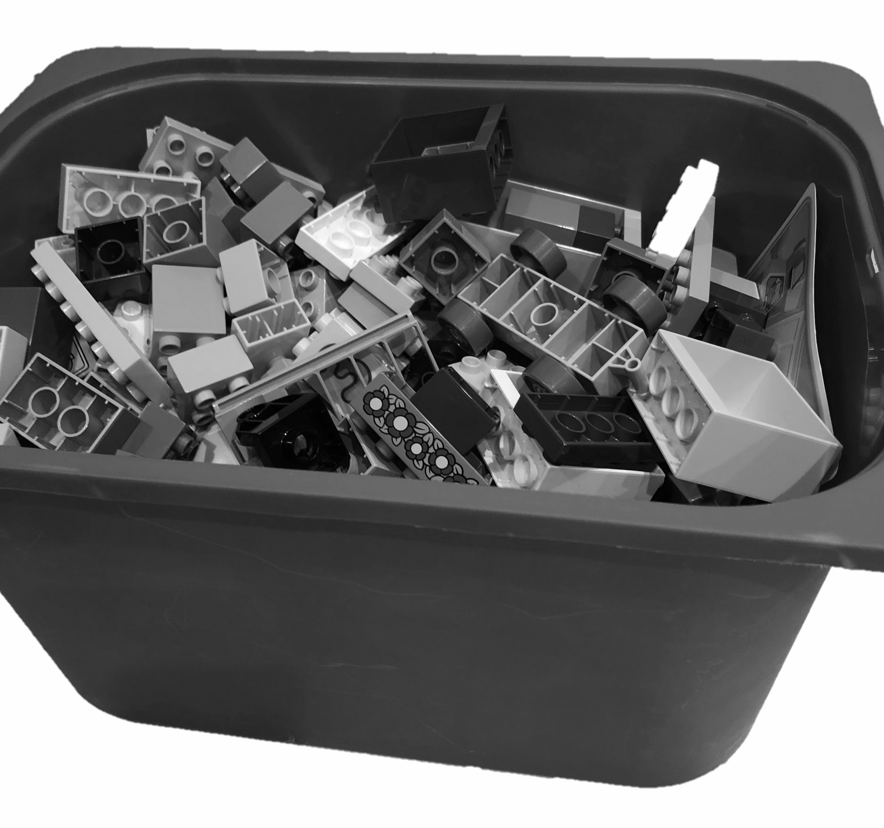
Which box is full?
Credit: Teacher owned image

Slide 6
Which bottle is empty?
Credit: Teacher owned image

Slide 7
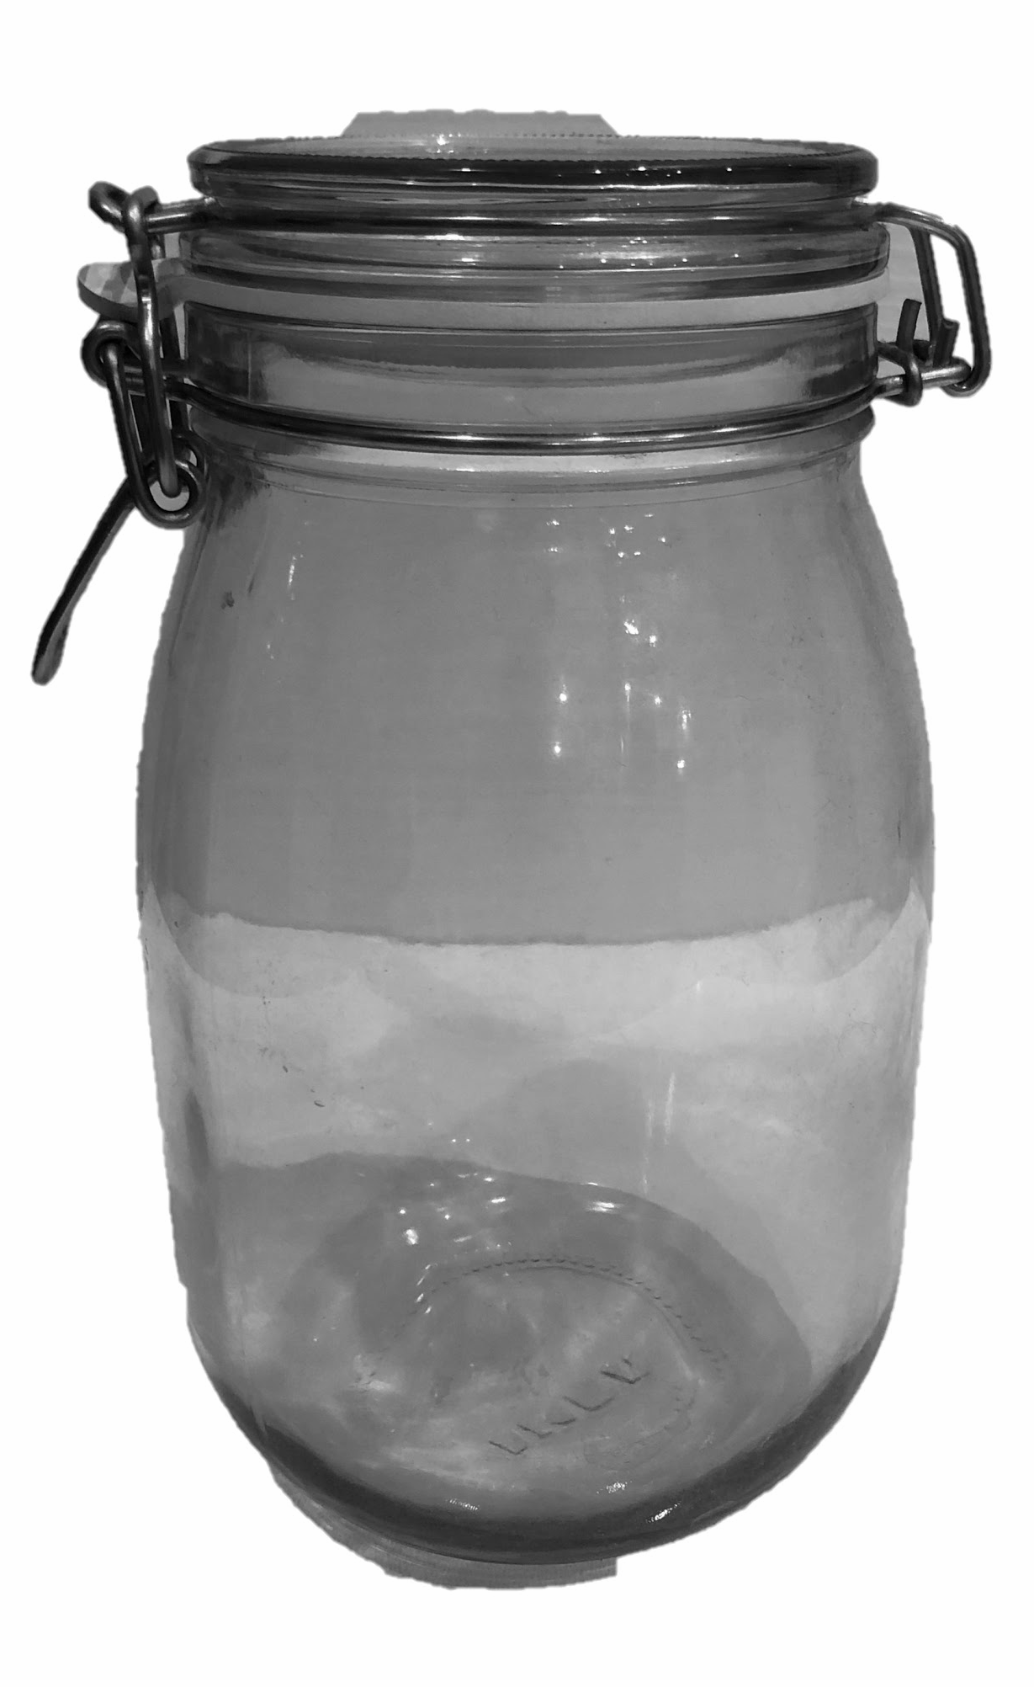
Which jar is empty?
Credit: Teacher owned image

Slide 8
Task
Full and Empty
Can you explore the different items?
Can you fill a container and know when to stop?
Can you identify containers which are full and empty?

Slide 9
Which box is heavy?
Credit: Teacher owned image

Slide 10
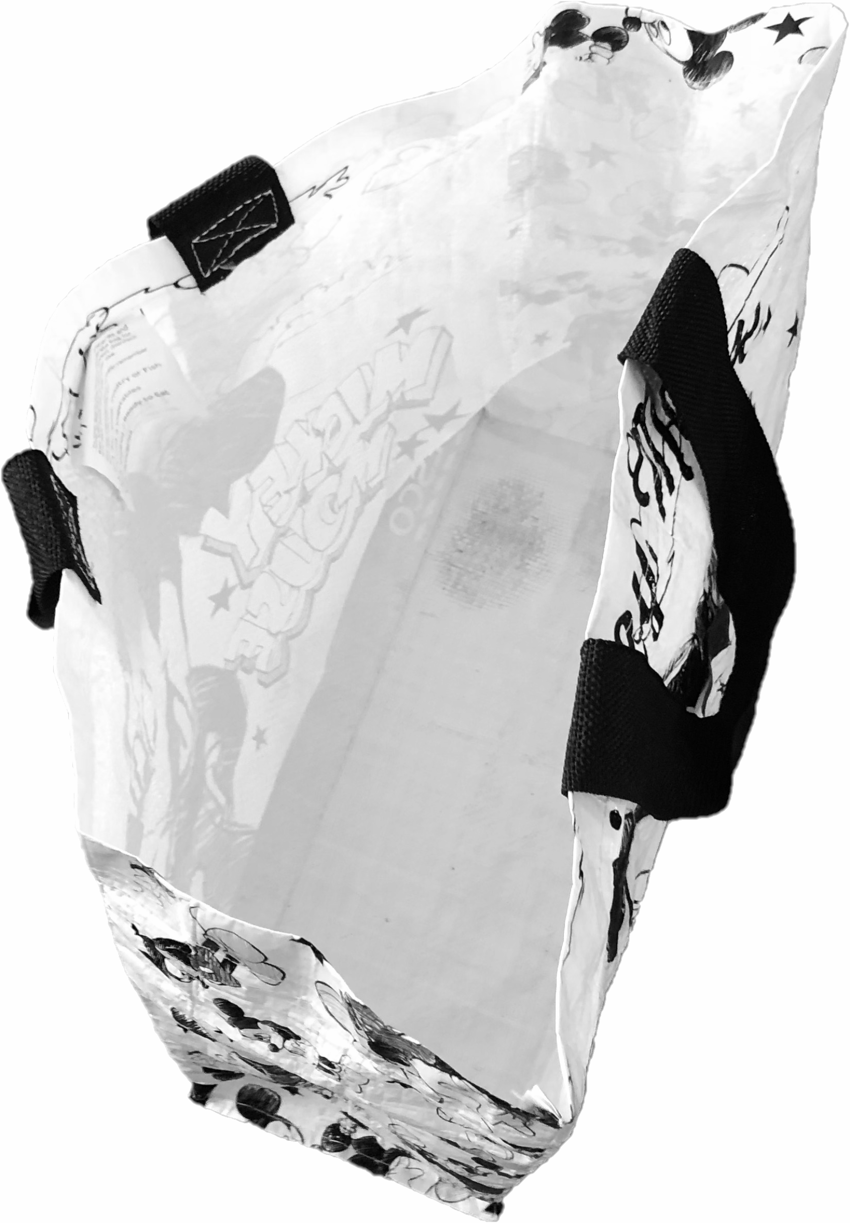
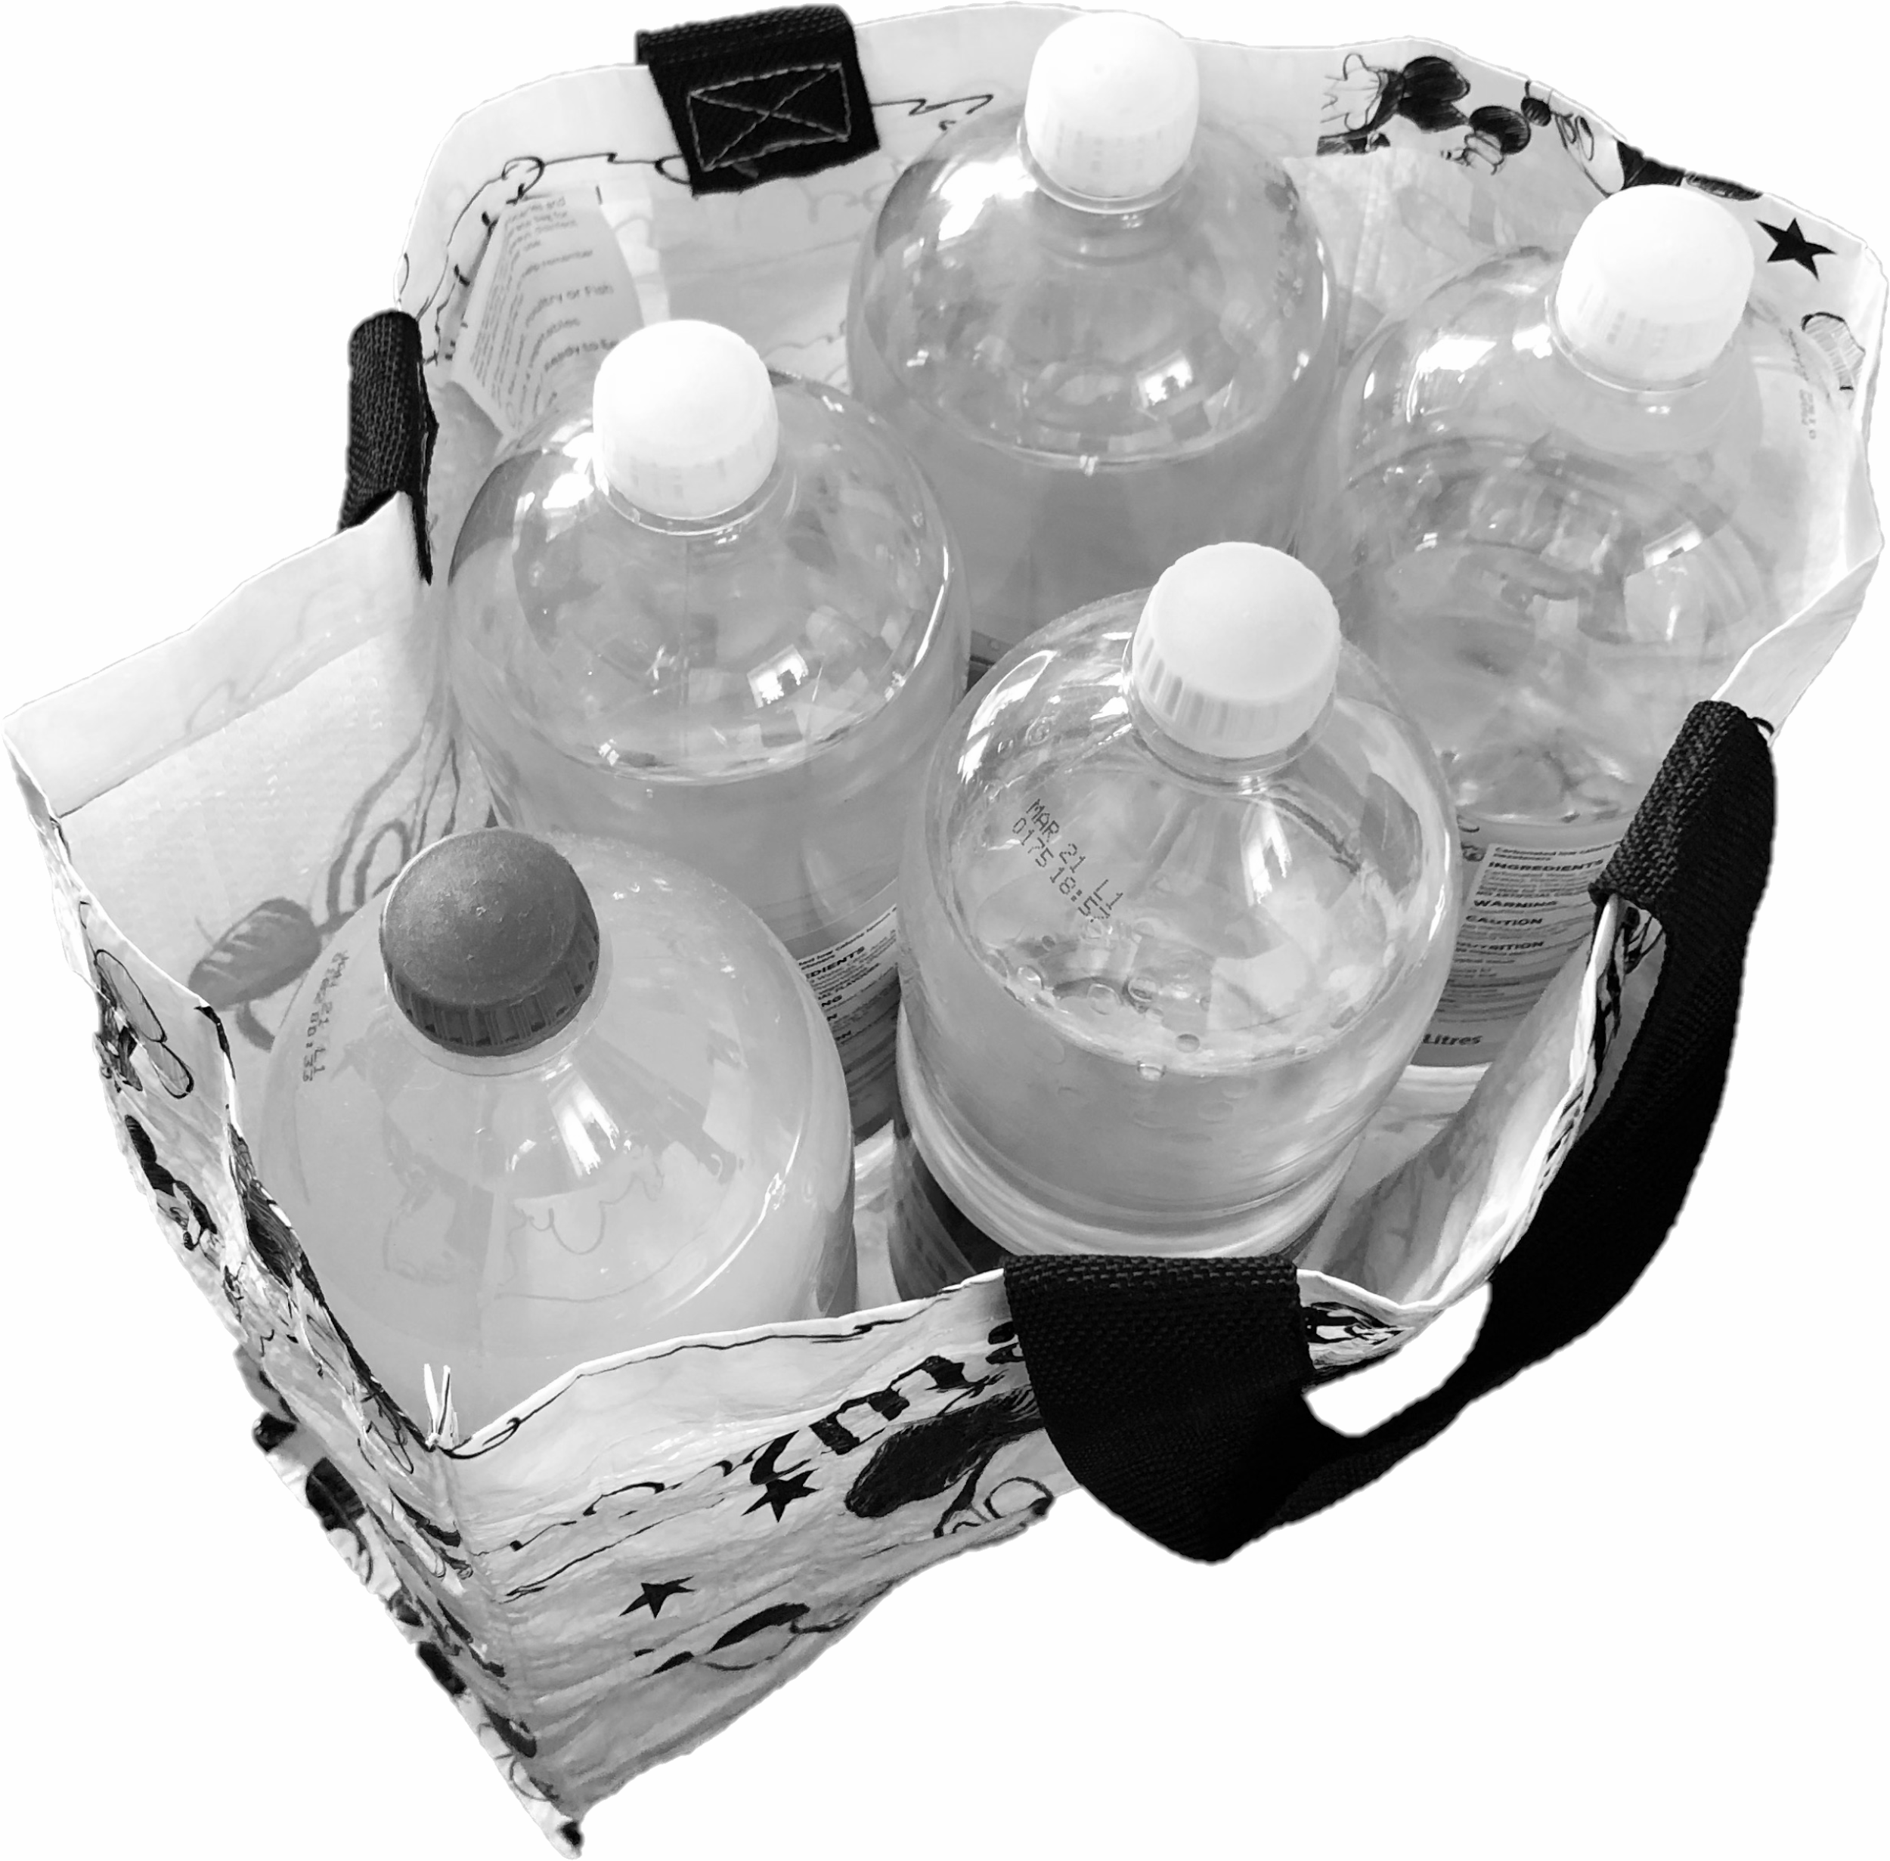
Which shopping bag is light?
Credit: Teacher owned image

Slide 11
Task
Heavy and Light
Can you explore different items?
Pick items up and identify whether you think they are light or heavy.
Compare two items and find the light one or the heavy one.

Slide 12
Measurement
Lesson 3: To compare items using mathematical vocabulary
Make it easier
Make it harder
More ideas
Choose items which have very obvious weight differences.
Only compare two items at a time. Do not compare more by using terms such as ‘heavier/heaviest’.
Begin to explore measuring devices such as scales and measuring jugs in order to be exposed to measurement language.
Compare items which are much more similar in weight.
Can your child describe items when they help you put the shopping away?
Can your child identify different items if you asked them to bring the ‘full’ one?

