Slide 1
Lesson 8 - Investigating speed
Physics - KS3
Forces and Motion
Mrs Wolstenholme

Slide 2
Complete the task
A parachute
Which force pulls the parachute towards the Earth?
Which force eventually stops the parachute accelerating?
As the speed increases, what happens to the air resistance?

Slide 3
Investigation
Area = length x width
As the area of the parachute increases, the drop time will (increase/decrease)
Notes:
Calculate the area

Slide 4
Method
Read the method and identify these:
a) Independent variable – the variable you will change
b) Dependent variable – the result that you will measure
c) Control variables – the variables that must stay the same for every test
Attach the smallest parachute to the tennis ball using sellotape.
Drop the parachute and make sure the drop height is the same each time.
Measure the time taken to for the parachute to fall to the floor and record the result into your results table.
Repeat this measurement 3 times
Repeat steps 1 – 5 with each different size of parachute
Notes:
Here is my method

Slide 5
Mean = (Test 1 + Test 2 + Test 3 )
3
Area (cm²) | Drop Time (s)
 | Test 1 | Test 2 | Test 3 | Mean
0 | 2.12 | 2.05 | 2.10
528 | 2.53 | 2.62 | 2.57
750 | 3.13 | 3.18 | 3.30
1090 | 3.83 | 4.02 | 4.15
2160 | 11.19 | 10.53 | 10.87
Notes:
Calculate the means. Pause the video to try,

Slide 6
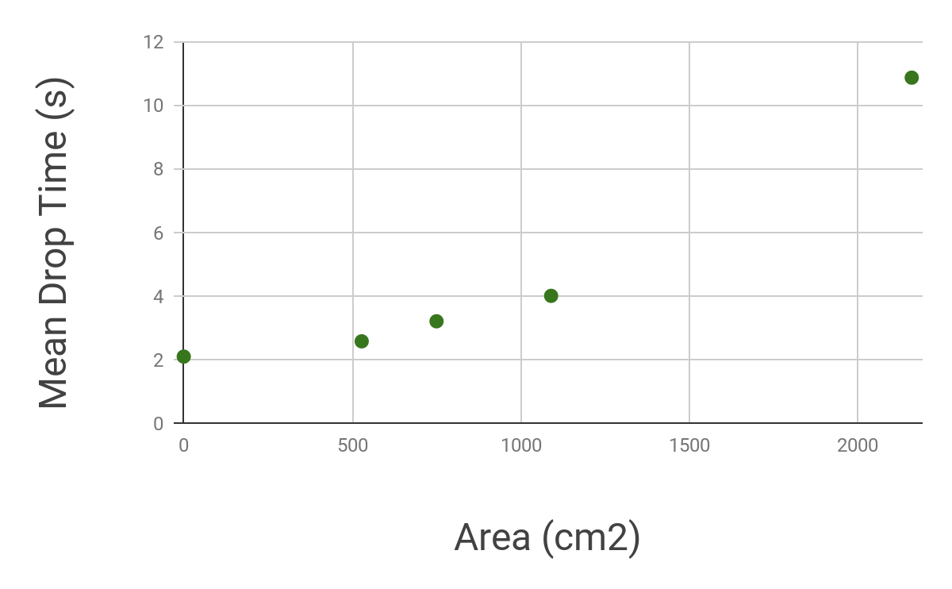
Area (cm²) | Mean Drop Time (s)
0 | 2.09
528 | 2.57
750 | 3.20
1090 | 4.00
2160 | 10.86
Notes:
Now we need to draw a graph of our results. This is what it should look like. Have a go at drawing your own. (Insert line graph of results)

Slide 7
Area (cm²) | Mean Drop Time (s)
0 | 2.09
528 | 2.57
750 | 3.20
1090 | 4.00
2160 | 10.86
Notes:
Have a go at drawing the graph on your own or use your own results

Slide 8
Conclusion
How did the area of the parachute affect the drop time?
What is the evidence (use at least 2 sets of results as example)
Does this support/ agree with your hypothesis?
Can you explain why the surface area affects the drop time this way?
Notes:
Here is my method

Slide 9
Conclusion
How did the area of the parachute affect the drop time?
The larger the area the _________________ the drop time.
What is the evidence (use at least 2 sets of results as example)
When the area was __________ the drop time was _______________. When the area was ______________ the drop time was ______________.
Does this support/ agree with your hypothesis?
This means my hypothesis was _____________.
Can you explain why the surface area affects the drop time this way?
Notes:
Here is my method

