Slide 1
Enlargement by a negative scale factor Lesson 4 of 8
Downloadable Resource
Mathematics
Miss Kidd-Rossiter

Slide 2
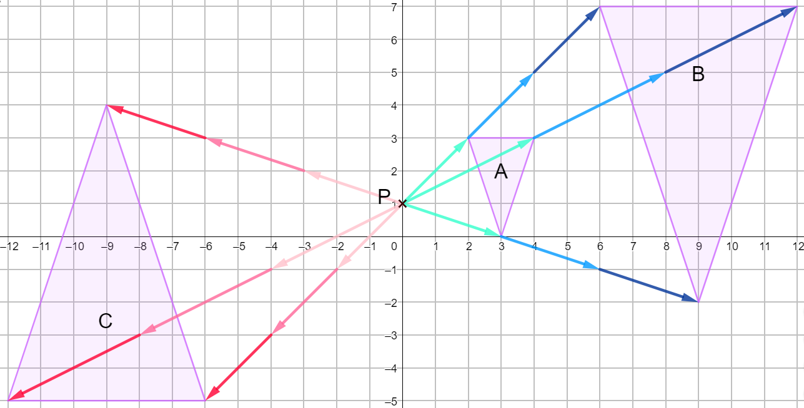
Try this
What’s the same and what’s different?

Slide 3
Connect

Slide 4
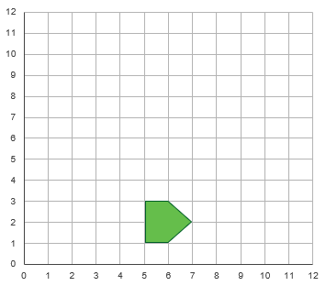
Independent task
Copy down the diagram to the left. Enlarge the shape by:
Scale factor -1 from (6,4)
Scale factor -1 from (7, 4)
Scale factor -1 from (4, 4)
Scale factor -1 from (4, 2)
Scale factor -2 from (5, 3)

Slide 5
Independent task
Draw a set of axes like the ones below. Copy A and P.
Enlarge A with centre P and:
Scale factor -2
Scale factor -1.5
Scale factor -0.5

Slide 6
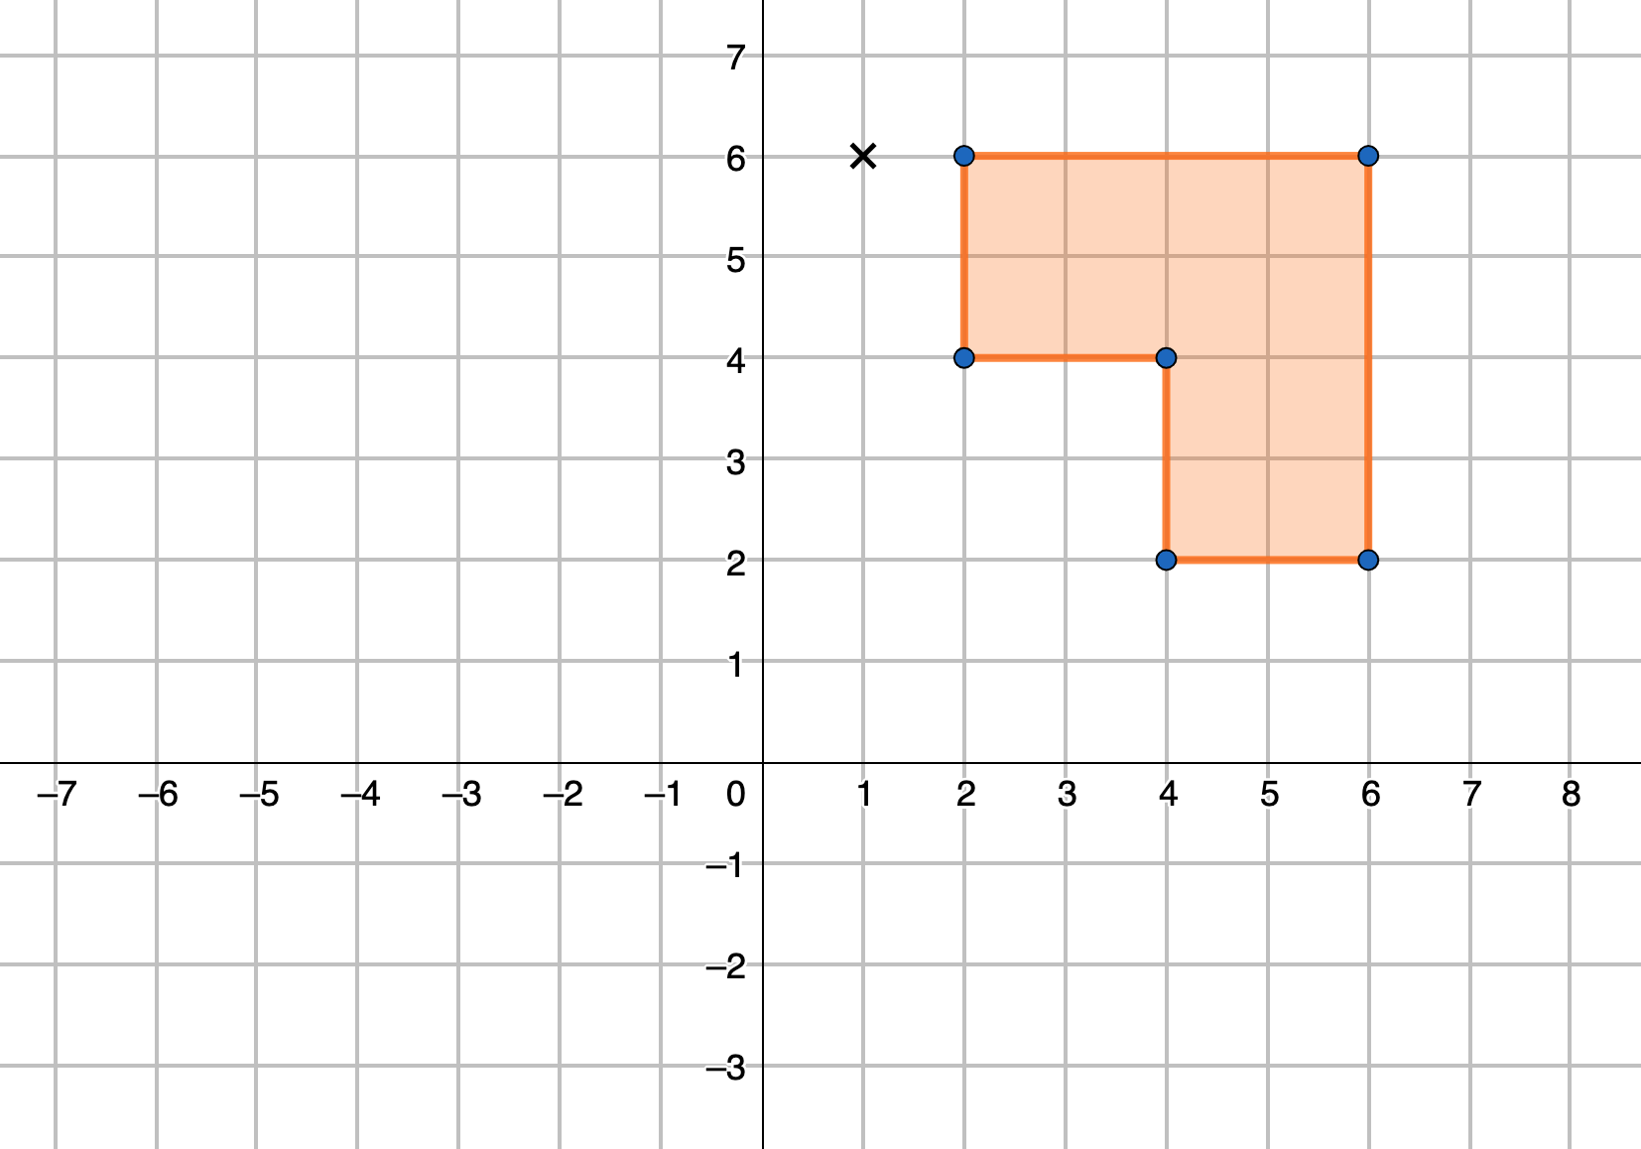
Explore
The image will have a greater area and the same orientation as the object
Zaki is going to enlarge the shape in the diagram about the marked point
Give an example of a scale factor he could be thinking of.
Can you write a similar statement for each of the following scales factors ranges?
Scale factor = 1
Scale factor = -1
-1 < Scale factor < 0
0 < Scale factor < 1
Scale factor > 1
Scale factor <-1

Slide 7
Explore
The image will have a greater area and the same orientation as the object
Scale factor = 1
0 < Scale factor < 1
Scale factor = -1
Scale factor > 1
-1 < Scale factor < 0
Scale factor <-1

Slide 8
Share your work with Oak National
If you'd like to, please ask your parent or carer to share your work on Twitter tagging @OakNational and #LearnwithOak

