Slide 1
Combined Science - Chemistry - Key Stage 4
Extraction of Aluminium
Mr Campbell

Slide 2
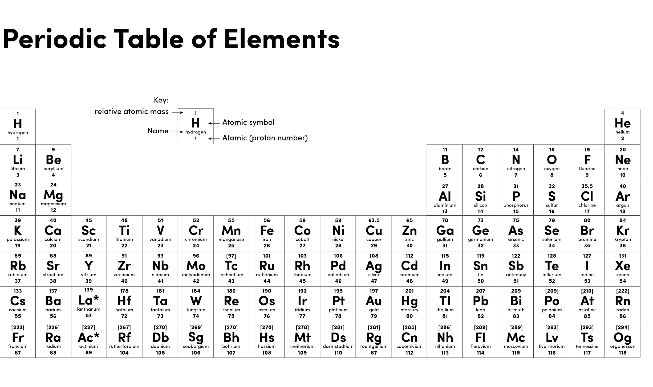
Source: Oak

Slide 3
Electrolysis recap
Electrolysis is the use of ________________ to ____________________ a compound
_______________ attracts _______ ions
_______________ attracts _______ ions
_______________ has to be ___________ or __________ so the _________ can move
Source Mr Campbell

Slide 4
Independent task
Explain why can aluminium not be extracted from aluminium oxide by heating with carbon.
Identify what is formed at the anode and the cathode during the electrolysis of aluminium oxide.
Explain why cryolite is used to dissolve the aluminium oxide during electrolysis.
Explain why the anode needs replacing during the electrolysis of aluminium oxide.

Slide 5
Independent answers
Aluminium is more reactive than carbon. So carbon can not displaces the aluminium from aluminium oxide.
Cathode = aluminium Anode = oxygen
Cryolite lowers the melting point of the aluminium oxide reducing the energy costs of the electrolysis.
The oxygen produced at the anode reacts with the carbon in the (graphite) electrode forming carbon dioxide.

