Slide 1
To compare numbers within 100 using a number line.
Maths
Mrs Bramble & Miss Sidhu
Notes:
Hello everyone!In this lesson you will be counting and comparing numbers within 100 using a number line. You will be using the vocabulary, greater and less to decide which number has the greatest or lesser value.

Slide 2
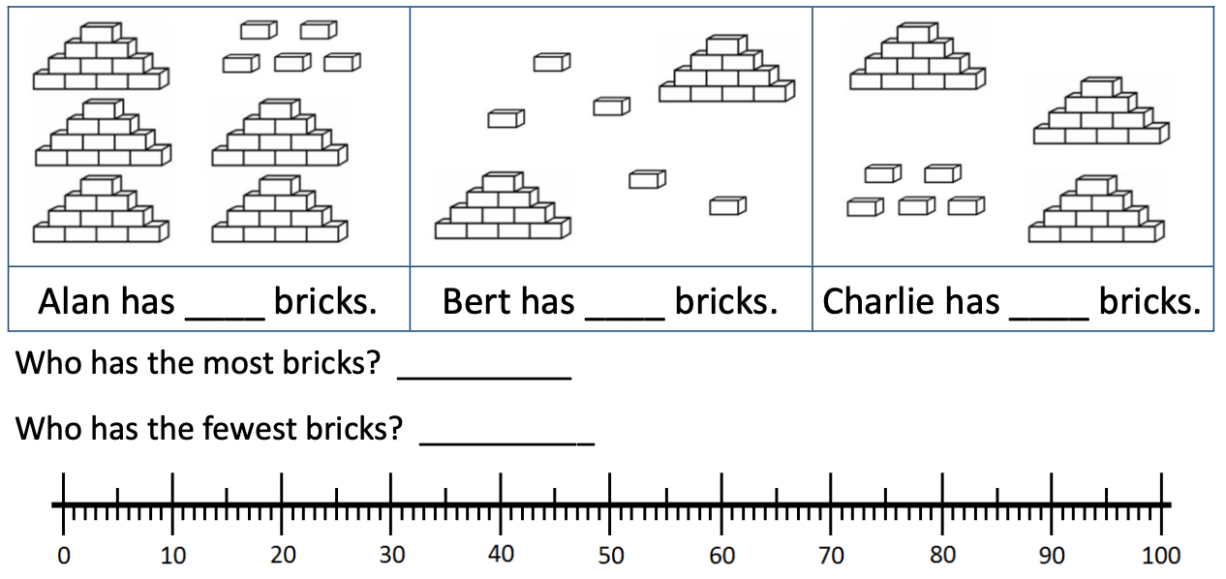
Independent Task
Task
Notes:
Here is today’s independent task.

Slide 3
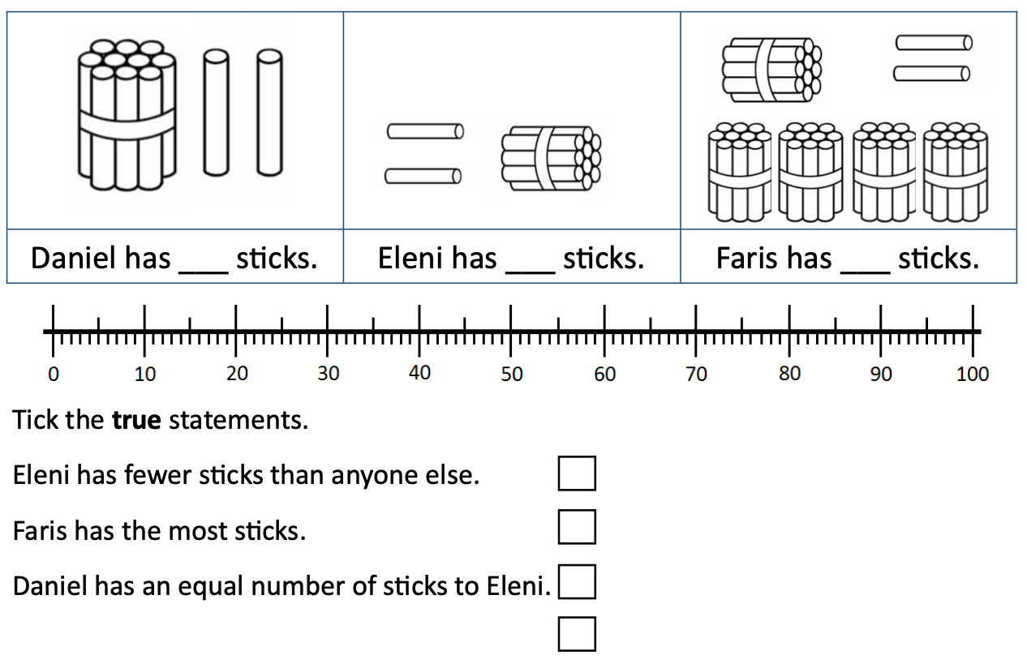
Independent Task
Task
Notes:
Here is today’s independent task.

Slide 4
Answers
Task
55
25
35
Alan has the most bricks.
Bert has the fewest bricks.

Slide 5
Answers
Task
12
12
52

