Slide 1
Counting sets within 10
Mathematics Independent Task
Miss Robson

Slide 2
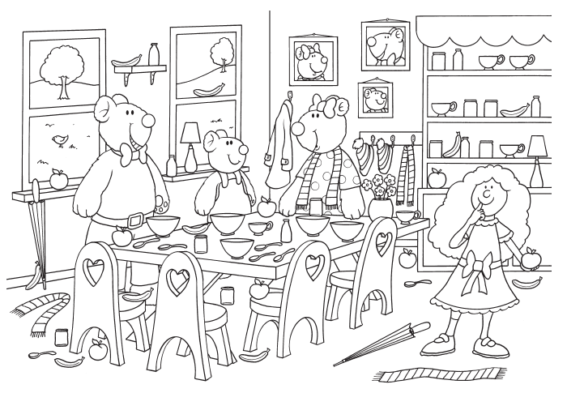
Activity
Represent the things you count in the big picture on the tens frame.

