Slide 1
Reading the time on the clock to the nearest five minutes
Mathematics
Miss Sabzvari

Slide 2
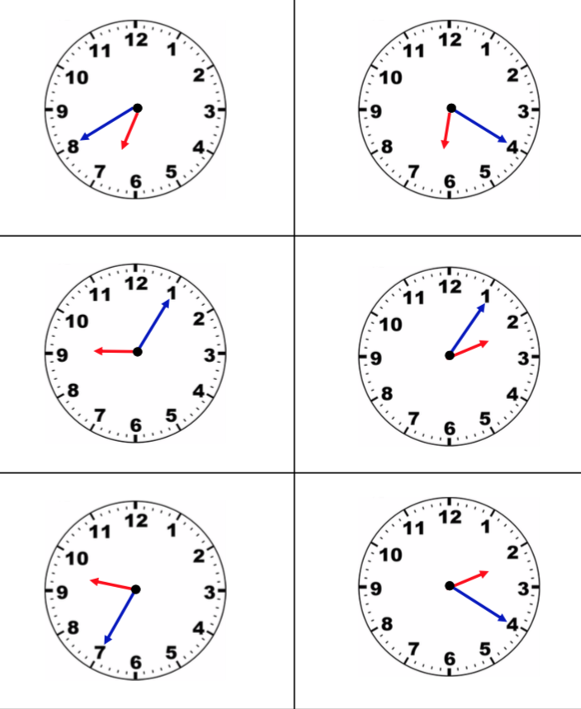
Independent Task
Here are six clocks showing times in the afternoon.
Put them in order from earliest to latest.

