Slide 1
Coordinates and shapes:
Describe coordinate positions on a grid.
Independent Task
Mathematics
Year 6
Miss Parsons

Slide 2
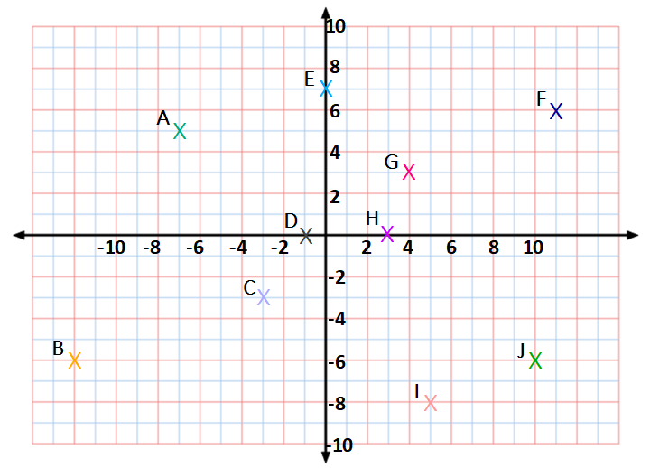
Question 1
Write the coordinates of each point.

Slide 3
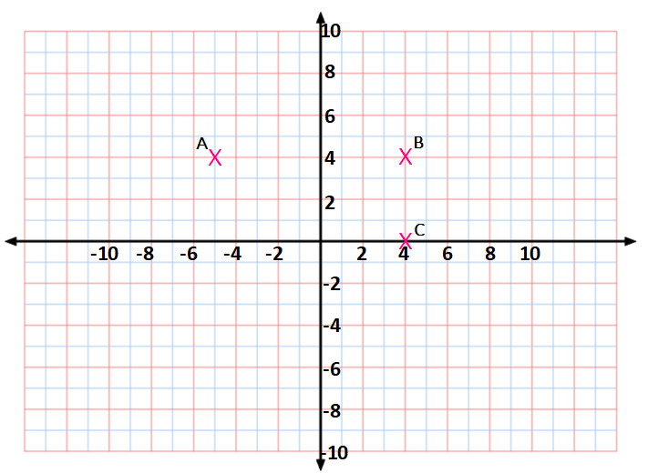
Question 2
A, B, C and D are the vertices of a rectangle.
What are the coordinates of point D?

Slide 4
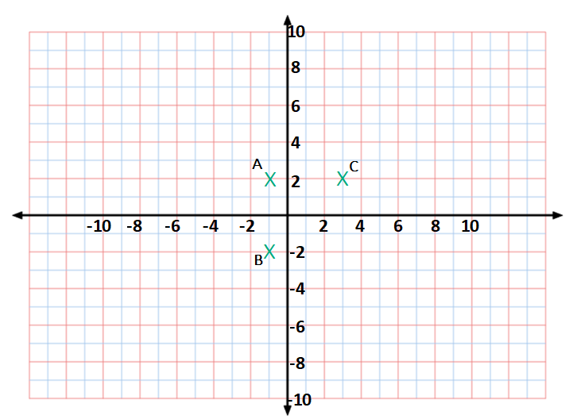
Question 3
A, B, C and D are the vertices of a square.
What are the coordinates of point D?

Slide 5
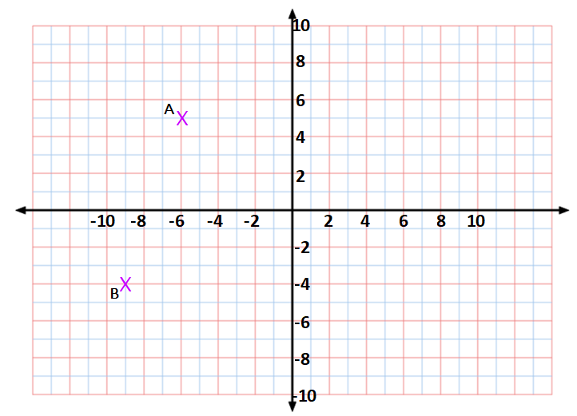
Question 4
A, B and C are the vertices of an isosceles triangle.
Point C has the same y coordinate as B.
What are the coordinates of point C?

Slide 6
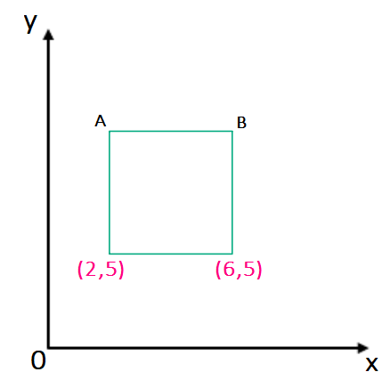
Question 5
Here is a square on the coordinate grid.
Write the coordinates of points A and B.
Hint: use the known x coordinates to work out the length of one side.

