Slide 1
Lesson 13 - Inhaled and exhaled air
(Downloadable Student Document)
Science - Biology - Key Stage 3
Cells, Tissues and Organs
Miss Wickham

Slide 2
Recap
What are the reactants of respiration?
What are the products of respiration?
What is respiration?
In which organ does gas exchange take place?
What is the name of the air sacs in which gas exchange takes place?

Slide 3
Recap
What are the reactants of respiration? Oxygen + glucose
What are the products of respiration? carbon dioxide + water
What is respiration?
A chemical reaction using oxygen and glucose to release energy
In which organ does gas exchange take place?
Lungs
What is the name of the air sacs in which gas exchange takes place?
Alveoli

Slide 4
What happens when we breathe in and out?
Task: Compare (what is the SAME and what is DIFFERENT) the inhaled and exhaled air.
Gas | Inhaled Air (%) | Exhaled Air (%)
Oxygen | 21 | 17
Carbon Dioxide | 0.04 | 4
Nitrogen | 78 | 78
Example: Looking at nitrogen 78% is inhaled and 78% is exhaled, therefore it has stayed the same.

Slide 5
What happens when we breathe in and out?
(answer)
The nitrogen volume stays the same
There is less oxygen exhaled than inhaled
There is more carbon dioxide exhaled than inhaled
Gas | Inhaled Air (%) | Exhaled Air (%)
Oxygen | 21 | 17
Carbon Dioxide | 0.04 | 4
Nitrogen | 78 | 78

Slide 6
Recap on drawing tables
What features make a good table? Write at least 3 features of a table.

Slide 7
Recap on drawing tables
What features make a good table? Write at least 3 features of a table.
Draw with a pencil and ruler
Independent variable goes in the left column
Dependent variable goes in the right column
Descriptive headings
There should be columns for repeats and averages

Slide 8
Task - Draw a table for our results to test the hypothesis: ‘the time a candle burns for is different for inhaled and exhaled air’.
The table should include the features from the previous slide

Slide 9
Task - Draw a table for our results to test the hypothesis: ‘the time a candle burns for is different for inhaled and exhaled air’.
The table should include the features from the previous slide
Air type | Time candle burns for (s)
 | 1 | 2 | 3 | 4 | Mean
Inhaled
Exhaled

Slide 10
Conclusion
What is the relationship between the air type and time the candle burned for?
Use data to back up what you’ve said.
Can you explain why this happens?
Air type | Time candle burns for (s)
 | 1 | 2 | 3 | 4 | Mean
Inhaled | 5.81 | 6.01 | 2.32 | 5.94
Exhaled | 3.21 | 4.22 | 3.67 | 6.29

Slide 11
Conclusion
What is the relationship between the air type and time the candle burned for?
Use data to back up what you’ve said.
Can you explain why this happens?
The candle burns for a longer time in inhaled air than in exhaled air.
For example, the mean burn time was 5.92 seconds in the inhaled air but only 3.7 seconds in the exhaled air.
This is because inhaled air has a higher concentration of oxygen than the exhaled air. The candle goes out when the oxygen level falls below a certain point and this happens sooner in exhaled air.

Slide 12
Pause the video to complete your task
A student said “I believe we breathe in more oxygen when running because our hearts are beating faster than when we are at resting heart rate”. Design an experiment to test this hypothesis.
Include:
Independent, dependent and control variables
Method in numbered steps
A table to record results

Slide 13
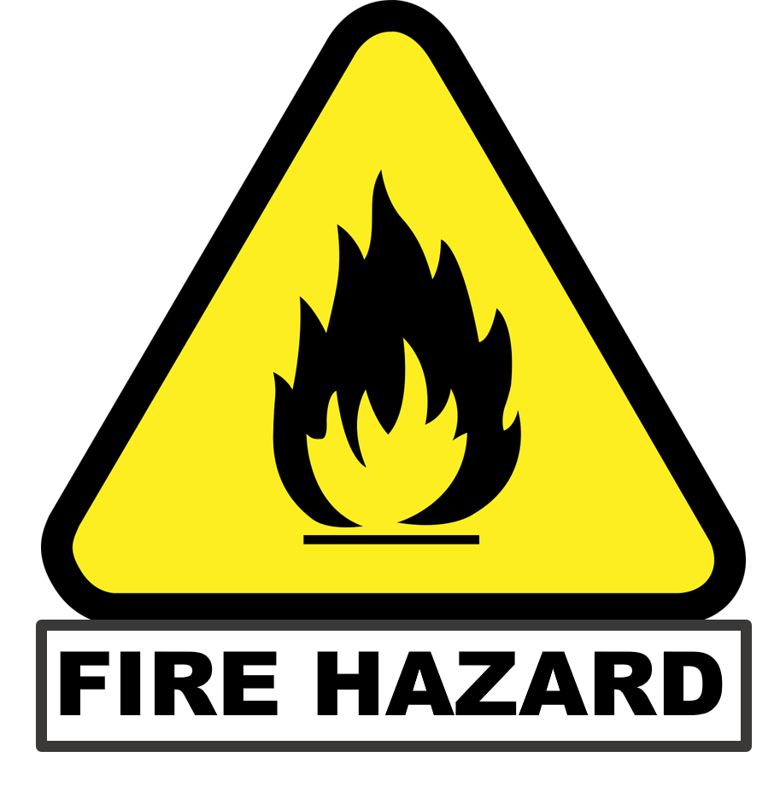
A student said “I believe we breathe in more oxygen when running because our hearts are beating faster than when we are at resting heart rate”. Design an experiment to test this hypothesis.
When lighting a fire, make sure no strong wind is blowing and ask an adult to supervise.
Example variables:
Independent variable - breathing rate (before and after exercise)
Dependent variable - volume of oxygen inhaled
Control variables - altitude, same person
Example method:
Collect inhaled breathe from the student before does exercise, trap into a jar.
Light a candle and place in the jar and time how long it takes for the candle to stop burning.
Repeat steps 1 and 2 with inhaled air after exercise.
Record data in table.

Slide 14
A student said “I believe we breathe in more oxygen when running because our hearts are beating faster than when we are at resting heart rate”. Design an experiment to test this hypothesis.
Air type | Time candle burns for (s)
 | 1 | 2 | 3 | 4 | Mean
Inhaled resting
Inhaled after exercise

